Slide 1
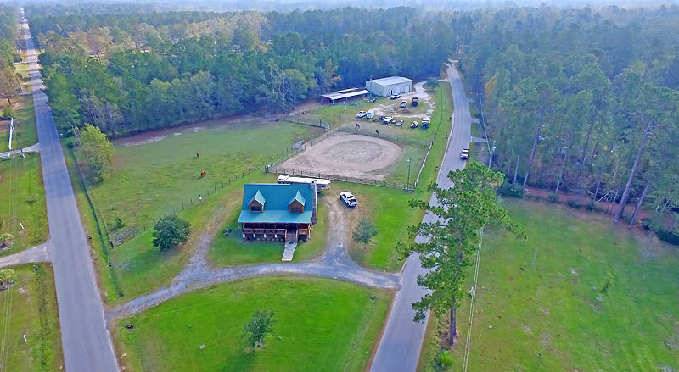
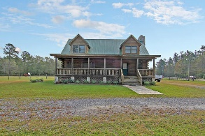
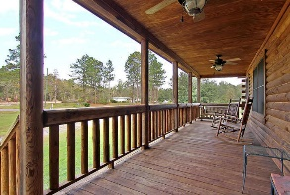
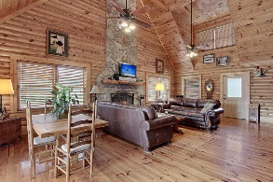
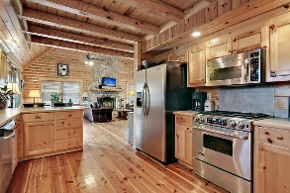
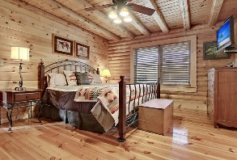
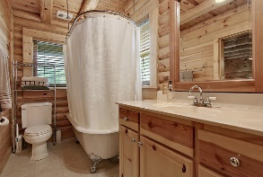
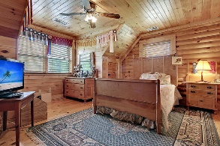
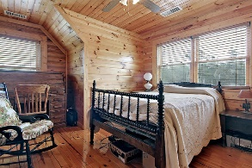
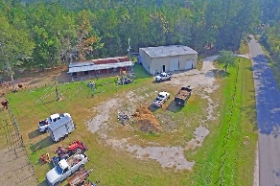
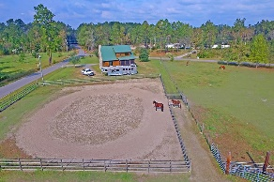
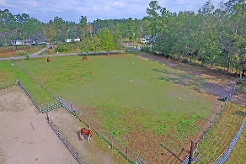
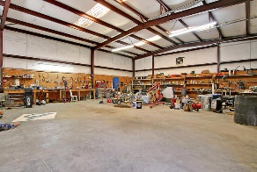
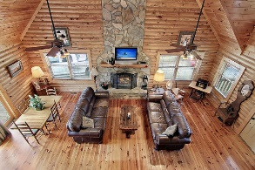

240 Sinclair Road
Greenwood Ranches | Summerville
MLS# 16028806 | $569,900
HORSE FARM!
Loaded with Updates
Beautiful 3 bedroom 2.5 bath log cabin home with chef's kitchen! This equestrian ranch has it all and only a short drive to shopping, dining and in Dorchester II School District-but you feel like you are in a private rural area!
This log cabins shows great and includes a gourmet kitchen, an abundance of windows and natural light, master suite down, master bath with claw foot tub, full front porch, back deck, screened-in porch, a tankless water heater, NO CARPET ANYWHERE, No HOA, and metal 5E roof.
*Fenced Riding Ring
*Pasture
*40x60 Workshop with electricity and water which can also be garage for 3+ vehicles
*5 Stall Barn with 4 12x12 stalls, 1 12x24 stall, and a 16x16 feed room
*Adjacent Lots may be available for sale for more acreage.
This home has endless possibilities!!
Stan Huff
843-670-2835
stan.huff@agentowned.com
Jill Marcacci
843-297-5590
jill@agentowned.com
www.agentownedrealty.com
AgentOwned Realty Co. Preferred Group, Inc. | 824 Johnnie Dodds Blvd | Mt Pleasant, SC 29464

