Slide 1
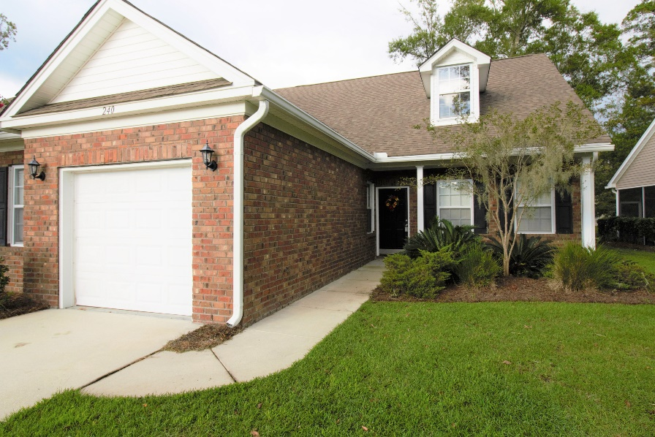

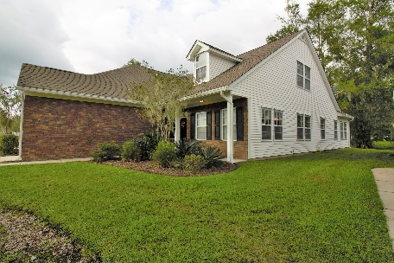
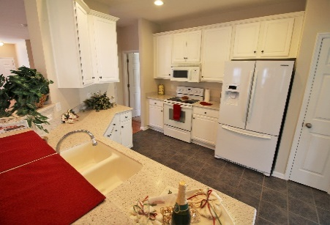
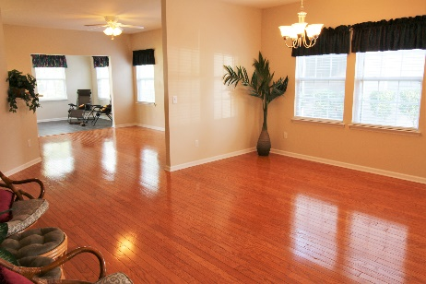
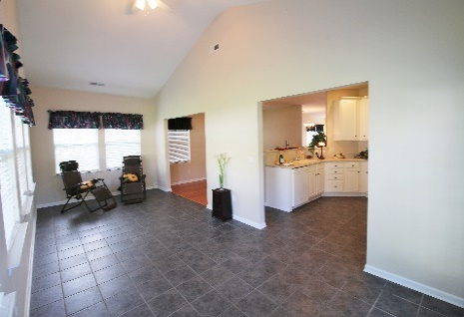
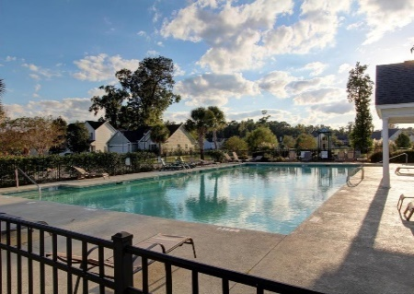


PRICE Reduced - $265,000
240 Xavier street, Charleston sc 29414
Grand oaks plantation – The Commons
Move in Ready! All kitchen appliances, along with washer and dryer, are included. This expansive 2400 sqft home includes 3 bedrooms and 3 baths (2 masters). Single owners splurged for all upgrades available by builder. This home has high smooth ceilings, hardwood floors, ceramic tile, Corian counters, energy efficient, upgraded kitchen appliances & More. MLS# 16025505
3 Bedroom
3 Baths
2398 approximate Sqft
2 Master Bedrooms
1.5 Car Attached Garage
Includes Refrigerator
Includes Washer & Dryer
Neighborhood Pool
Neighborhood Park
Tennis Court
Walking / Jogging trails
Built in 2007
Sunroom & Breakfast Room
Loaded with Upgrades
Ceiling Fans
& More!
Add a caption for your photo here.
BRAD CHRISTENSEN
843-991-2110
Brad.Christensen@AgentOwnedRealty.com
www.CharlestonPremierAgent.com
902 Savannah Hwy, Charleston SC 29407
Any Information of special interest should be obtained through independent verification

