Slide 1
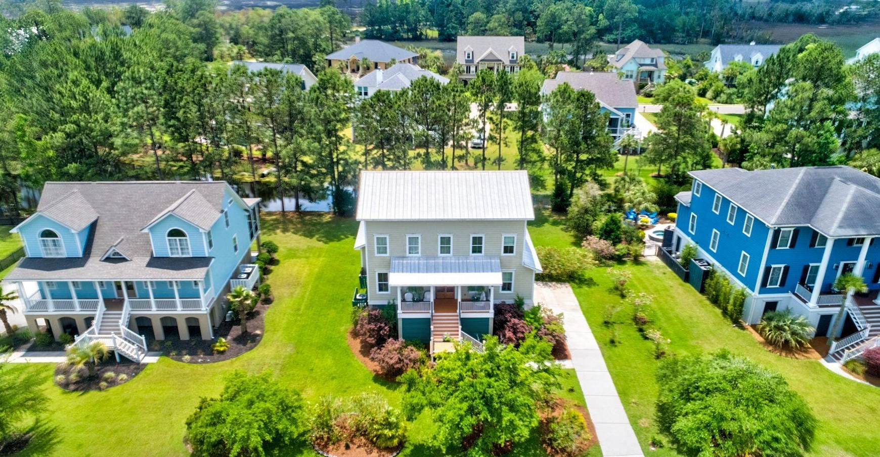
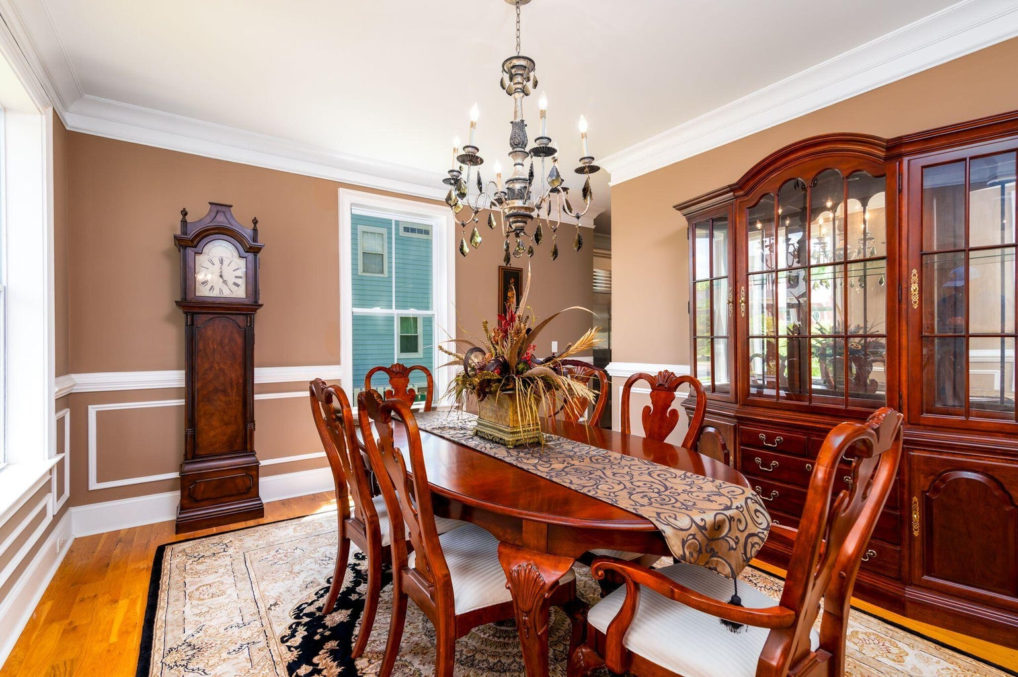
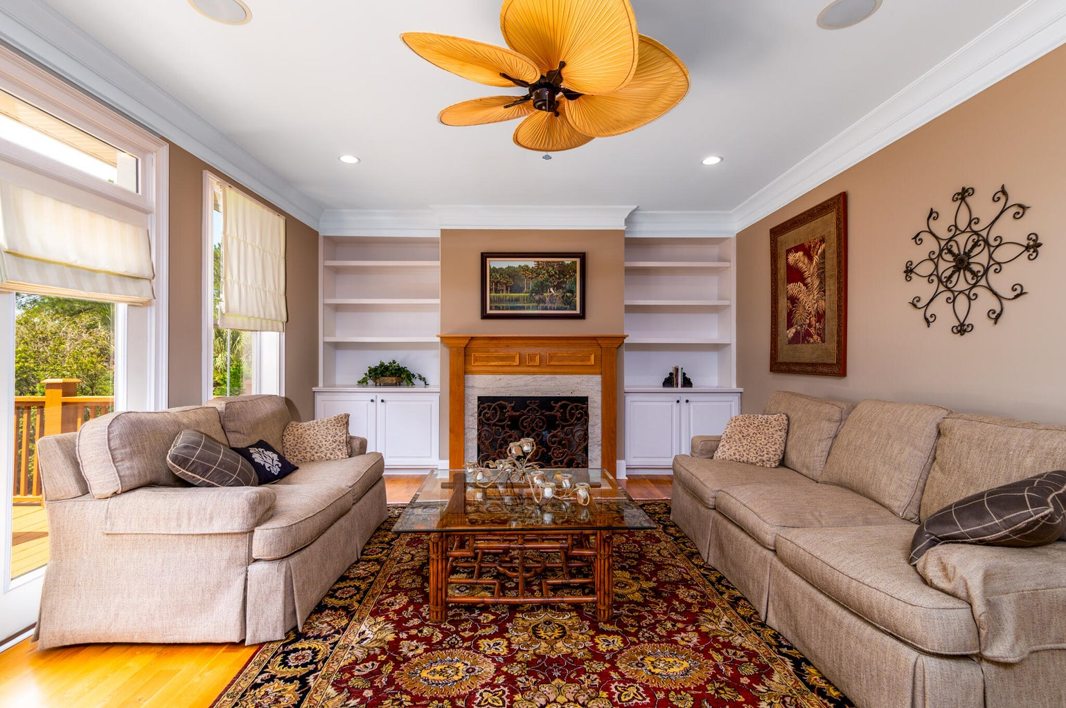
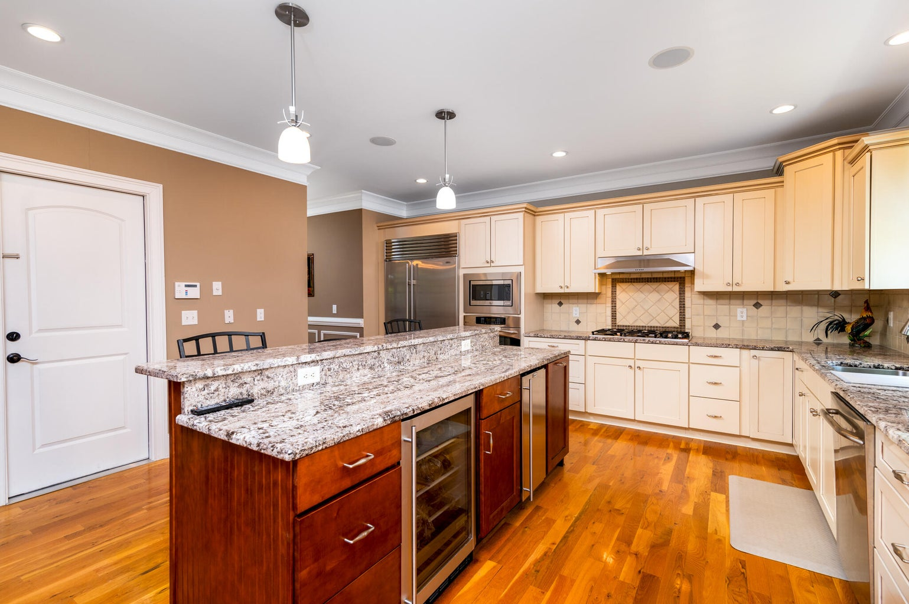
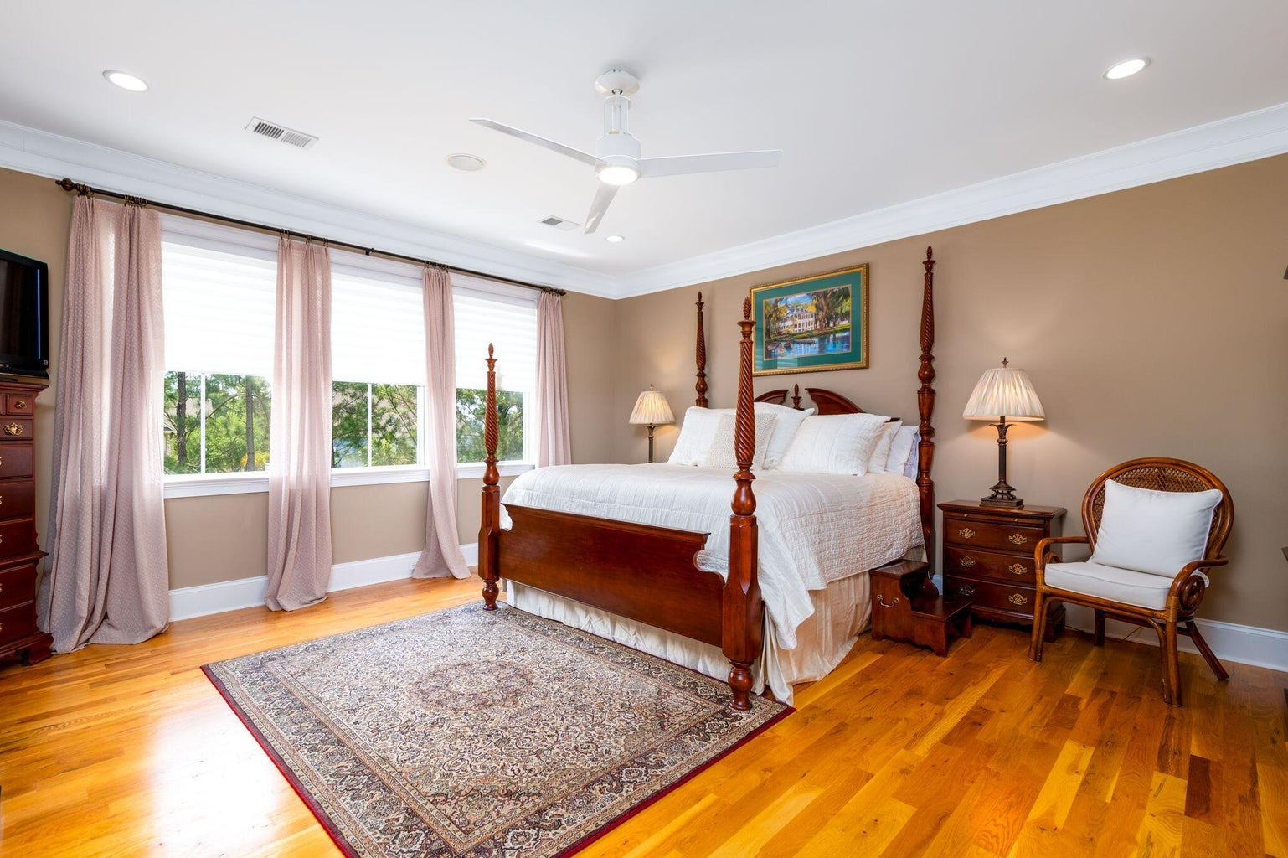
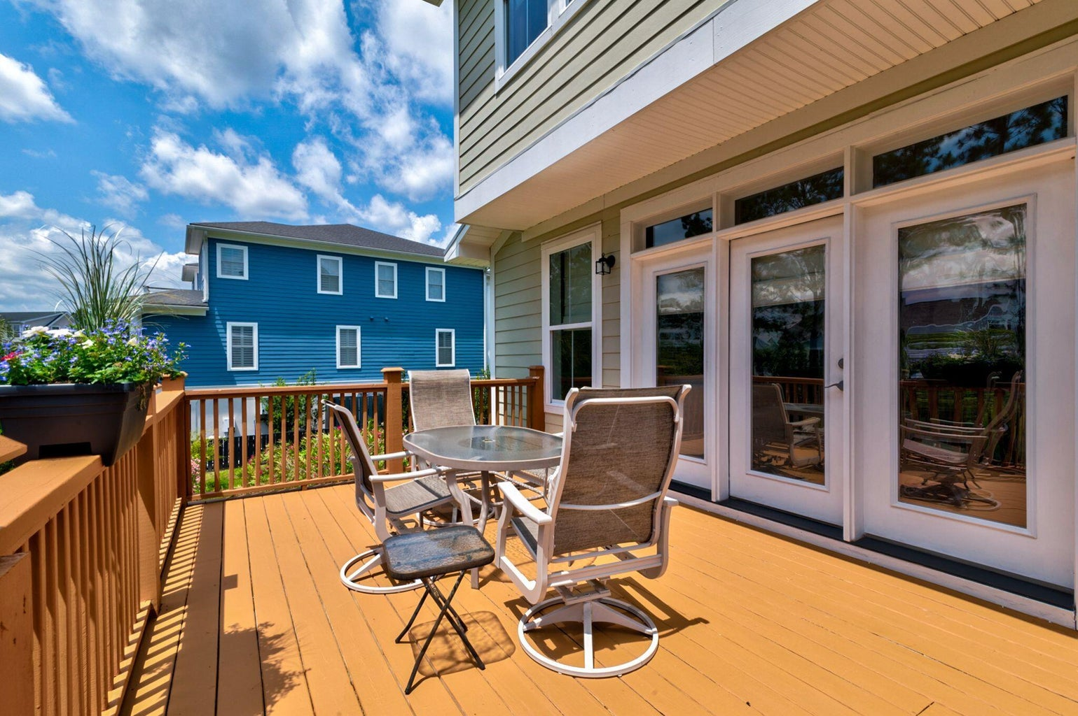
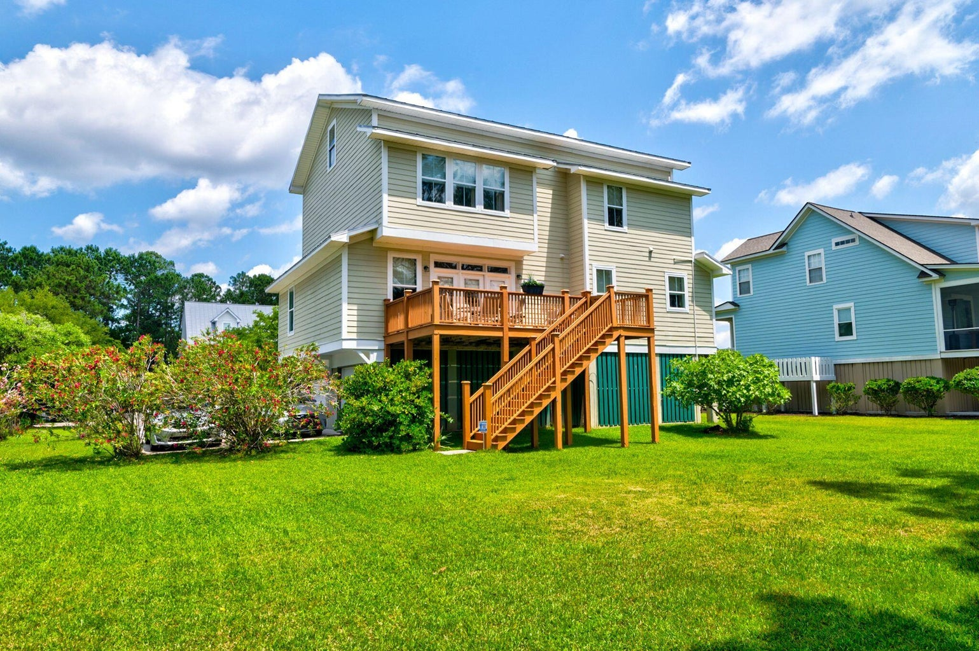
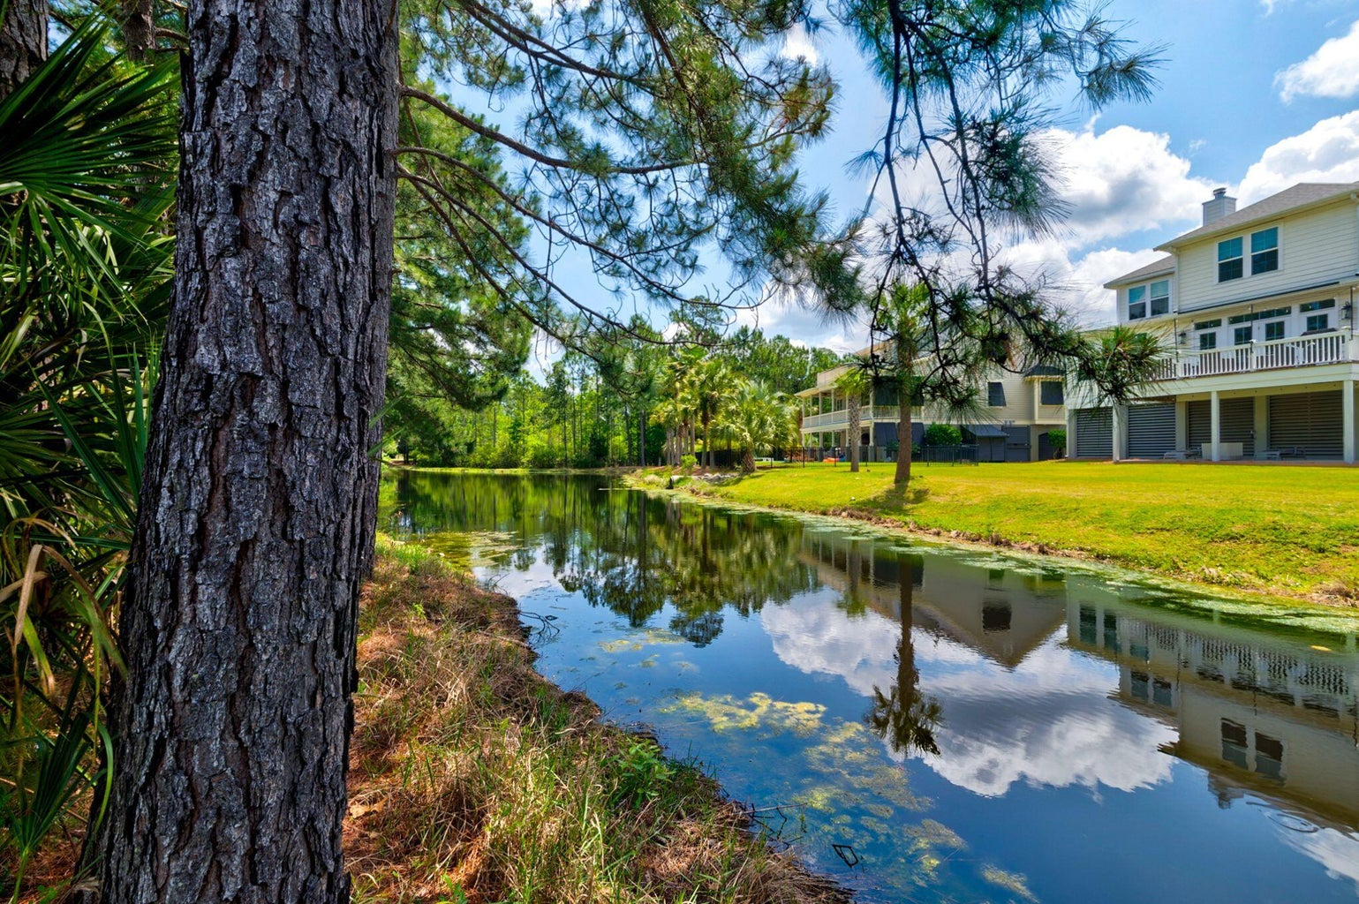


Just Listed in Rivertowne Country Club
2412 Bending Oak Loop
Mount Pleasant, SC 29466 | MLS# 24011878 | $1,360,000
Welcome to your dream home in Mt. Pleasant, SC. This exquisite three-story residence offers elegance and functionality. The main level features a spacious foyer, formal dining, bright living room with fireplace, fully equipped kitchen, and dedicated office space with ensuite bathroom. Upstairs, enjoy an open loft, master suite, laundry, and guest room with ensuite bathroom. The third floor offers 2 bedrooms and a full bath. Step outside to a tranquil pond view surrounded by wildlife. With a two-car garage, this home has it all. Don't miss your chance to experience luxury living in one of Charleston's most sought-after communities. Schedule your private showing today and make this your forever home!
Ruby Toporek
843-609-0020
rubytoporek@kw.com
Keller Williams Realty Charleston
503 Wando Park Blvd, Ste 130
Mt. Pleasant, SC 29464

