Slide 1
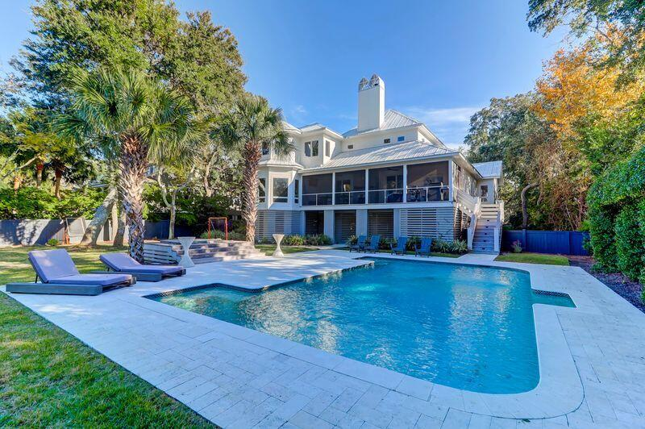
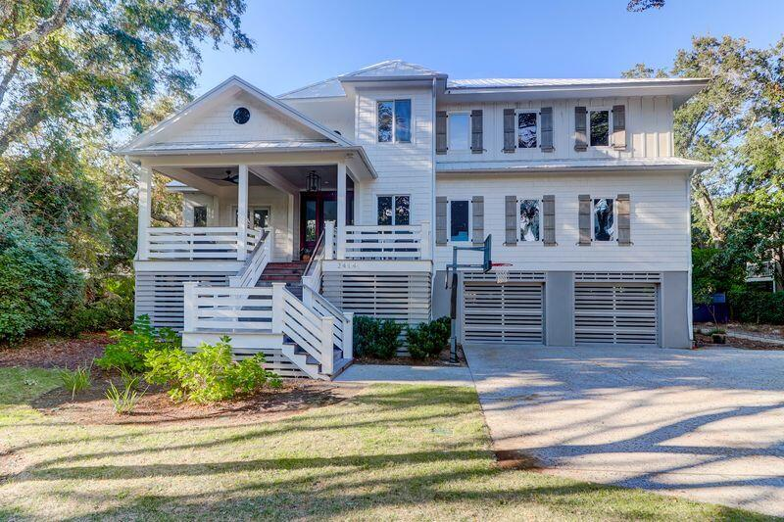
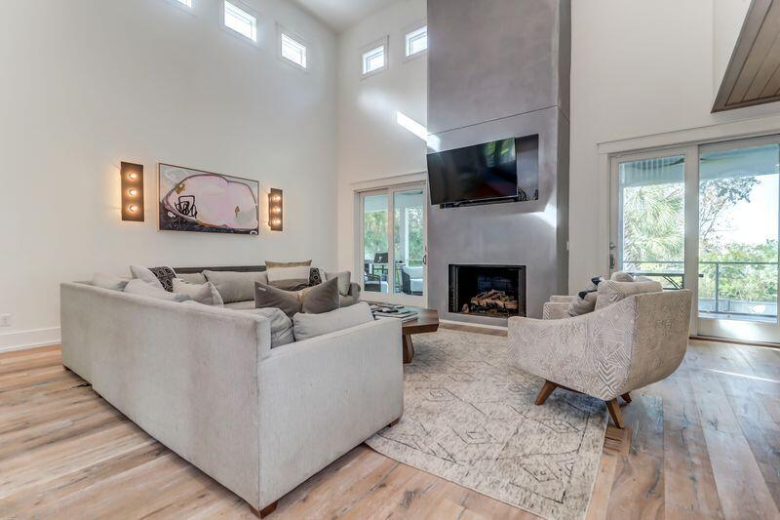
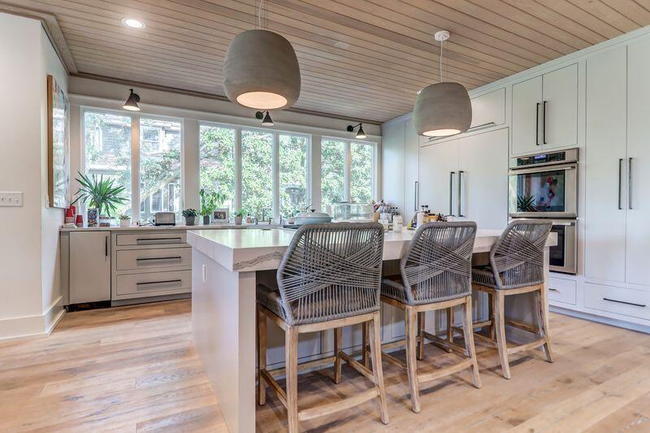
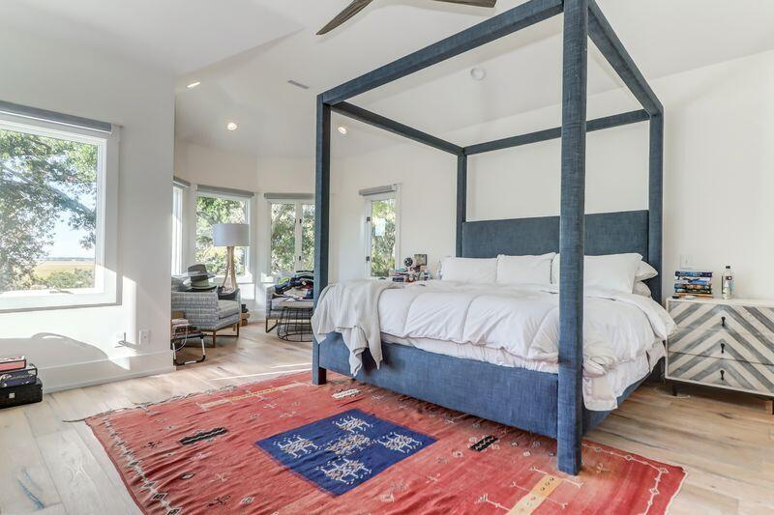
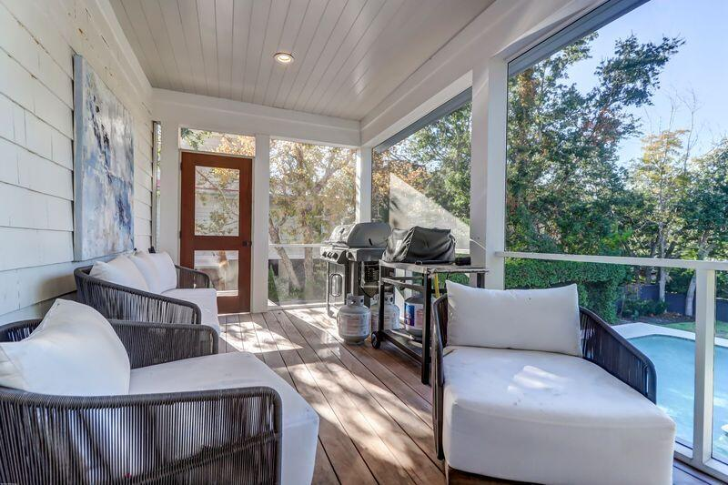
Prime Location On Sullivans Island
2414 Goldbug Avenue
Sullivans Island, SC 29482
MLS# 25018001 | $6,100,000
Welcome to this beautiful home located in one of the most desirable locations on Sullivan's Island. This home was completely renovated in 2018. Set on over a half-acre, street-to-street lot, with beautiful oak trees, and privacy galore. The fenced in back yard features a pristine swimming pool surrounded by lush landscaping and lots travertine decking. The home has an open and spacious floorplan, that includes 7-inch engineered hardwood floors and tile floors throughout. The kitchen features quartz counters thru out and is well equipped with new over the top Thermador appliance package, including a range, double wall oven, microwave, dishwasher, 30-inch freezer and 30-inch fridge. The entrance foyer opens up to a two-story great room, screen porch with fireplace and overlooks a magnificent back yard, and an awesome size pool. The upstairs oversized master suite offers beautiful peeks of the marsh and Intracoastal Waterway, a sitting area and walk in kitchen. The master bath is to die for, with one of the largest Showers on the island, with its on-sky light, double heads and quartz bench. This is a great opportunity to reside in a fabulous home in one of the Island's best locations.
ENJOY A VIRTUAL TOUR
Jamie Hollingsworth
843-442-6492 | iopsold@aol.com
Salmonsen Realty | 864 Lowcountry Blvd Ste B | Mt Pleasant, SC 29464

