Slide 1
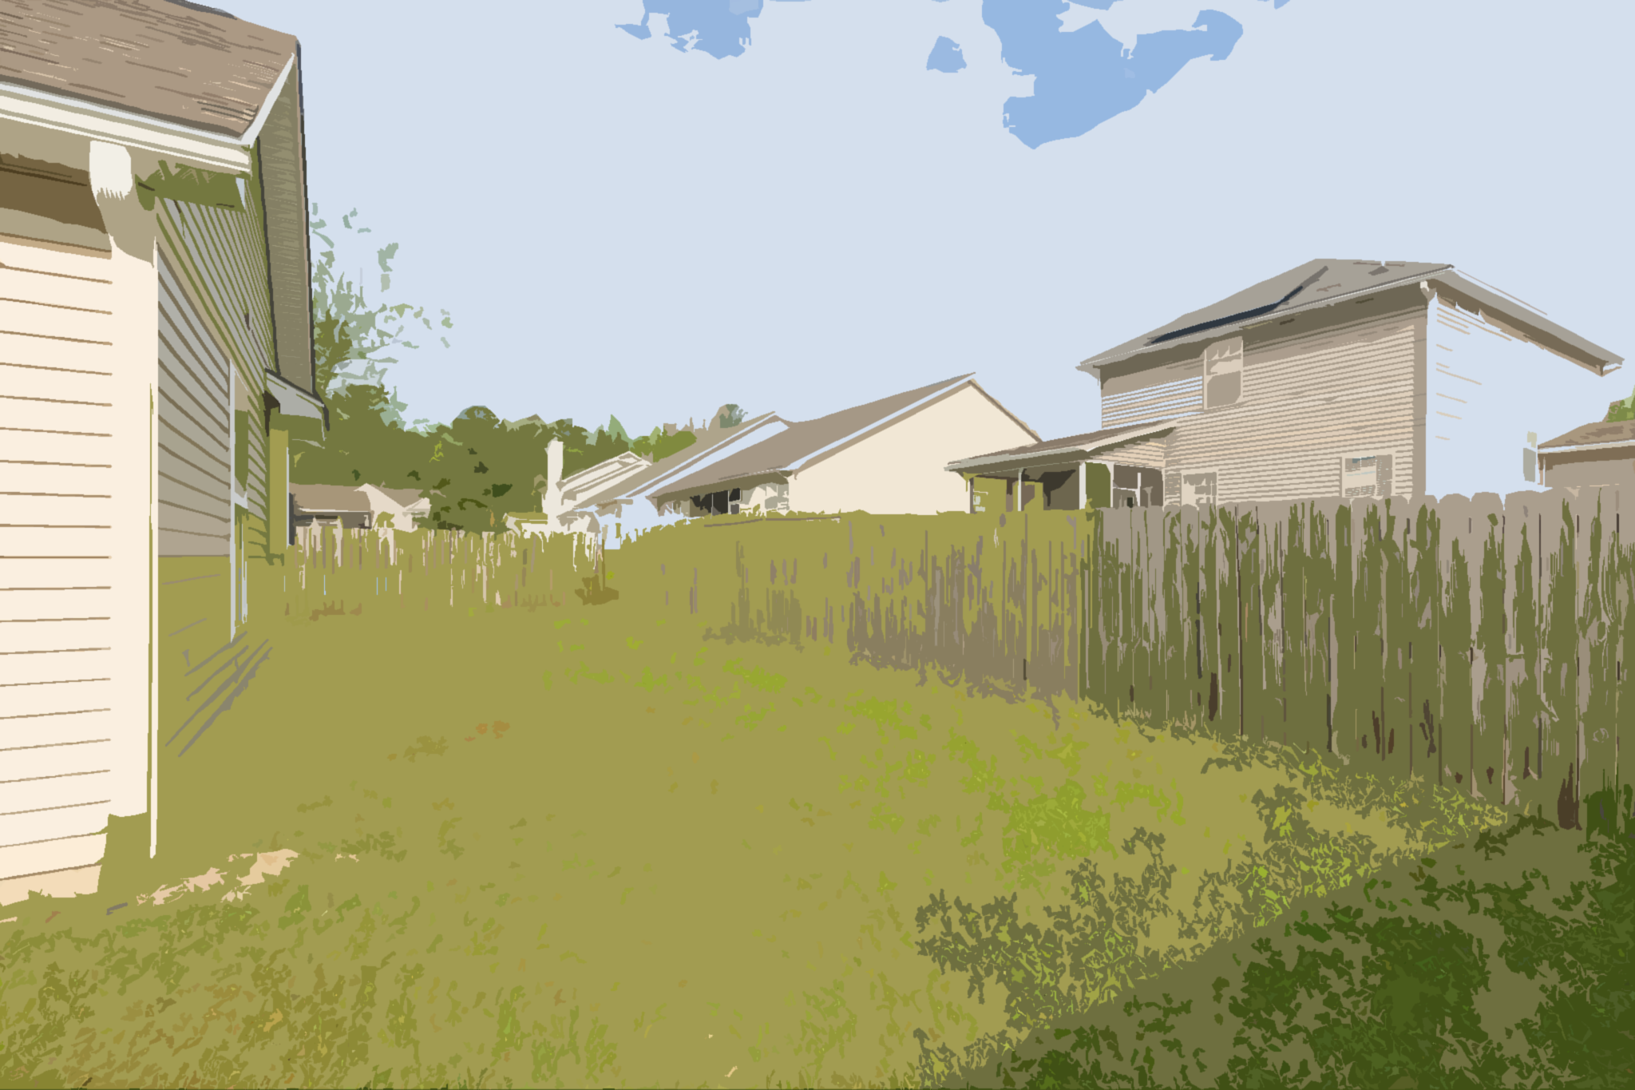
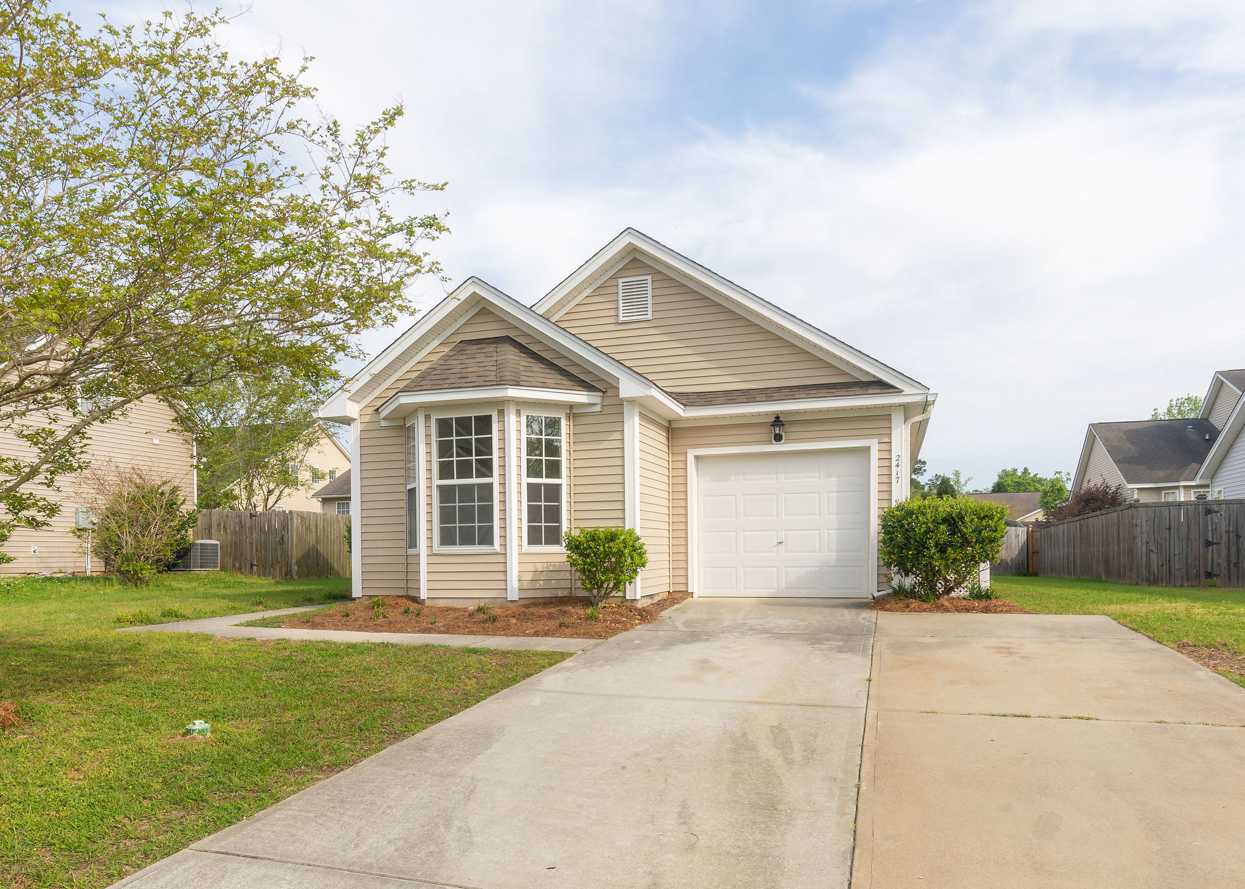
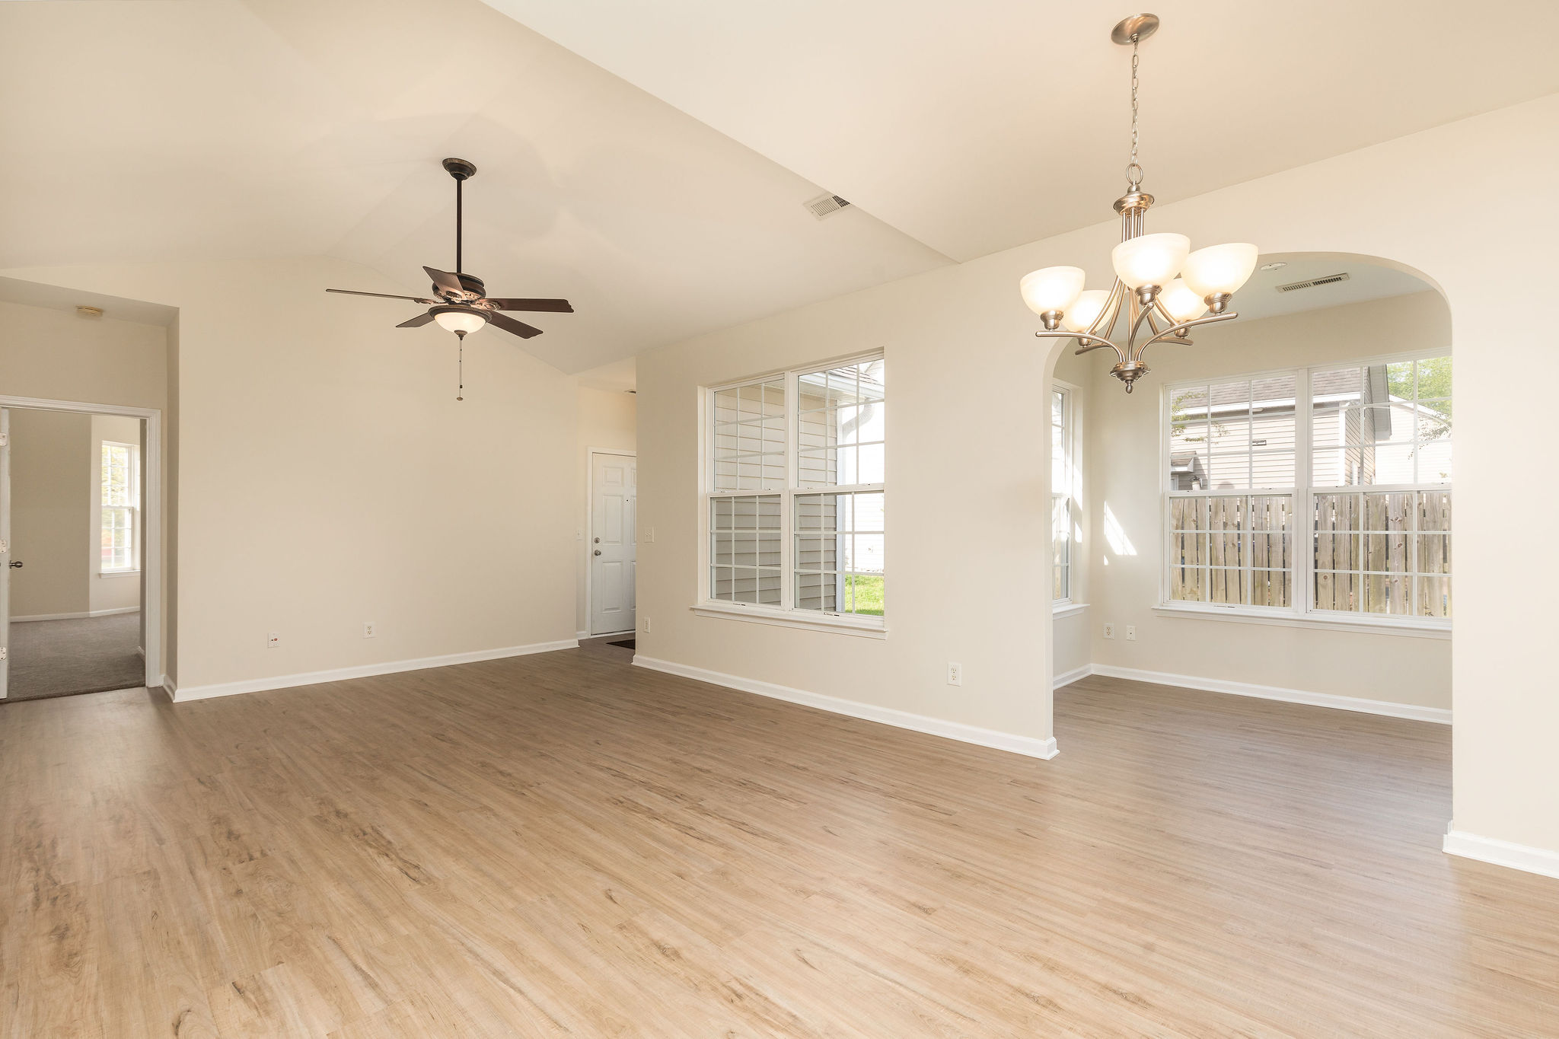
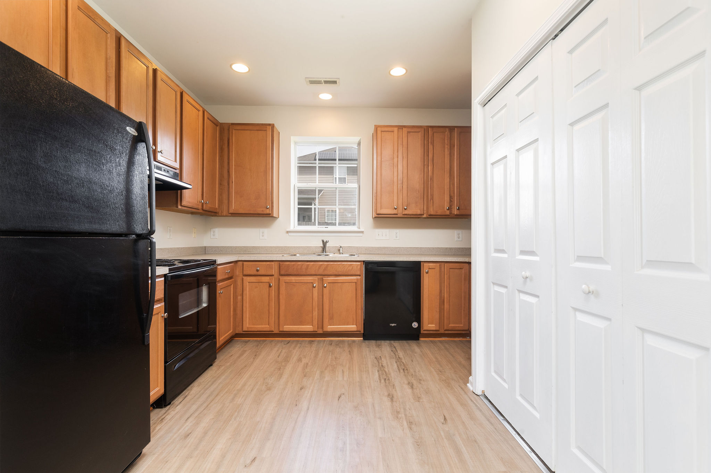
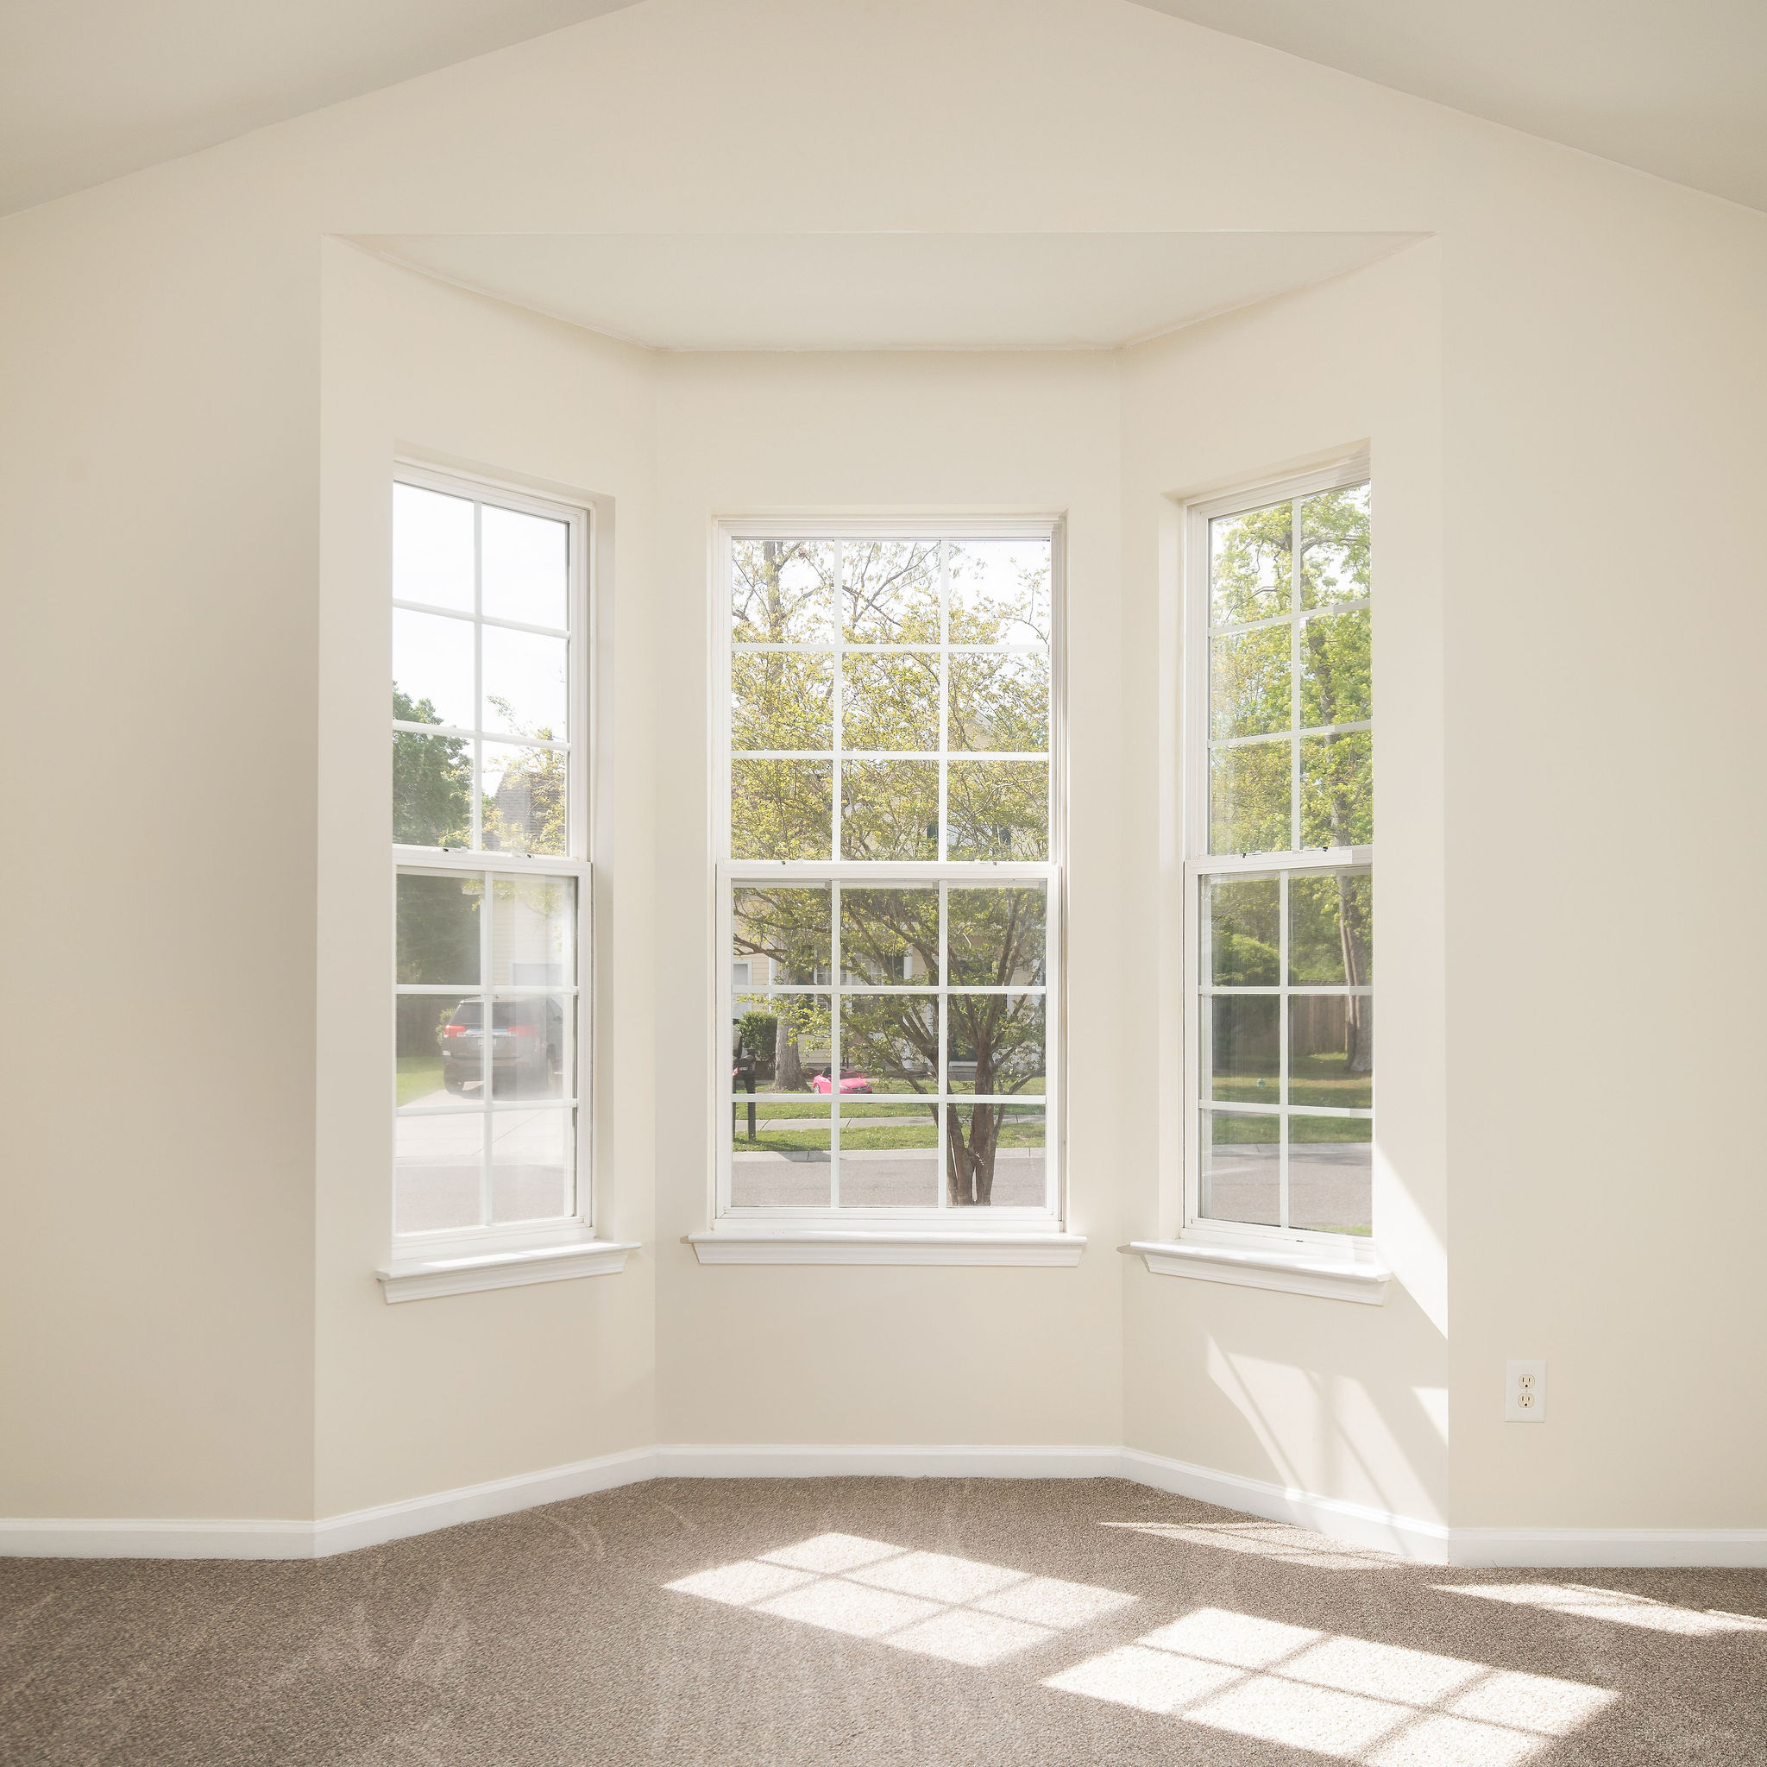
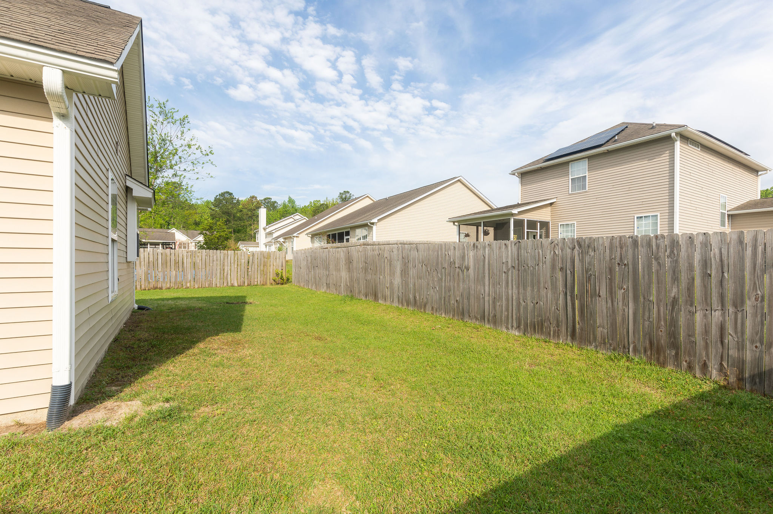
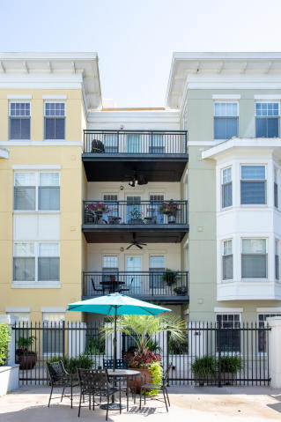


DRAFT
Off Market Offering
2417 Thoreau St | N Charleston, SC 29406 | $189,000
3 bed/2 bath | 1,285 sq ft | Built in 2007
Greg Gelber
(843) 494-2354
greg.gelber@agentownedrealty.com
AgentOwned Charleston Group | 902 Savannah Hwy | Charleston, SC 29407-7802

