Slide 1
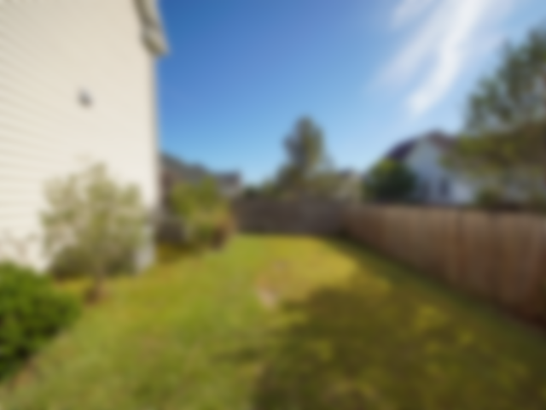
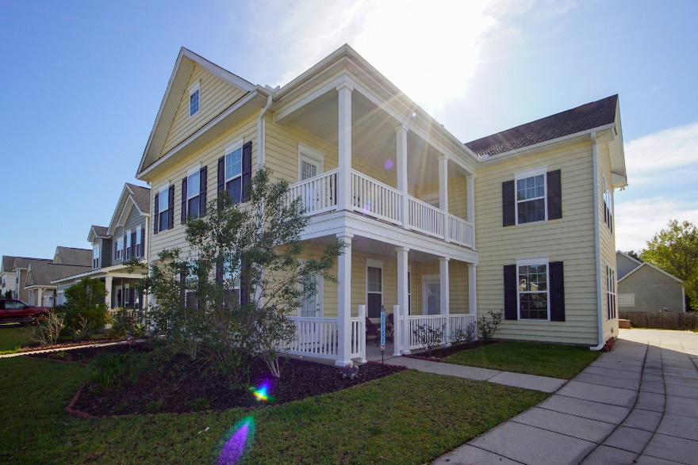
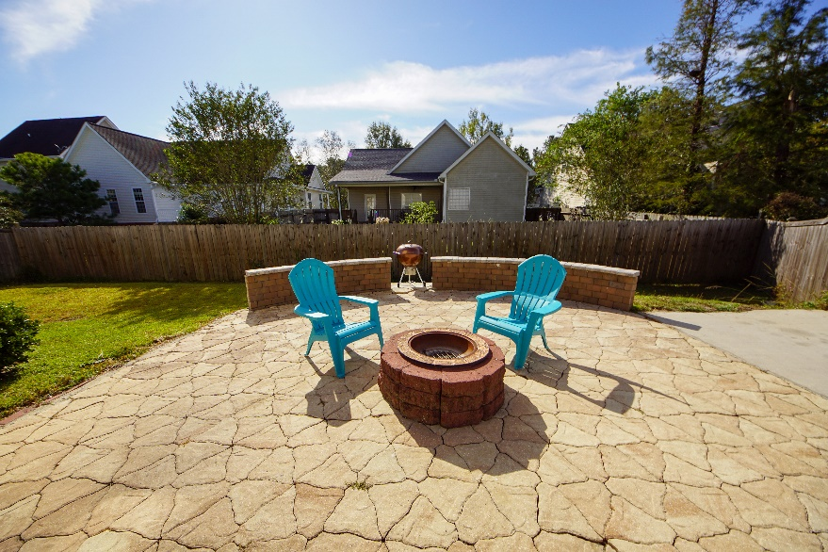
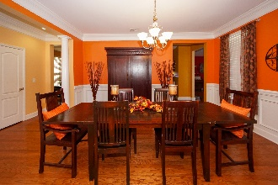
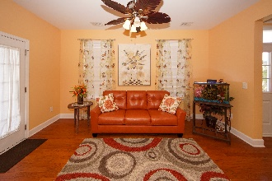
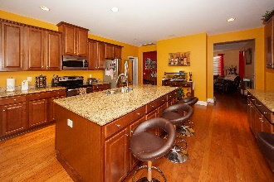
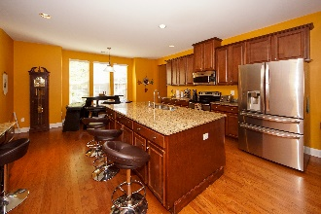
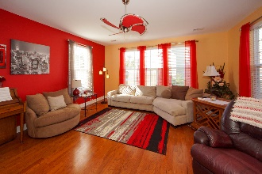
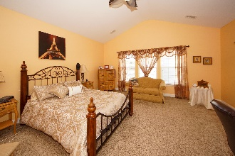
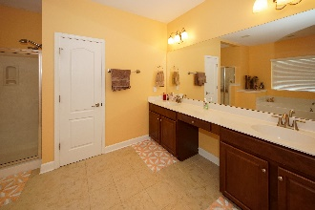
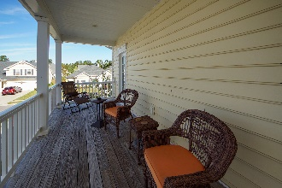
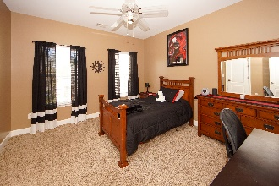
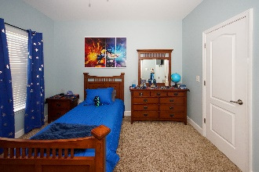


JUST REDUCED $10,000!
241 Berwick Drive
Wentworth Hall | Summerville, SC 29483 | MLS# 19029805 | $319,900
This former model home has all the upgrades! As you walk into the main entrance you are greeted by large elegant Charlestonian columns surrounding the formal dining room. The rooms are spacious and have tall ceilings, the home has a wonderful open feel to it. There's plenty of windows letting in natural light. There's a formal dining room and living room with a fireplace and each room feels private yet warmly connected. The kitchen is surrounded in beautiful 42'' cabinets and granite counter tops with a huge walk-in pantry. Upstairs you are greeted by an open loft and 4 bedrooms. The master is a must-see! As you open the double doors it leads you into an impressive hallway with the large bathroom and walk-in closet before making your way to the bedroom. There's an entrance to the upstairs double porch, which is a great area to unwind and relax. There's another entrance off of the porch leading into another amazing bedroom that comes with its own separate bathroom and can be ideal for guests or a mother-in-law suite. The other two bedrooms share a jack-and-jill bath. In the back yard there's a tucked-away storage shed that doesn’t take away from the yard, and there's a wonderful private patio with a fire pit which is perfect area for grilling or just relaxing. This home has plenty of space where everyone can spread out and wonderful living spaces where everyone can come together.
Keller Williams Realty Charleston West Ashley
1180 Sam Rittenberg
Ste 105
Charleston, SC 29407
Brad Braun (843) 209-8105
bradbraunhomes@gmail.com
westashleyhomesforsale.com

