Slide 1
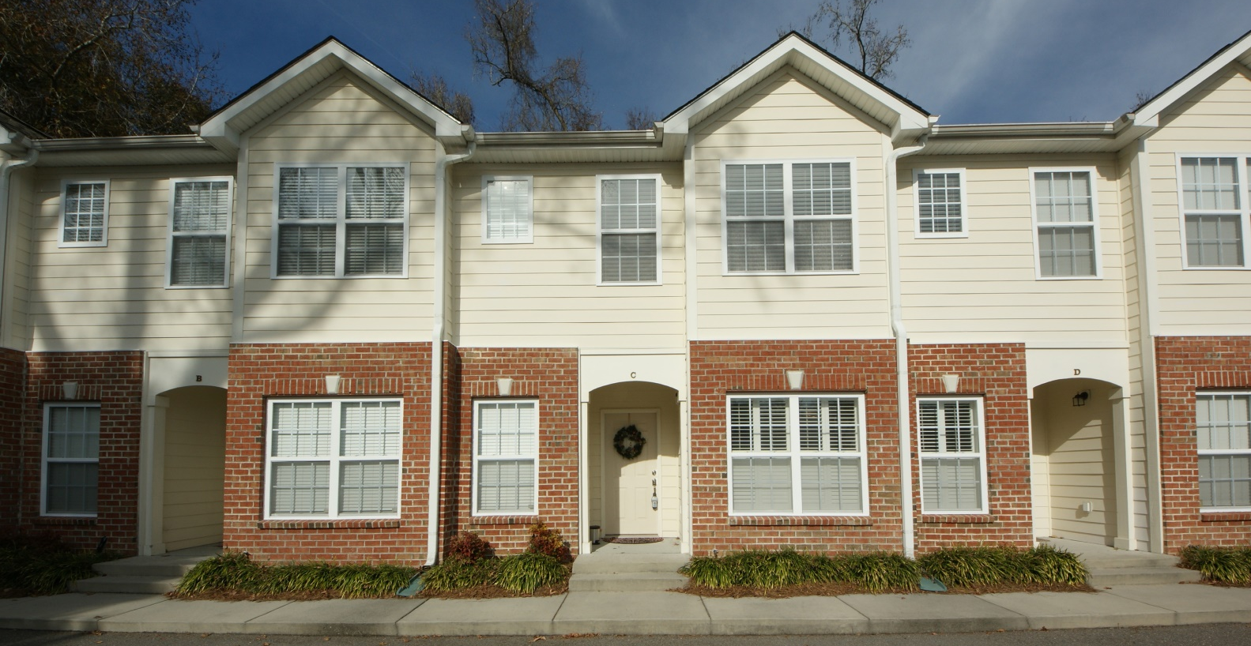
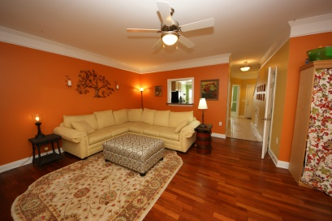
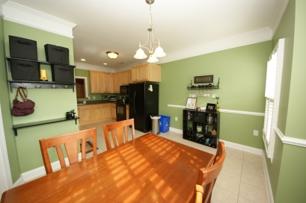
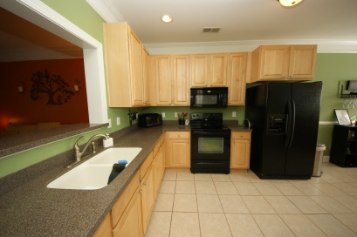
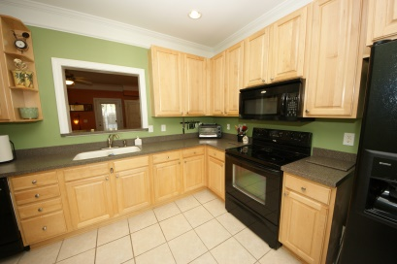
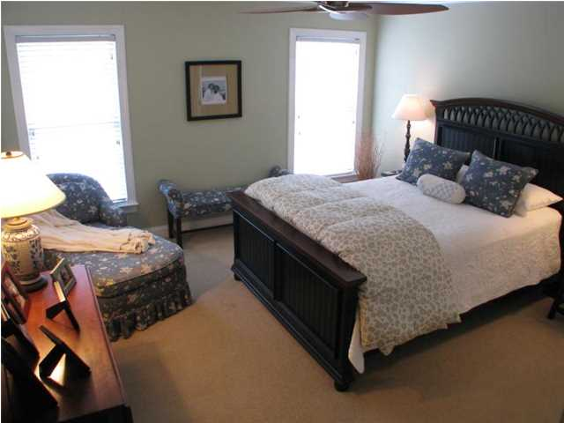
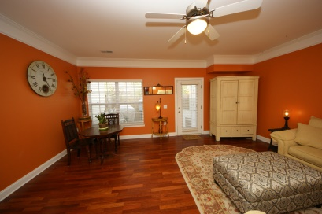
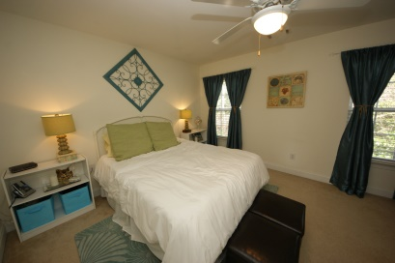
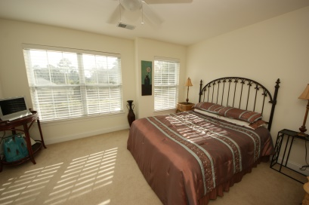
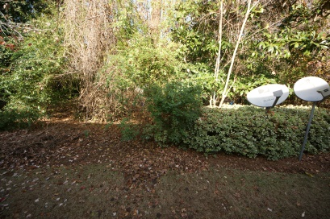
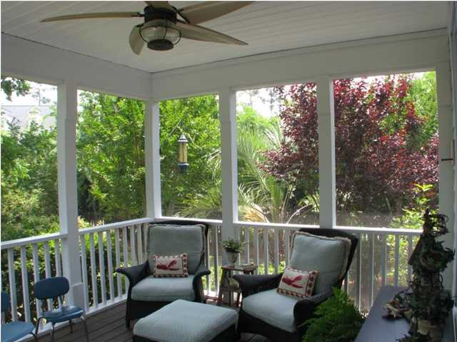


241 Howle Avenue C
Palm Pointe Condominiums ~ Charleston ~ MLS# 14031296 ~ $219,900
LOCATION, LOCATION, LOCATION! MUST SEE condo located just minutes to DOWNTOWN CHARLESTON, MUSC, FOLLY BEACH etc. Don't Miss out - Come view this wonderful Condo today! Conveniently Located to just about everything & within Walking distance to entertainment, shopping, dining etc. Perfect Location for just about everyone from the 1st time home buyer to the savvy investor! 9 ft CEILINGS, DOUBLE CROWN MOLDING, CHAIR RAIL, engineered HARDWOOD FLOORS in family room, CARPET UPSTAIRS, CERAMIC TILE IN ALL THREE BATHS, KITCHEN and EAT-IN-AREA! plenty of TALL CABINETS in the LARGE KITCHEN! UPSTAIRS LAUNDRY ROOM. TWO MASTER SUITES WITH WALK IN CLOSETS. Located Between the two suites at the top of the staircase there is a Flex AREA WITH PHONE AND CABLE outlets along with EXTRA ELECTRIC PLUGS, this area could also serve as a MEDIA ROOM, WORK AREA, EXERCISE AREA or a SECOND DEN. PLENTY OF EXTRA STORAGE is provided - UNDER THE STAIRS, in the ATTIC and on the BACK PATIO. DUAL ZONE A/C UNIT for upstairs and downstairs make this a very economical & smart extra. TWO HOUR FIRE WALL system installed for your safety.
The SELLER WILL PAY $2,000.00 TOWARD BUYER'S CLOSING COST.
Agent Open House ~ Wednesday from 11a-1p
Maggie Curtis
Broker Associate, ABR, EPRO, LMC
Cell 843-693-8207
maggiecurtis@comcast.net
Coldwell Banker United
1127 Queensborough Blvd Suite 103
Mt Pleasant, SC 29464

