Slide 1
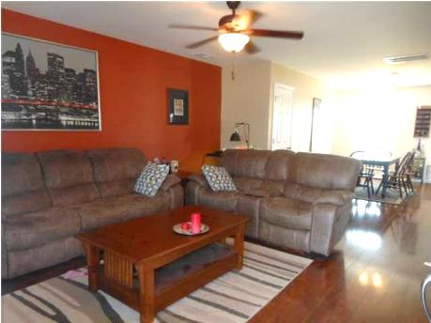
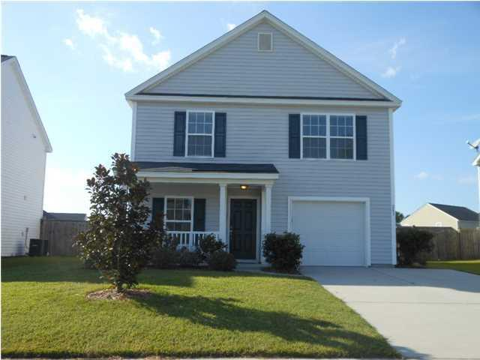
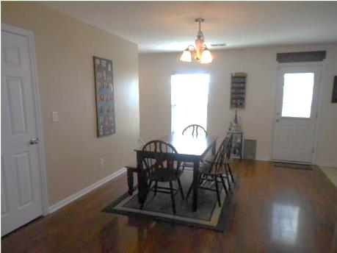
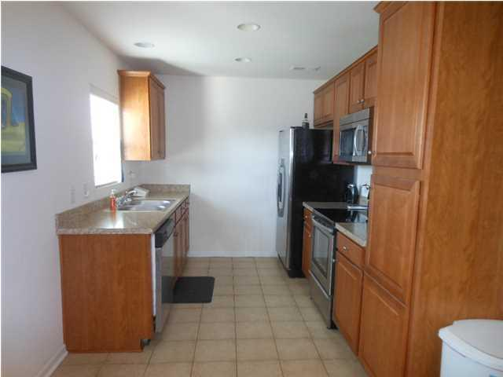
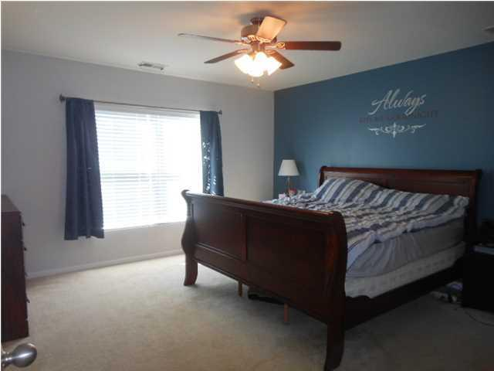
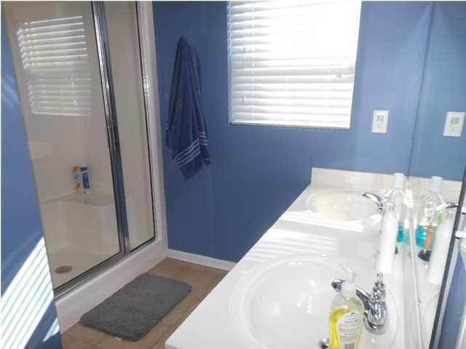
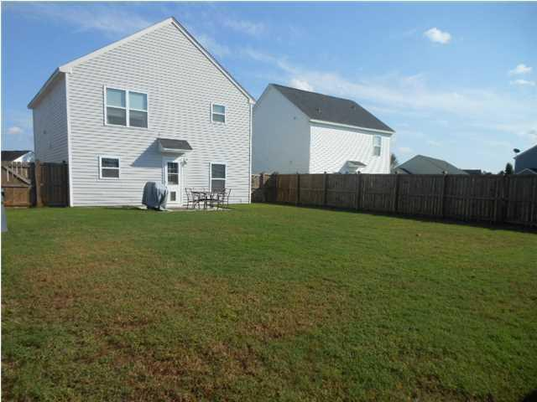
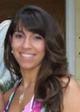

241 Emerald Isle Drive
Moss Grove Plantation - Moncks Corner
MLS# 1426847 - $162,500
Looking for a well cared for, ''new construction'' home without the new construction time frame? Look no more! Come visit this gem located in the desirable Moss Grove Plantation. 241 Emerald Isle Dr features a well flowing open floor plan with upgraded laminate wood flooring (that will not scratch), stainless appliances, large master suite, walk-in closets, garden tub and separate shower in the master bathroom. Other amazing features for this property include the welcoming front porch and large, private fenced back yard. No neighbors directly behind you and no neighbors directly in front!!! What more could you ask for??? Neighborhood amenities include a clubhouse, neighborhood pool, and play park.
Brittany Soldano, REALTOR
Cell - 843-324-0183
bsoldano1217@gmail.com
Beresford Appraisals, LLC of Wando
295 Seven Farms Dr, Ste C-114 | Wando, SC 29492

