Slide 1
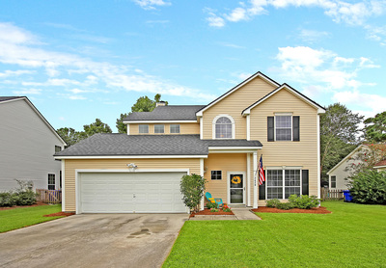
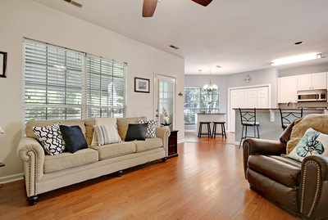
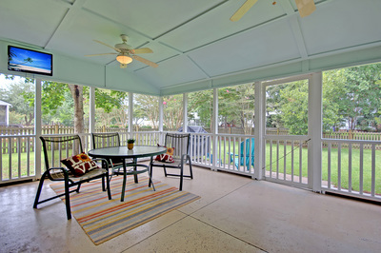


MLS® #18024132
**** Just Listed! ****
2420 Cotton Creek Drive| Mount Pleasant, SC
Adorable 3 bedroom, 2.5 bath home with open floor plan, two story entrance, a huge screened porch, and a large fenced yard. Perfect for your family and pets. The kitchen with granite counters, stainless steel appliances, pantry and dining area, opens to the great room with an inviting fireplace. The separate dining room can also serve as an office or playroom. A powder room completes this floor. Upstairs, double doors open to a spacious master bedroom with a walk-in closet, a huge bath with a large shower, garden tub and double sinks. Two more bedrooms and a full bath complete this floor. Two car garage with a laundry area, gives you plenty of room for car, lawn mower and storage. Enjoy the Community Pool, Club House, Tennis Courts and Jogging Trails.
3 bedrooms
2 full, 1 half baths
1668 sq. ft., 0.17 acres
Planters Pointe Subdivision
Offered at $345,000
More Details
Toula DiGiovanni
843.469.7555
toulad@nvrealtygroup.com
toula.nvrealtygroup.com

