Slide 1
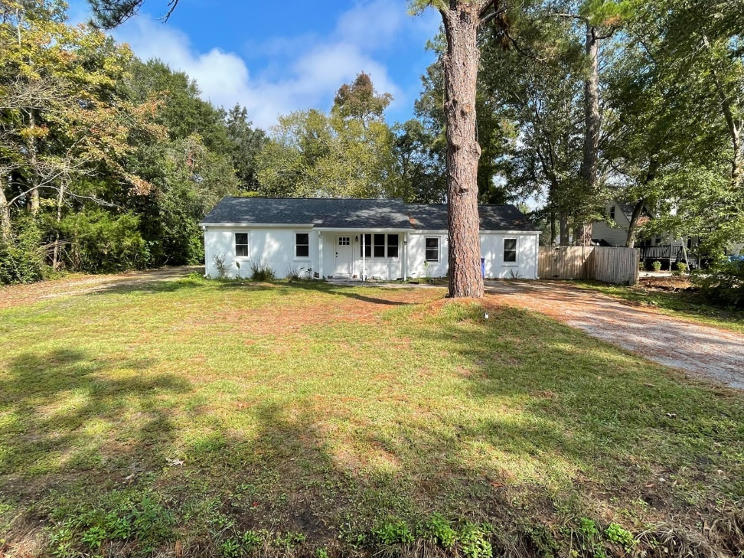
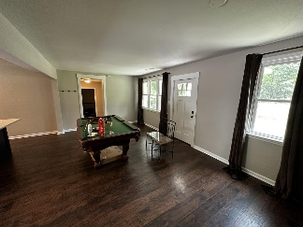
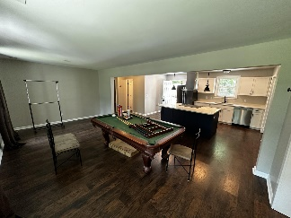
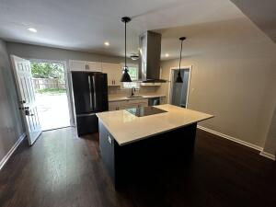
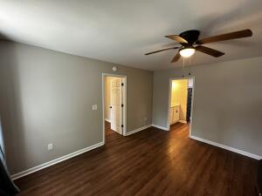
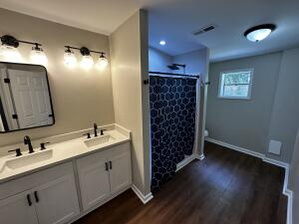
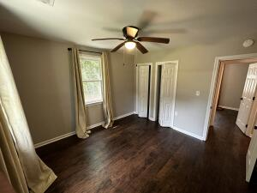
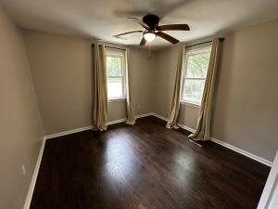
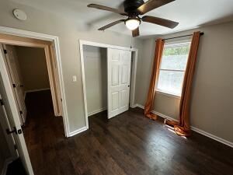
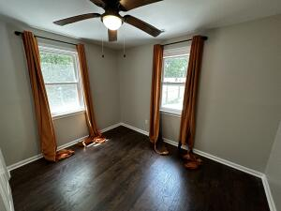
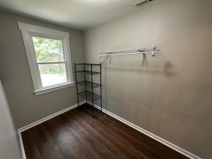



Brick Ranch HOUSE HACK in West Ashley!
2420 Cherokee Hall Ln
Cherokee Hall
Charleston, SC 29414
MLS# 23009132
$450,000
3 Bed | 2 Bath | 1,604 sf
Stunning home in the heart of West Ashley! House Hack! NO HOA! HUGE LOT! This 3 bedroom and 2 bathroom solid concrete ranch was fully renovated in 2020 with an open floor plan. All LVP flooring, just completely repainted agreeable gray, and as of 2020 the following is NEW; roof, HVAC, gas tankless water heater, water (PEX) and sewer (PVC) lines, gutters, high-end stainless steel appliances, washer and dryer, completely renovated bathrooms. Privacy fence added 2021. French drain system added 2022. Converted garage into DELUXE owner's suite with en-suite boasting double vanities, walk-in shower and HUGE walk-in closet. Google Nest Wireless Thermostat for controlling the temperature ANYWHERE. Perfect house hack as the property has a separate mobile home behind it (does not convey with sale) but tenant pays LOT RENT! Come by today!
Nick Mazzilli
(843) 640-5575
nick@nickmcharleston.com
nickmavencharleston.com
Maven Realty
2180 McMillan Ave
#71672
Charleston, SC 29405

