Slide 1
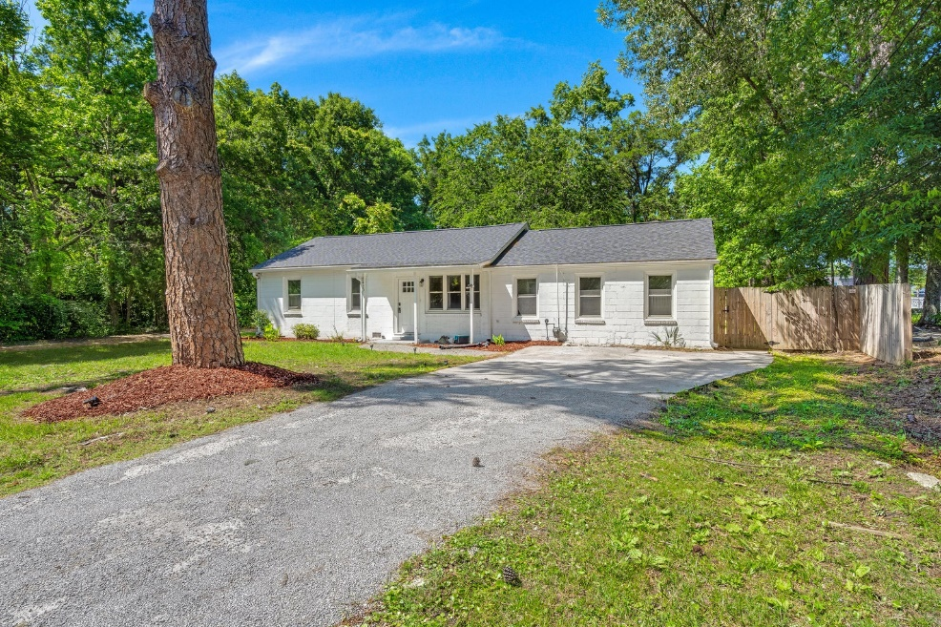
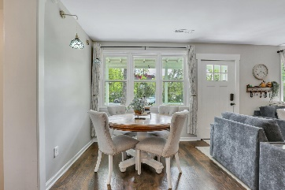
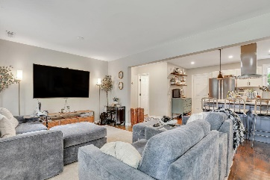
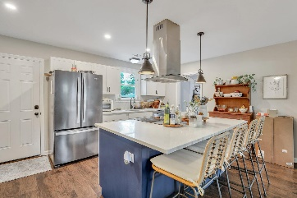
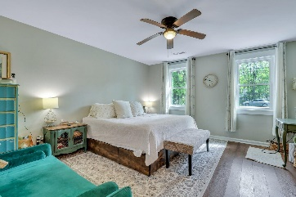
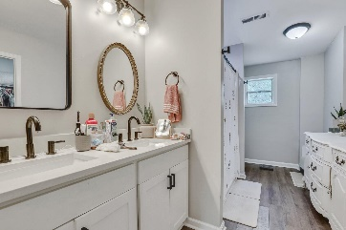
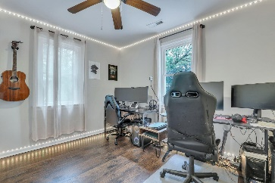
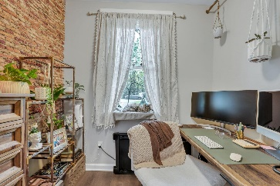
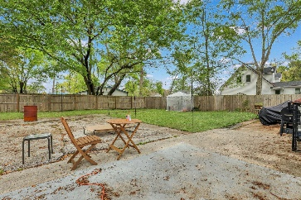
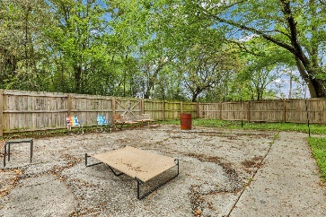
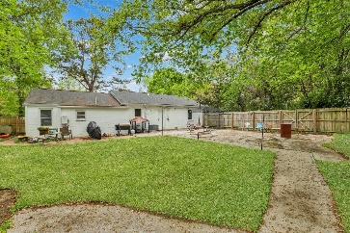



West Ashley Brick Ranch with Passive Income!
2420 Cherokee Hall Ln
Cherokee Hall
Charleston, SC 29414
MLS# 24007575
$499,500
3 Bed | 2 Bath | 1,604 sf
Stunning home in the heart of West Ashley, just steps from the West Ashley Greenway! House Hack! Investment opportunity! NO HOA! HUGE LOT! This 3 bedroom and 2 bathroom solid concrete ranch was fully renovated in 2020 with an open floor plan. All LVP flooring, completely repainted agreeable gray in 2023, and as of 2020 the following is NEW; roof, HVAC, gas tankless water heater, water (PEX) and sewer (PVC) lines and plumbing, gutters, stainless steel appliances, quartz kitchen countertops, cabinetry, washer/dryer, bathrooms. Privacy fence added 2021. French drain system added 2022. Converted garage into DELUXE owner's suite with en-suite boasting double vanities, walk-in shower and HUGE walk-in closet. Google Nest Thermostat for controlling the temperature ANYWHERE!
Step inside this gorgeous block ranch home built in 1958 awaiting its next owner. Upon entering, you are greeted by the dark laminate vinyl plank flooring and large living room. Enjoy creating fresh meals in the updated kitchen with plenty of counterspace on the quartz countertops, like-new cabinets, and stainless steel appliances. You CANNOT miss the enormous pantry off the kitchen which leads into the laundry room. Having company or family room is easy with the two guest bedrooms along with the renovated guest bathroom. Walk into the huge master suite with separate space for a small office or closet, en-suite with a HUGE closet. Perfect house hack as the property has a separate mobile home behind it (does not convey with sale) but tenant pays LOT RENT! Couple minutes from I-526, 15 miles to Folly, and less than 15 minutes to DOWNTOWN CHARLESTON! Close by plenty of restaurants, grocery stores, gyms, bars, schools, the list goes on! Come by today!
Nick Mazzilli (843) 640-5575
nick@nickmcharleston.com
nickmavencharleston.com
Maven Realty
2180 McMillan Ave
#71672
Charleston, SC 29405

