Slide 1
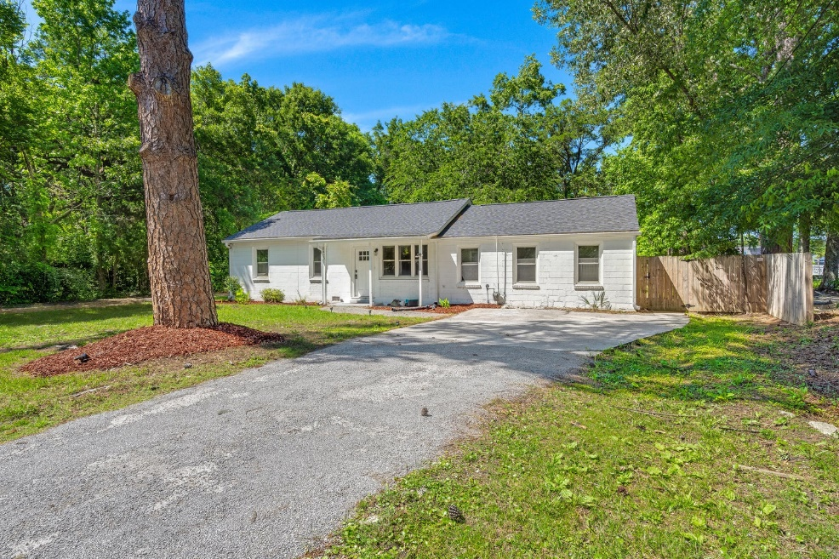
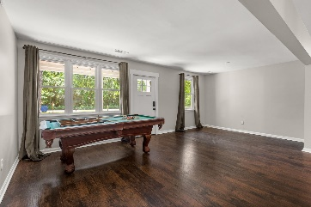
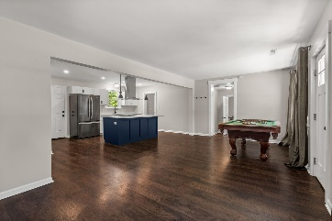
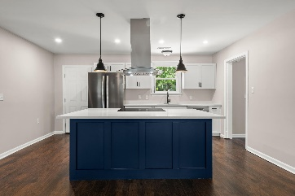
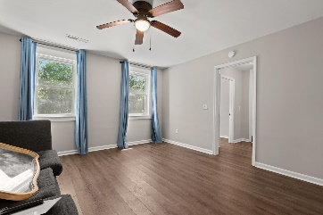
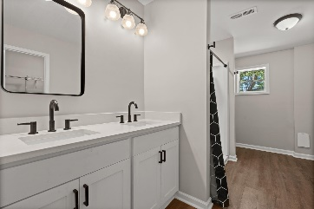
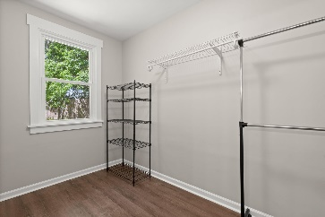
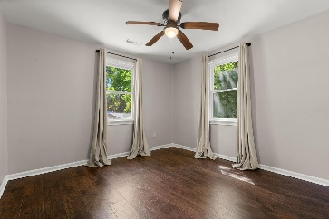
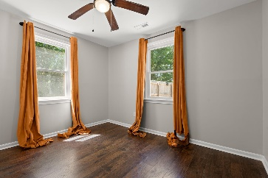
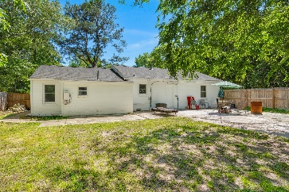
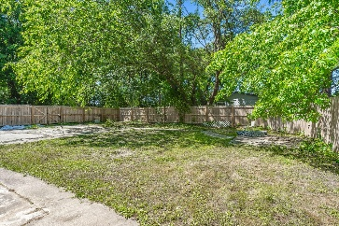



Gorgeous Brick Ranch with Fenced-in Backyard!
2420 Cherokee Hall Ln
Cherokee Hall
Charleston, SC 29414
MLS# 23015885
$2,950/mo
3 Bed | 2 Bath | 1,604 sf
Stunning home in the heart of West Ashley! House Hack! NO HOA! HUGE LOT! This 3 bedroom and 2 bathroom solid concrete ranch was fully renovated in 2020 with an open floor plan. All LVP flooring, just completely repainted agreeable gray, and as of 2020 the following is NEW; roof, HVAC, gas tankless water heater, water (PEX) and sewer (PVC) lines, gutters, high-end stainless steel appliances, washer and dryer, completely renovated bathrooms. Privacy fence added 2021. French drain system added 2022. Converted garage into DELUXE owner's suite with en-suite boasting double vanities, walk-in shower and HUGE walk-in closet. Google Nest Wireless Thermostat for controlling the temperature ANYWHERE.
Just a block over from the West Ashley Greenway, a couple minutes from I-526, and less than 15 minutes to DOWNTOWN CHARLESTON! Close by plenty of restaurants, grocery stores, gyms, bars, schools, the list goes on! Come by today! Absolutely NO PETS ALLOWED. Minimum 2 - 3 month lease term. Tenant to pay all utilities.
Nick Mazzilli
(843) 640-5575
nickmavenrealty@gmail.com
nickmavencharleston.com
Maven Realty
2180 McMillan Ave
#71672
Charleston, SC 29405

