Slide 1
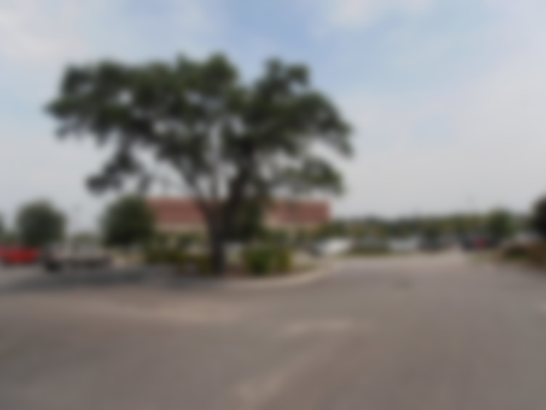
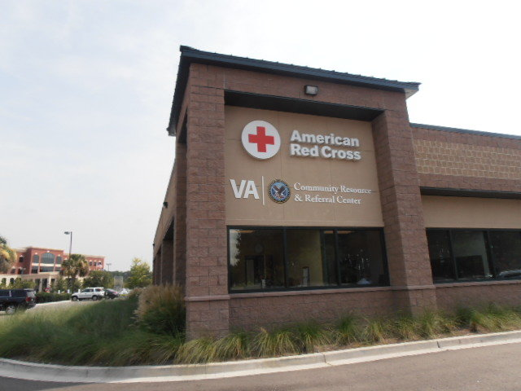
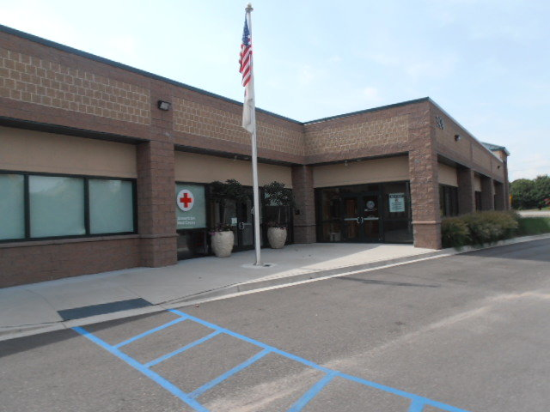
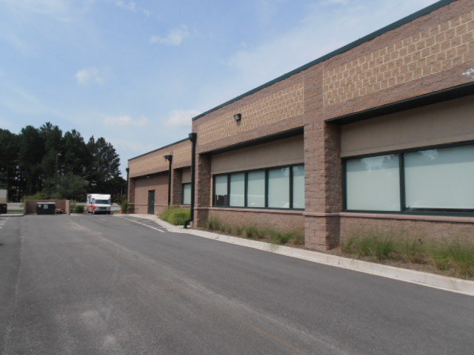
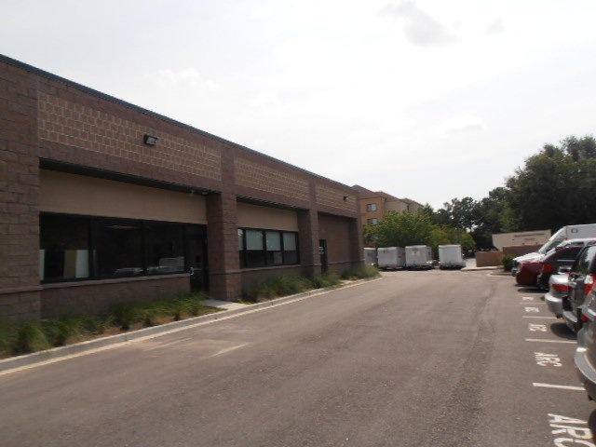
VA/Red Cross Building for Sale
2424 City Hall Ln
N Charleston, SC, 29406
CMLS# 30237045
$3,000,000
Relatively new office building located in the heart of North Charleston, directly in front of the City Hall of North Charleston.
Building consists 14,698 sqft with 2 tenants, the VA & The Red Cross.
130 Acres of Vacant Land
Convenient to Boeing, Charleston International Airport, Tanger Outlet, & Hotels.
Charles Salmonsen
M (843) 224-0300 | O (843) 388-6613 | charles@salmonsen.com
Salmonsen Realty | 864 Lowcountry Blvd Ste B | Mt Pleasant, SC 29464

