Slide 1
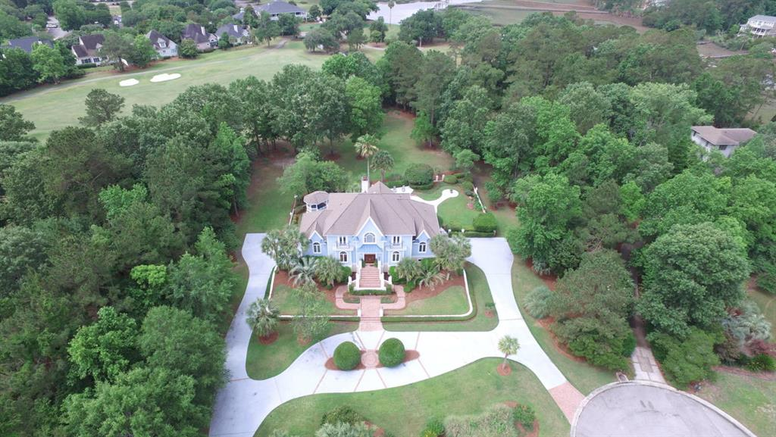
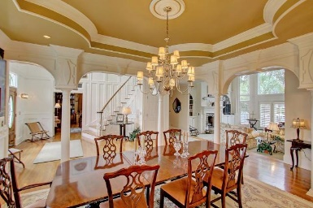
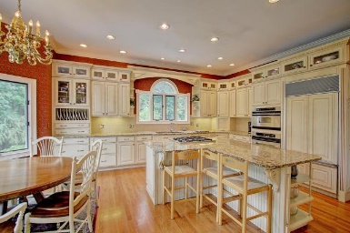
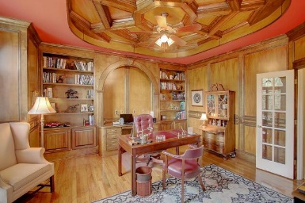
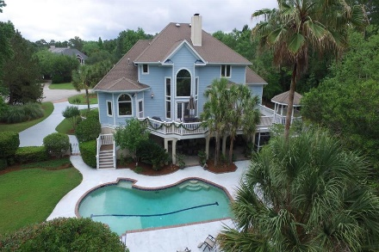

2425 Wagner Creek Court Mount Pleasant, SC 29466 :: MLS# 16015801 :: $1,150,000
Dunes West Luxury
Along 9th hole on a Cul-de-Sac
4 Bedroom with Master Suite on 1st floor
Handsome Study/Office with cherry wood on walls and ceiling
Large gourmet eat-in kitchen
Beautiful dining room & family room
Man-cave with bar and wine closet on lower level open to a volleyball pool with decks, a screened porch and a hot-tub
Plenty of room for entertaining!
Catha Remington
843-697-1667 - M
843-202-8722 – F
cremington@carolinaone.com www.catharemington.com
Carolina One Real Estate
628 Long Point Rd.
Mt Pleasant, SC 29464-3032
www.IOnHomesForSale.com

