Slide 1
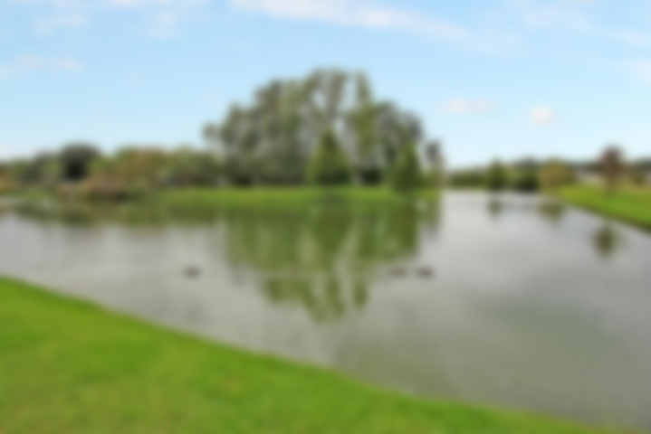
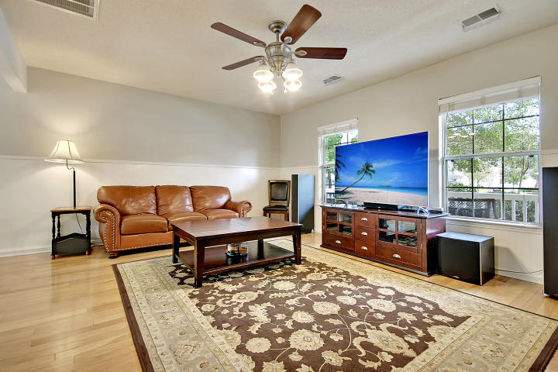
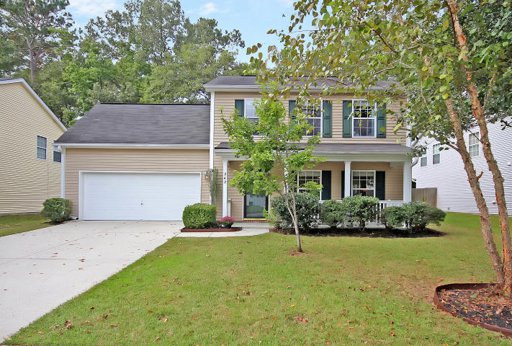
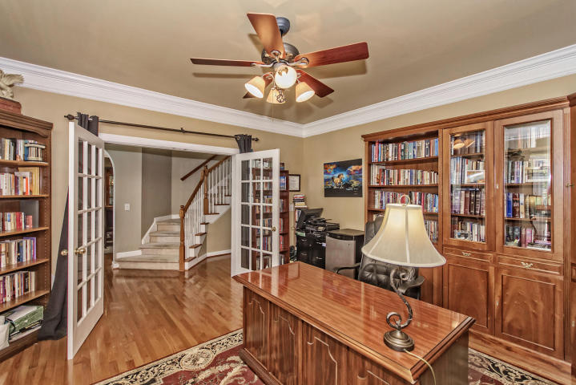
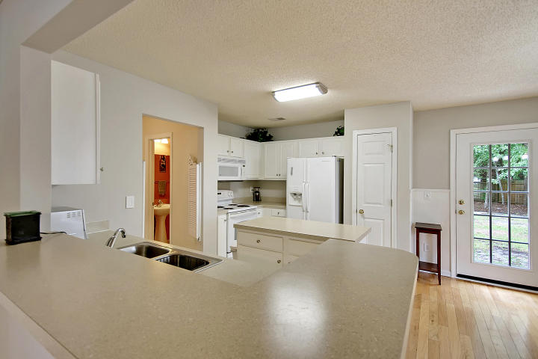
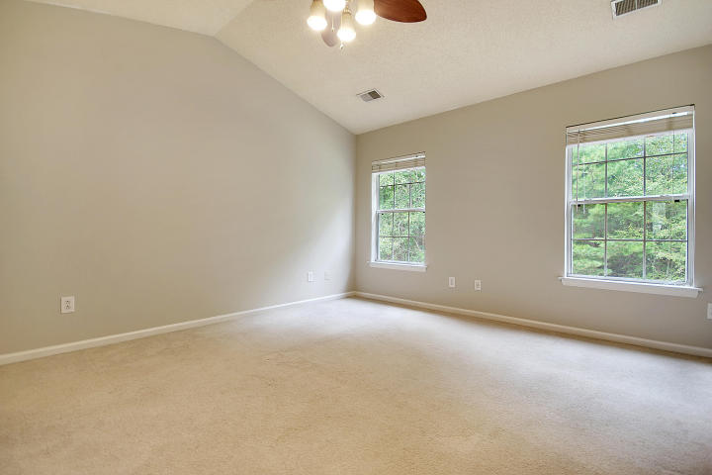
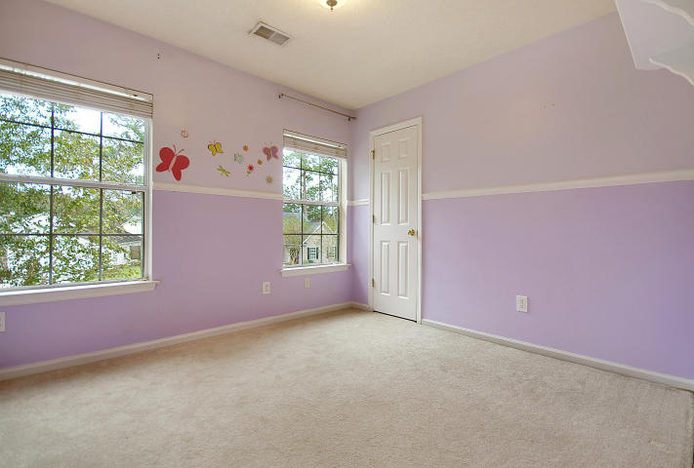
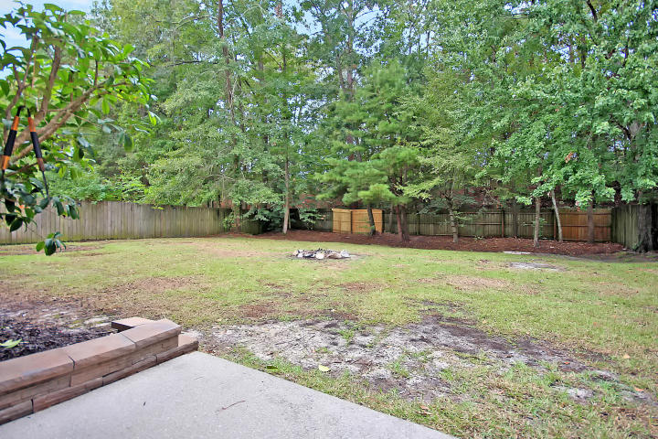
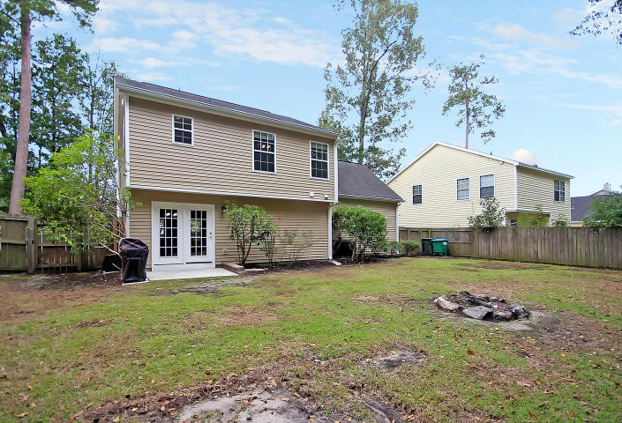

BEST VALUE PRICE
IN SUMMERVILLE!
242 Eagle Ridge Road Bridges of Summerville | Summerville
MLS# 17028298 | $224,900
MOVE-IN READY with privacy-fenced back yard in superior school district. 3 bedroom, 2.5 bath home with large lot. Light and bright with oversized windows. Hardwoods, carpet, paint, roof all in great condition. New HVAC, hot water heater, dishwasher, garbage disposal. Wooded back yard enclosed by tall privacy fence. Chef’s kitchen has island and ample counter space. Located in the award winning Dorchester School District II. Beautiful neighborhood pool and playpark with ponds and nature all around. Location convenient to historic Summerville, the airport, Boeing, the Mercedes and Volvo plants as well as a short ride to downtown Charleston and the world-class sun-kissed beaches of Sullivan’s Island, Isle of Palms and Folly. All of this can be yours for the BEST VALUE PRICE in Summerville.
Chip Walsh
843-822-4663
chipwalsh@gmail.com
The Boulevard Company, LLC 35 Broad Street Charleston, SC 29401
www.TeamWalshRealEstate.com

