Slide 1
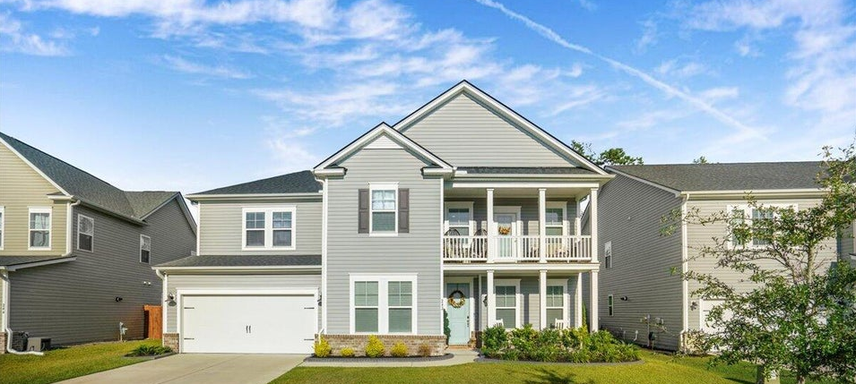
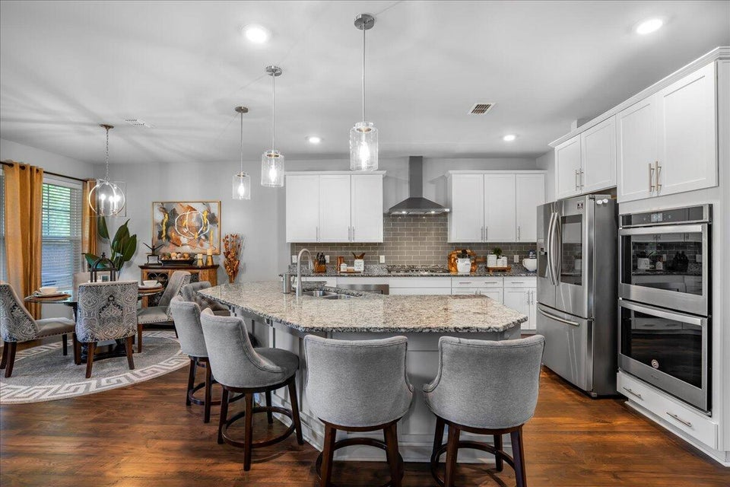
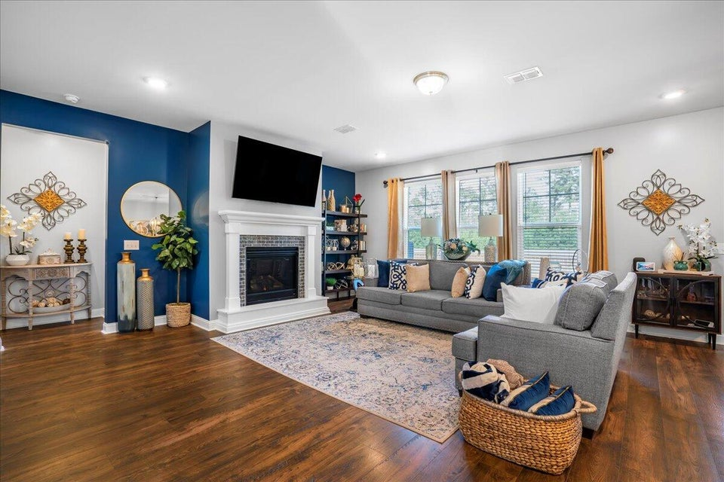
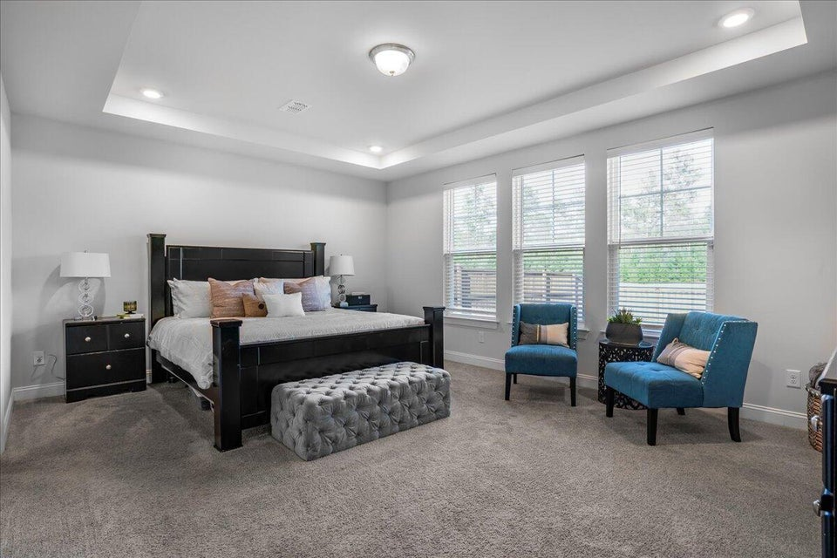



242 BERING LANE | SUMMERVILLE, SC 29486
11/
5 BEDROOMS
4 BATHS
3,199 SF
� 1753
piiq 2
PRICE IMPROVEMENT IN CANE BAY PLANTATION!
MLS# 24026575 | $525,000
ENJOY A VIDEO TOUR!
CHARLESTON
WEST ASHLE
KELLERWILLIAMS.

