Slide 1
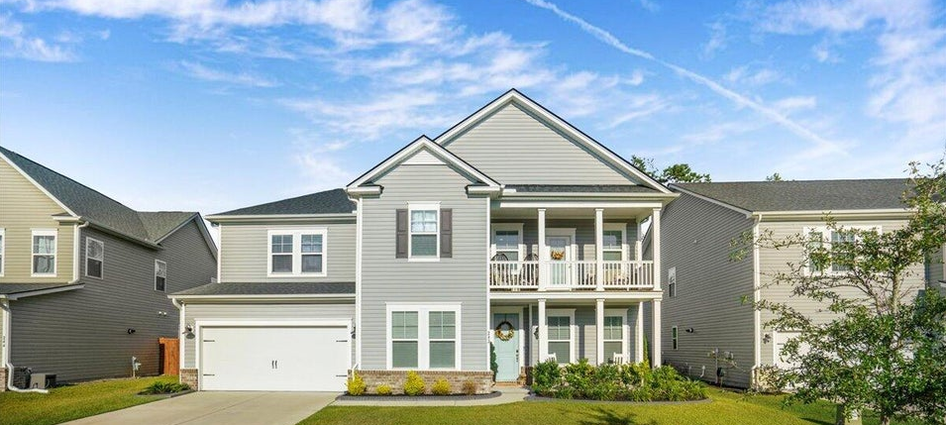
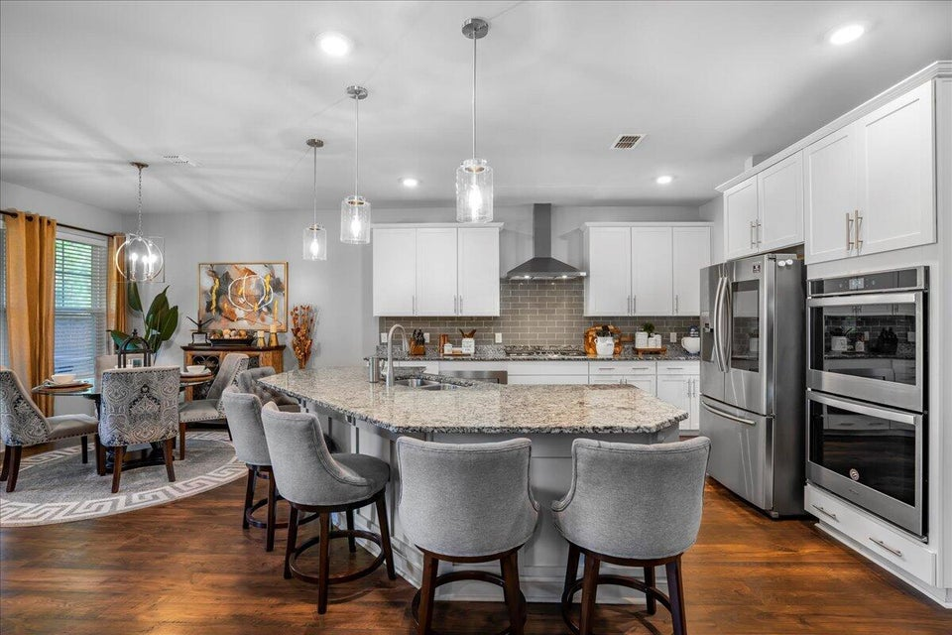
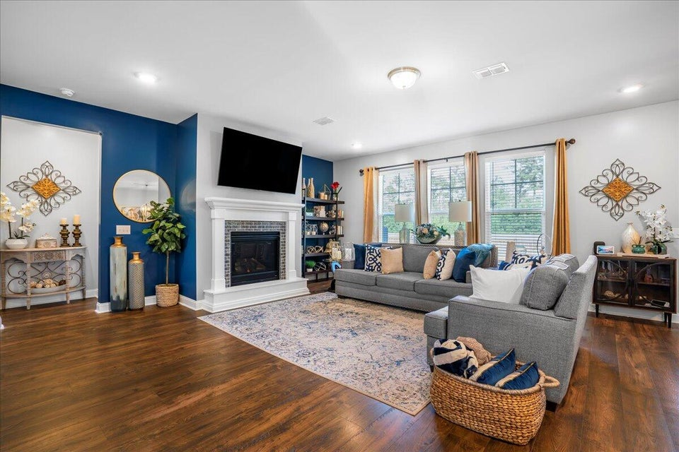
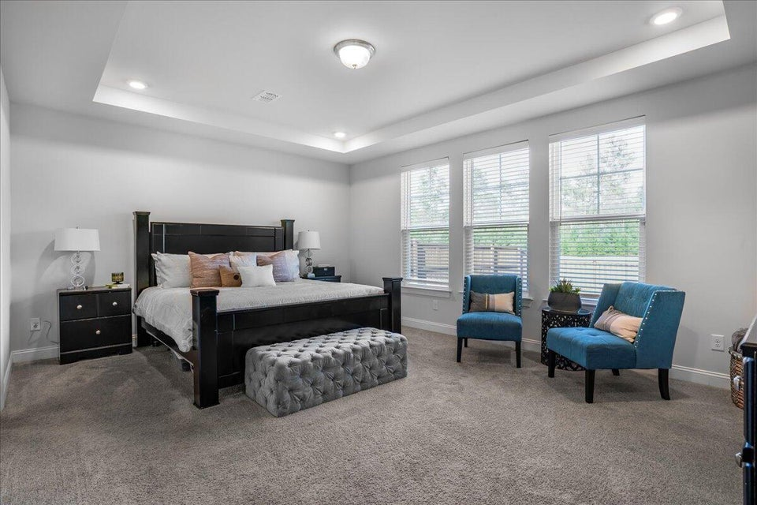



242 BERING LANE | SUMMERVILLE, SC 29486
11/
5 BEDROOMS
4 BATHS
3,199 SF
� 1753
piiq 2
PRICE IMPROVEMENT!
CANE BAY PLANTATION
MLS# 24026575 | $537,000
CHARLESTON
WEST ASHLE
KELLERWILLIAMS.

