Slide 1
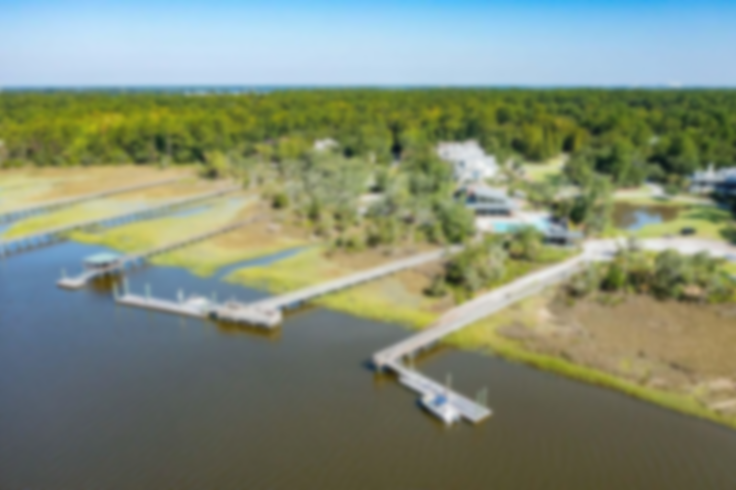
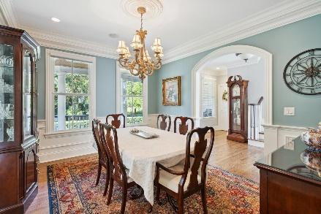
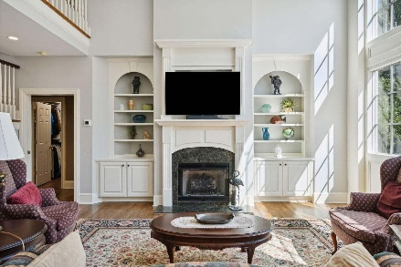
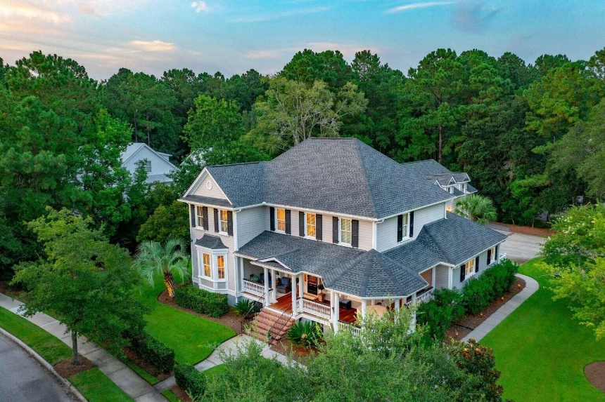
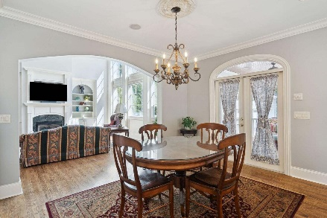
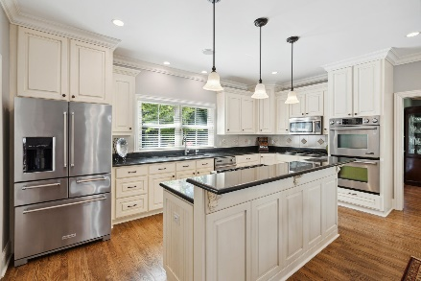
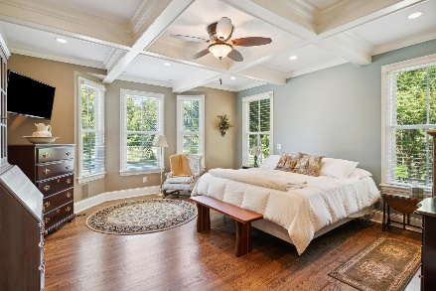
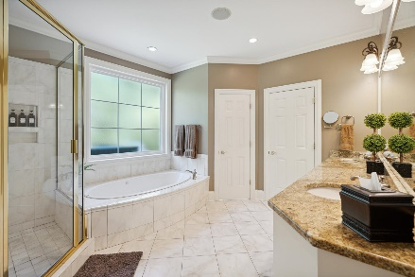
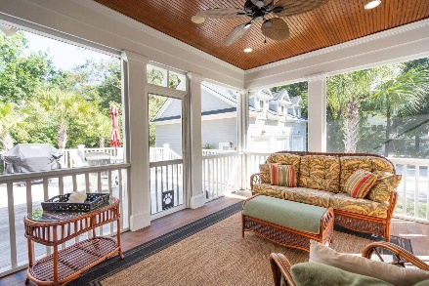
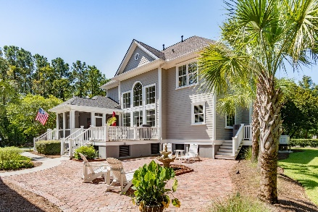
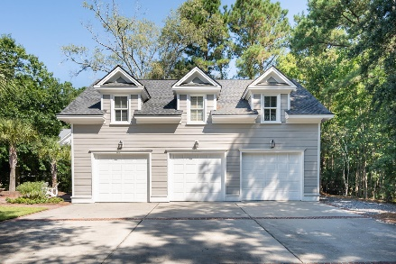
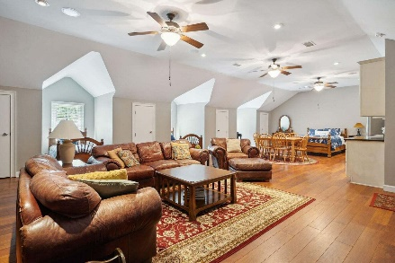
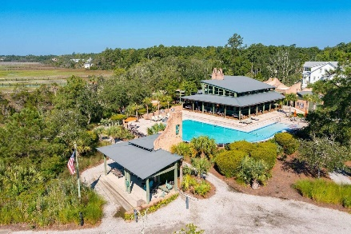
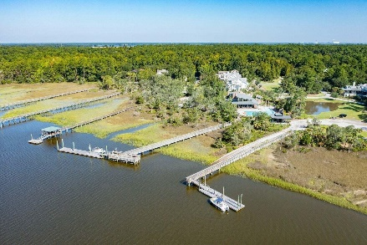


242 Grand Park Boulevard
Beresford Hall
Charleston, SC 29492
MLS# 24015095 | $1,600,000
Best Value In Beresford Hall
Motivated Seller
Behind the gates of Beresford Hall, a private and prestigious riverfront enclave perched on the banks of the Wando River, this southern plantation style home is nestled into an estate sized wooded lot. The exterior of the home is impressive, from the brick trimmed drive to the large southern sitting porch, this home exudes a stately yet warm and welcoming feel. Once inside, you'll find the custom details are everywhere. Gorgeous millwork, including hardwood floors, multi-piece crown moulding, custom built-ins, and wainscoting trimmed walls are found throughout. The formal dining room is generously sized to accommodate the largest of dining tables and you can just envision family and friends gathered around the table as you propose a toast to the special occasion! This traditional home's floor plan gives way to an open and airy family room that boasts a two-story wall of windows, 18'+ ceilings and a gas log fireplace flanked by custom built-ins. Natural light floods the living area from above while a balcony-style cat walk adds a touch of dramatic architectural flare. Ideal for entertaining, this home offers an easy flow into the casual dining area and the kitchen. A true gourmet kitchen that will please the most discerning of home chefs, it is anchored by a large center island and adorned with professional grade appliances including a built-in refrigerator, double ovens and a six burner gas cooktop. These sleek, modern conveniences are tempered by the farmhouse feel of the custom cabinetry, tile backsplash and granite countertops. A huge walk-in pantry provides additional storage for all of your kitchen necessities. A highly desired first floor master retreat is sure to become your favorite escape as there is plenty of room for a sitting area or yoga/mediation space. This elegant master suite boasts a large walk-in closet finished with custom closet system, coffered ceiling and an en-suite luxury bathroom. The bath feels like a spa-inspired sanctuary with its luxury walk-in tiled shower, long expanses of granite atop a custom cabinet dual sink vanity, private water closet, and an oversized soaker tub. Upstairs you'll find three generously sized bedrooms and two additional, well appointed full bathrooms. As if the interior living space wasn't impressive enough, the screened in rear porch is expansive and offers the ideal space for dining alfresco or simply relaxing with a morning cup of coffee while enjoying the park-like setting of the large backyard. An open air deck leads to the oversized 3 car garage complete with workshop space and a large studio apartment with kitchen and full bathroom. Ideal for use as a guest suite, teen retreat, adult children returning home, home office, or ultimate game room or "man cave.' Additional upgrades include 2 New Natural Gas Generators, security system, new water softener and 2 New Reverse Osmosis purification systems for the house and the apartment. Located in one of Charleston's premier gated communities, Beresford Hall offers a zero-depth entry neighborhood pool, beautiful party pavilion, miles of walking trails, Childrens play park, and a neighborhood deep water boat launch with floating dock. Beresford Hall is conveniently located close to I-526, I-26, area beaches, and a short drive to the world class dining and shopping of historic downtown Charleston
Video Tour
Don Dawson
843-514-0452
ddawson@carolinaone.com
Carolina One Real Estate • 2713 Highway 17 North • Mount Pleasant, SC 29466
www.TeamDawsonSC.com

