Slide 1
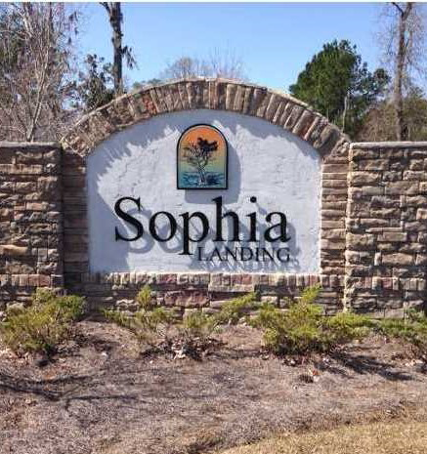
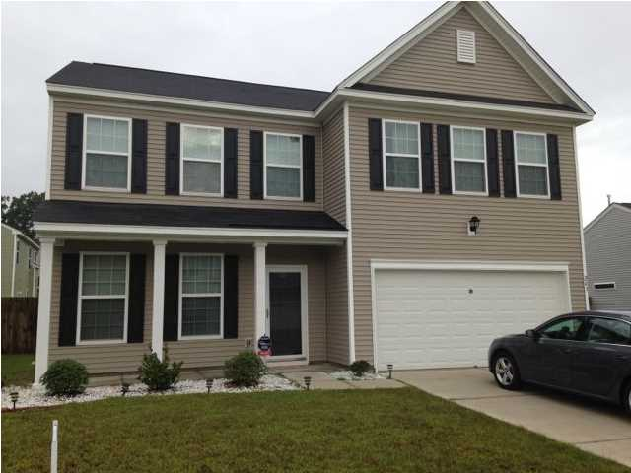
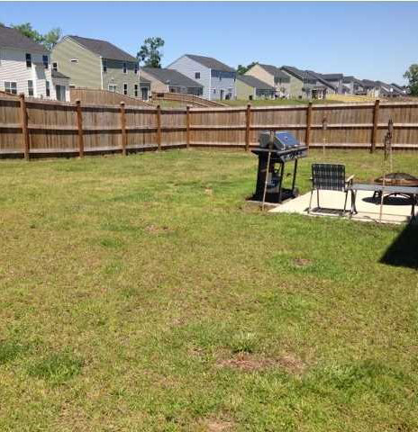
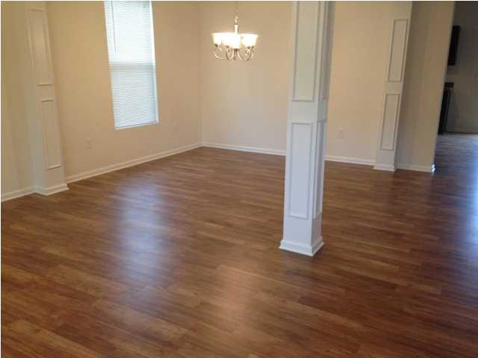
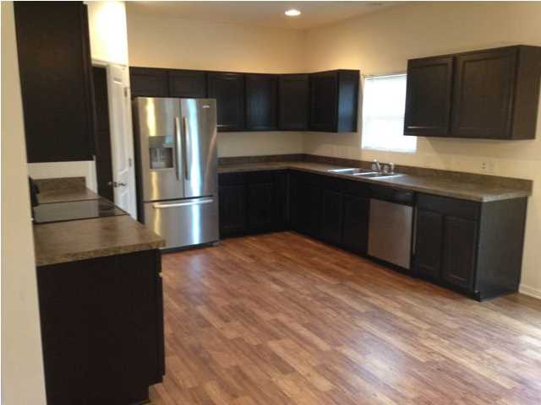
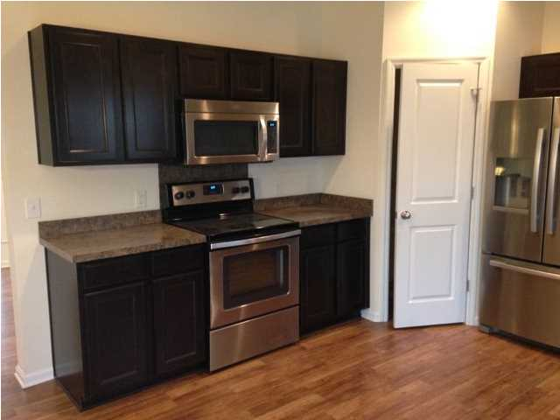
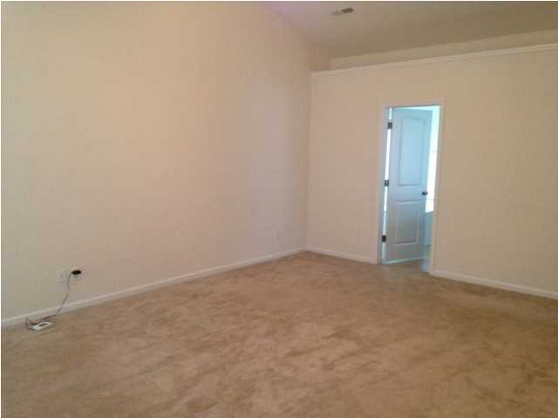
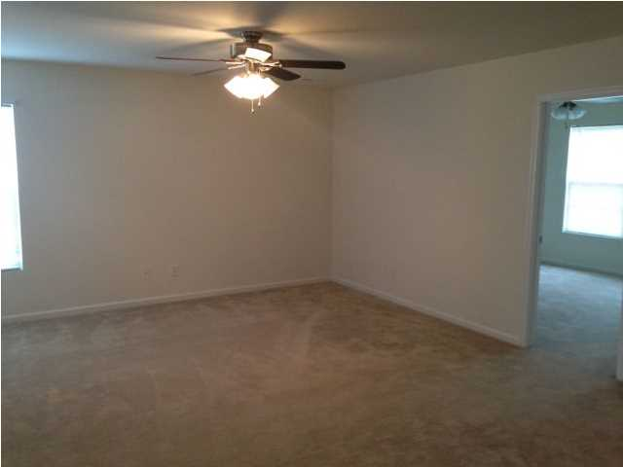


New Hardwood Floors!
243 Donatella Dr | Goose Creek
MLS# 1423469 | Offering at $209,900
Seller will pay up to $3,500.00 towards closing costs. New hardwood flooring installed throughout first floor! Freshly painted! Absolutely beautiful! Like new home built in 2012. This is the very popular Augusta floor plan by Eastwood Homes. Open floor plan is great for entertaining! Kitchen features walk-in pantry, upgraded cabinets and all whirlpool stainless appliances! Downstairs has a large open kitchen with great room and separate formal dining room. Six ceiling fans, one in great room, one in upstairs loft and one in each bedroom! All four bedrooms are large. Three bedrooms have walk-in closets. Six ceiling fans throughout house. Master bedroom measures 20'10" x 15'4" with a vaulted ceiling. Master bath features dual sinks, garden tub, separate shower and huge walk-in closet. Upstairs laundry room. All light fixtures are brushed nickel. Gas water heater. Refrigerator may be negotiated.
Frank Collins
C 843-327-3292
O 843-875-5525
frankscollins@gmail.com
Coldwell Banker United, REALTORS 4969 Centre Pointe Dr.
Ste 203 Charleston, SC 29418

