Slide 1
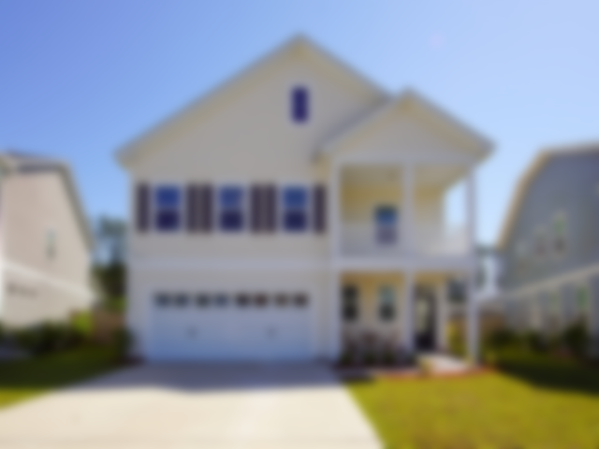




Walk Through Beautiful Home in Palmetto Walk @ Cane Bay
243 Palmetto Walk Drive ~ Summerville ~ MLS# 20010393 ~ $339,000
Why wait for New Construction? The Wylie Plan by Sabal boasts an abundance of indoor/outdoor space. Upon entry be impressed by the large foyer and wide plank wood flooring that flows throughout the first floor. The large drop zone off the garage is just the start of what this home has to offer. The formal dining room with coffered ceiling is perfect of holiday gatherings. The open concept kitchen and family room is wonderful for entertaining. The eat in kitchen has a large center island with granite countertops and tasteful tile backsplash. The stainless steel appliances include a gas stove. There is a flex/office space with beautiful glass French doors perfect for a home office or for a place for the kids to do their homework. The large family room looks out to the screen porch overlooking a peaceful pond. The master bedroom located upstairs features a front porch perfect for enjoying your morning coffee or a beautiful sunset. The master bathroom boasts a separate tub and shower with beautiful ceramic tile flooring. Upstairs you will also find three generously sized bedrooms, one with its own full bathroom, and the other two bedrooms share a large full bathroom. Lastly, the large loft area is a bonus and can be used as a media room for the movie lover, a play room for the kids or a workout or craft room. This beautiful home has an abundance of indoor/outdoor space and is a must see!
Video Walkthrough: https://www.youtube.com/watch?v=CfXmc6ki7Hk
Handsome Properties, Inc 53 Broad St Charleston, SC 29401
BHHS Carolina Sun Real Estate
1440 Ben Sawyer Blvd ste 1503
Mt Pleasant, SC 29464
Suzanne Conway
843-814-6778
s.conway@bhhssun.com

