Slide 1
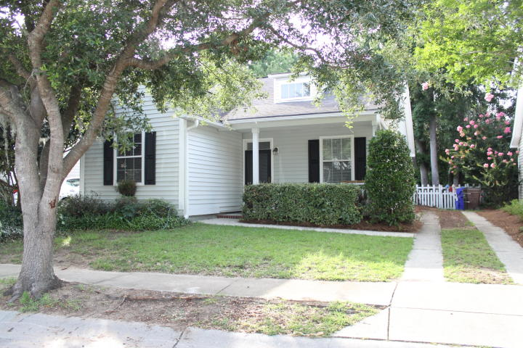
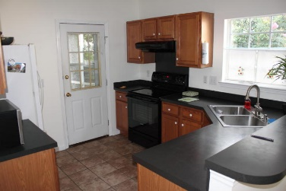
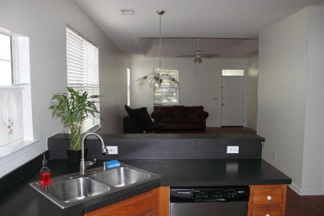
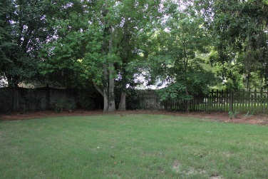
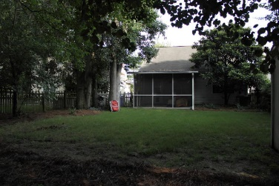

$270k in Mount Pleasant!
2444 Fulford Court
Chadbury Village
Mount Pleasant, SC 29466
MLS# 15018072
$270,000
3 Bedrooms | 2 Baths | 1,220 sf
Location, location, location! Home is located less than 5 miles to the Isle of Palms beach, 10 miles from Downtown Charleston, and minutes away from the Towne Center and Harris Teeter. This is a one story home on a shaded lot with several mature trees. Open concept with a combined family room/dining room with hardwoods and tray ceiling. Two bedrooms with shared full bathroom located in the front part of the home. Master bedroom with walk in closet and private master bathroom in rear of home. Kitchen is located toward rear of home with direct access to spacious screen porch and very private fenced in backyard. Brand new HVAC installed in July 2011. Home is also under termite bond with Ledfords through May 2016. Community pond and green space located just down the street.

