Slide 1
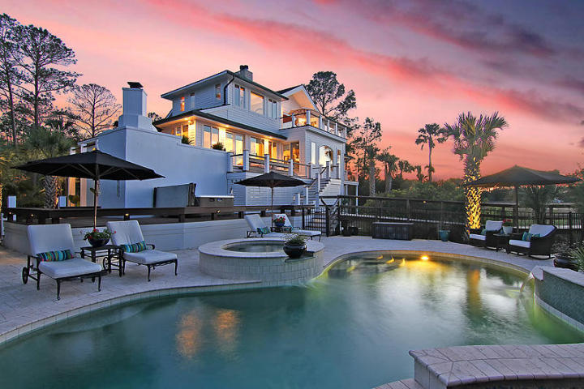
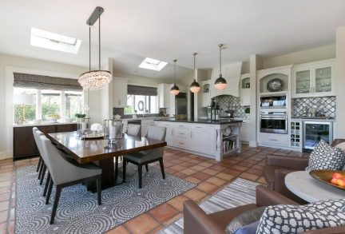
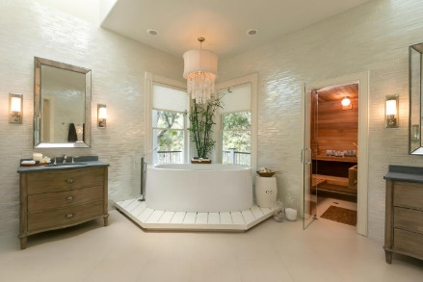
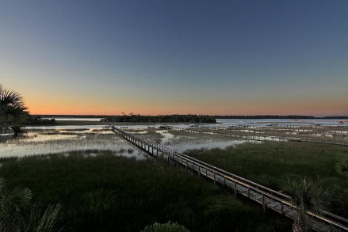
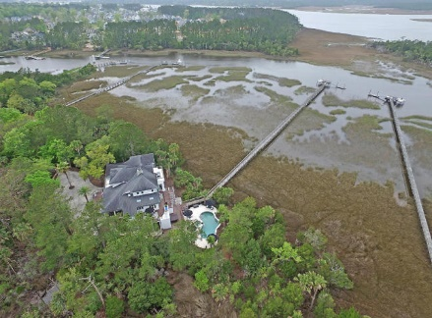

Dunes West Stunner
2446 Brick Landing Ct
Mount Pleasant, SC 29466
MLS# 17000038
$1,799,000
3 Bedrooms | 3½ Baths
Property like this rarely becomes available! You will instantly fall in love with the views the moment you walk up to the front door, where you can see straight through to the Wando River and marshes. As you enter, you will continue to be impressed with the high-end finishes throughout. Views are spectacular from EVERY room in this fabulous Executive home. A stunning kitchen with wood-burning fireplace, includes Wolf Range, Subzero fridge, and custom handmade backsplash tiles finish off this beautiful kitchen. Master bath has heated floors, sauna, steam shower, and Maestro tub, along with breathtaking, floor-to-ceiling Italian glass tile. Additional features include wine cellar, custom garage doors, Carolina Lanterns... Too much to list. It doesn't get any better! Schedule a showing today!
EXTERIOR FEATURES
-3 Levels of Expansive Ipe Decking, with Marine Cable
-Copper Gutters
-Saltwater Pool
-Travertine Decking
-Outdoor Landscape Lighting
-Custom Charleston Lanterns
-Custom Mahogany Garage Doors w/German Manufactured Motors
-Hurricane Shutters
-Dock with 10,000 lb Boat Lift
-UNMATCHED Privacy in Mount Pleasant!
INTERIOR FEATURES
-Amazing Views from Every Room
-Over $50k in Custom Light Fixtures
-Custom Draperies & Window Treatments
-Solid Wood Doors throughout home
-Master Bath with Sauna & Steam
-Heated Floors
-Custom Tile from Floor to Ceiling
-Maestro Hydra-Soaking Tub
-Nickel Faucets
-Gas & Wood-Burning Fireplaces
-Wine Cellar for more than 1500 bottle collection
-Interior Fire Sprinklers
Robin Iriart
Mobile 843-568-7720
Office 843-284-8834
Rickrobin@comcast.net
Gatehouse Realty, LLC
708 S. Shelmore Blvd, Ste. 102
Mt. Pleasant, SC 29464
www.gatehousecharleston.com

