Slide 1
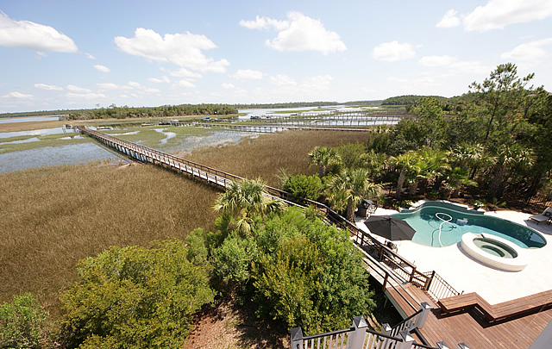
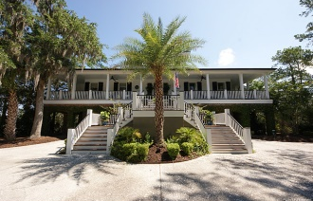
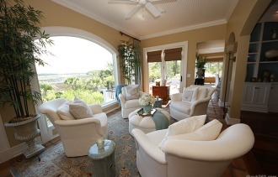
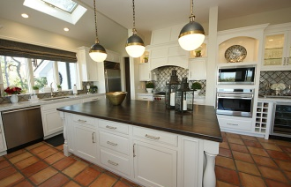
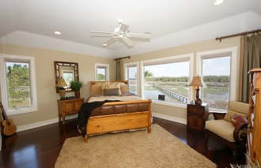
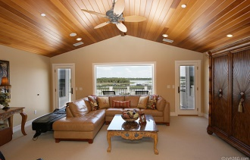
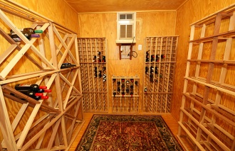
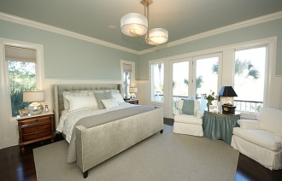
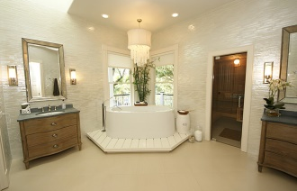
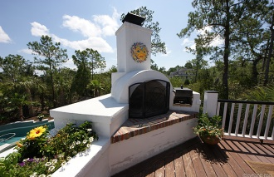
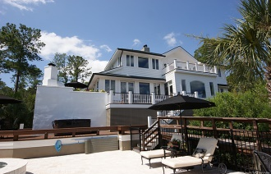
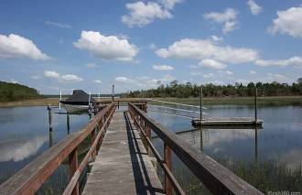


2446 Brick Landing Court
Dunes West ~ Mount Pleasant
MLS# 15000867 ~ $1,847,000
Property like this rarely becomes available!
You will instantly fall in love with the views the moment you walk up to the front door, where you can see straight through to the Wando River and marshes. As you enter, you will continue to be impressed with the high-end finishes throughout. Views are spectacular from EVERY room in this fabulous Executive home. A stunning kitchen with wood-burning fireplace, includes Wolf Range, Subzero fridge, and custom handmade backsplash tiles finish off this beautiful kitchen. Master bath has heated floors, sauna, steam shower, and Maestro tub, along with breathtaking, floor-to-ceiling Italian glass tile. Additional features include wine cellar, custom garage doors, Carolina Lanterns... Too much to list. It doesn't get any better! Schedule a showing today!
Gatehouse Realty, LLC 708 S. Shelmore Blvd, Ste. 102 Mt. Pleasant, SC 29464
Robin Iriart
M 843-568-7720
Rickrobin@comcast.net

