Slide 1
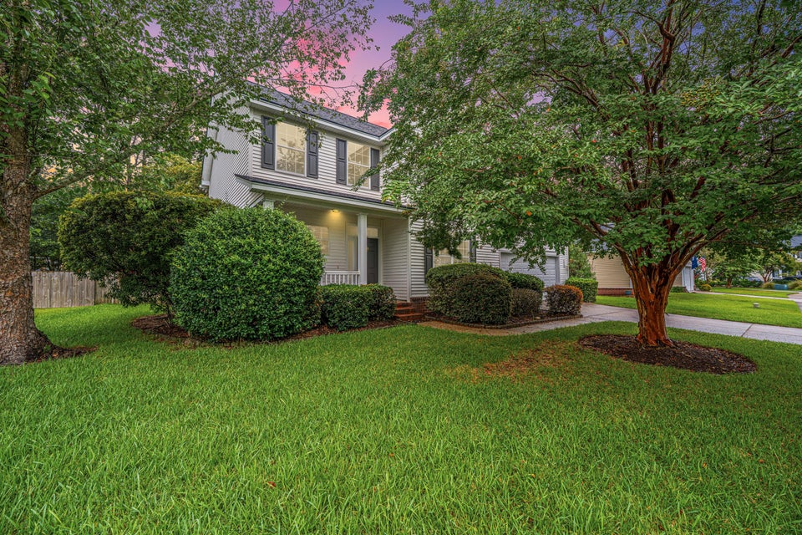
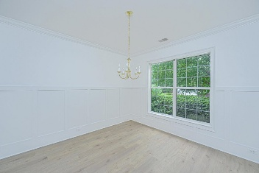
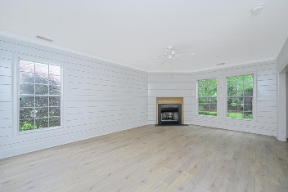
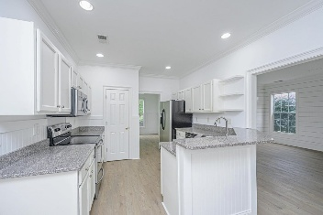
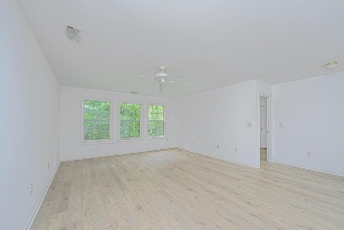
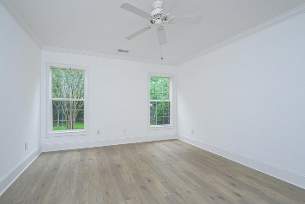

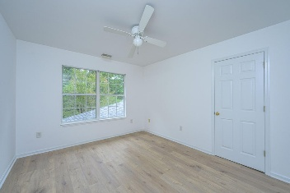
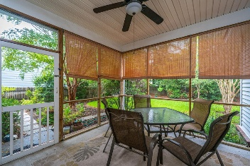
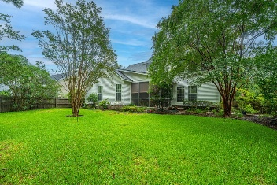


2448 Bergeron Way
Planters Pointe | Mt Pleasant, SC 29466
MLS# 25025028 | $749,250
OPEN HOUSE SATURDAY 1-3
PRICE ADJUSTMENT!
Welcome to this freshly updated 3-bedroom, 2.5-bath home located in the highly desirable Planters Pointe community of Mount Pleasant. Thoughtfully refreshed with new interior paint and custom shiplap accents, this home blends timeless charm with modern appeal. The spacious first-floor primary suite is a true retreat, featuring dual walk-in closets and a well-appointed en-suite bathroom. The open concept main living area is filled with natural light and offers a warm, welcoming space for entertaining or relaxing. Upstairs, you'll find a huge loft. Ideal as a second living area, home office or playroom, plus a generously sized FROG (finished room over garage) that provides excellent flexibility as a media room, guest space or home gym.
Step outside to enjoy a fully fenced backyard, perfect for kids, pets and outdoor gatherings. Located on a quiet street within one of Mount Pleasant's most family-friendly neighborhoods, this home is just minutes from top-rated schools, shopping, dining and Isle of Palms beach. Planters Pointe offers fabulous amenities including a clubhouse, community pool, tennis courts, walking trails, and playgrounds. This move in ready home is a must see! Schedule your private showing today.
Scan for a virtual walkthrough!
Suzi Baldrick
Mobile 843-442-3149
suzi.baldrick@carolinaone.com
Carolina One Real Estate
1503 Palm Blvd
Isle of Palms, SC 29451-2280

