Slide 1
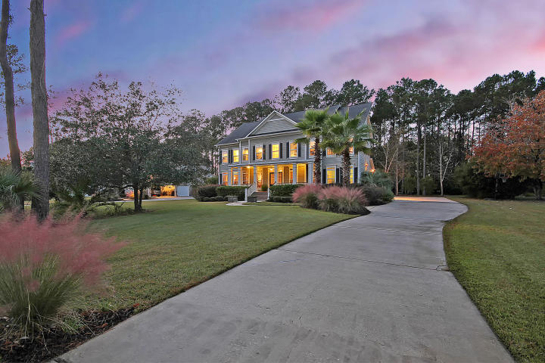
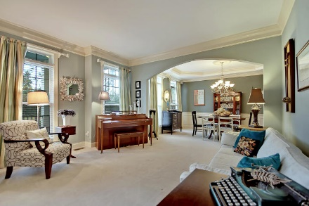
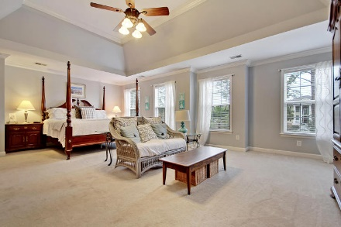
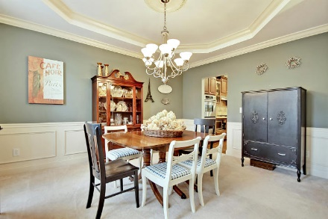
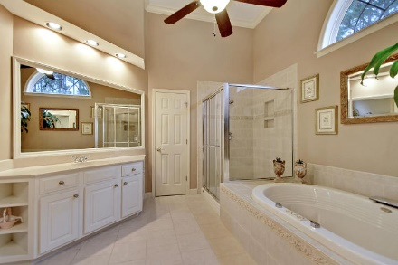
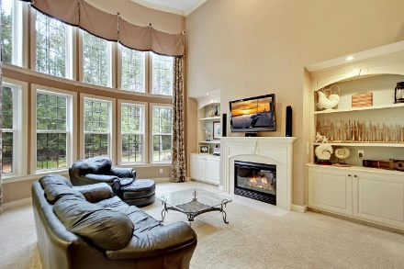
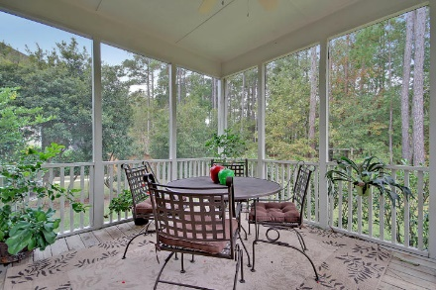
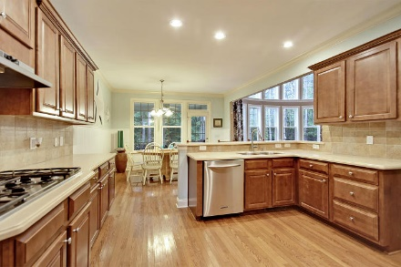
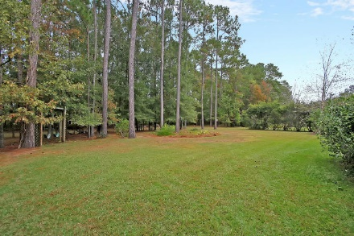
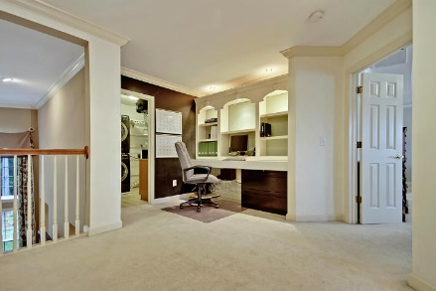
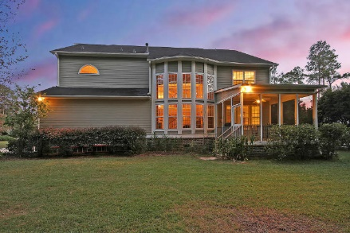
Price Reduced!
Sellers Are Offering A $12,000 Buyer Allowance
At Closing To Go Towards Buyers Choice Of Upgrades/Updates.
2449 Darts Cove Way
Dunes West ~ Mount Pleasant, SC 29466 ~ MLS# 17031733 ~ $715,000
Spacious and beautiful are two words that will continually come to mind when you view this stunning two story home in the gated community of Dunes West. The front yard, the back yard, the master bedroom, the finished space & storage space on the third level, the three car garage, all these spaces are large! The welcoming front porch, the soaring ceilings in the 2 story family room with its floor to ceiling windows, the eat-in kitchen, formal dining room & first floor guest suite are all beautiful components of this house that make it a home & provide you with several WOW moments when touring the residence. It'll be very easy to envision family & friends comfortably gathering here. Don't forget to take advantage of the community's world class amenities that make home seem like vacation!
Additional features include:
Hardwood floors and crown molding
Two-story foyer
Spacious kitchen has stainless steel KitchenAid appliances, abundant counter and cabinet space, a tile backsplash, a custom pantry, breakfast bar and a lovely eat-in area with access to the screened-in porch
Family room has a fireplace and built-ins and 18 foot windows
First floor bedroom with en suite bath
Library with built-in shelving
Formal living room
Dining room with tray ceiling and wainscotting
Master bedroom has a double-door entry, tray ceilings, a seating area, two walk-in closets and en-suite bath with dual vanities, and Jacuzzi tub and walk-in shower
Loft with built-in desk and shelving on second floor
Three bedrooms with en suite bathrooms are located on the second floor
Second floor laundry room
Third floor has a large finished space, and the attic space could potentially be expanded
35 windows for lots of natural light, and each door, window and transom has custom UV coatings for UV protections and increased energy efficiency
Insulated garage doors
Private and spacious backyard
Dehumidifier for all three levels
Nate Gainey nate@mattoneillteam.com 843-513-2038

