Slide 1
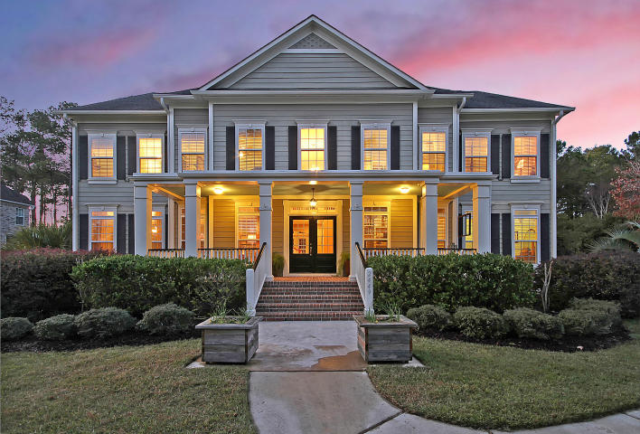
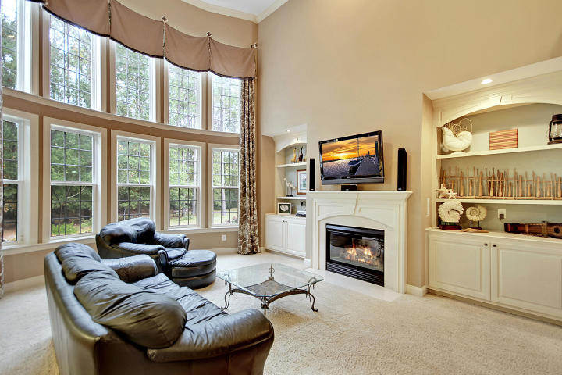
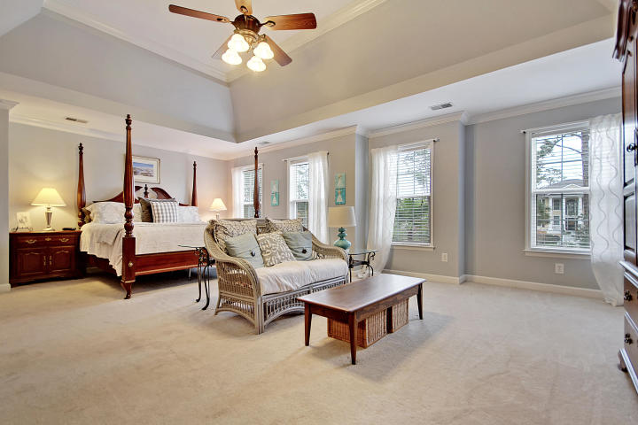
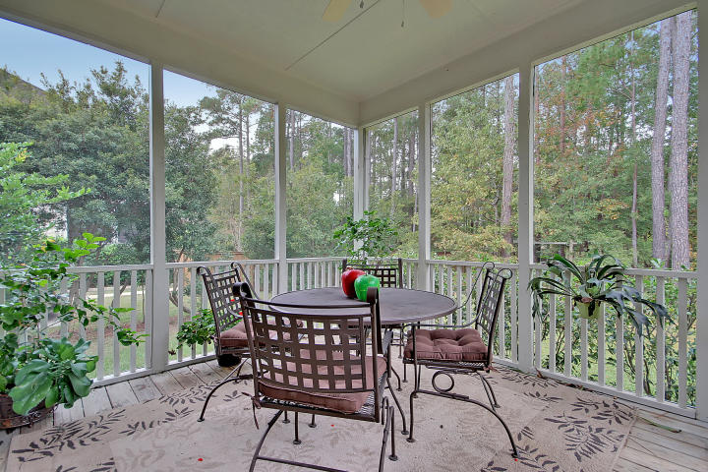
Price Reduced in Dunes West! New A/C Units With Nest Controllers PLUS a 10 Year Warranty
Spacious &
Beautiful
2449 Darts Cove Way Dunes West ~ Mount Pleasant, SC 29466 ~ MLS# 17031733 ~ $675,000
Stunning two story home in the gated community of Dunes West. The front yard, the back yard, the master bedroom, the finished space & storage space on the third level, the three car garage, all these spaces are large! It'll be very easy to envision family & friends comfortably gathering here.
Nate Gainey nate@mattoneillteam.com 843-513-2038

