Slide 1
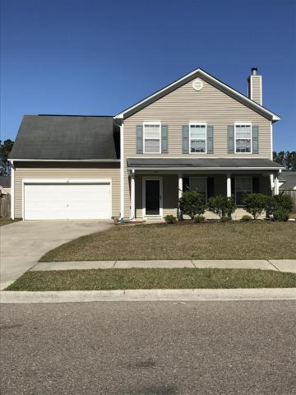
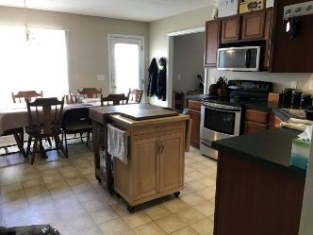
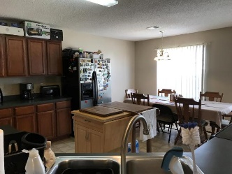
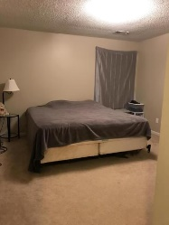
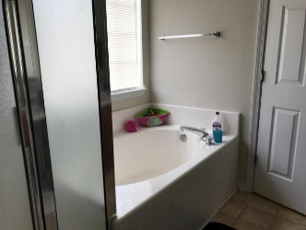
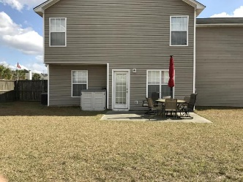


Just Reduced in Berkeley Commons
244 Dunning Road
Summerville, SC 29486 ~ MLS# 17005231 ~ $225,000
Great traditional home with a full front porch situated on a large well maintained corner lot. Enter from the foyer to a flowing floor plan opening to a large family room with fireplace, adjoining to the formal dining. All stainless steel appliances in the over sized kitchen with separate eating area, it also offers a pass through to the family room. Enjoy the large back yard with a patio and privacy fence. The downstairs is completed with a laundry room and a powder room. Upstairs offers a center hall floor plan with a loft/nook area. The large master bedroom and bath offers a walk in closet and separate garden tub and shower. There are two other generous sized bedrooms and an enormous FROG that can be used as the fourth bedroom (has deep storage space, no closet). The Frog offers great flexibility for a bedroom, office, second family room, exercise room etc... Lots of closet and storage space throughout. Centrally located with easy access to I-26 and Hwy 176, Historic downtown Summerville, shopping, dining and entertainment. A must see!
Jacqui Swain
O (843) 871-1710 | M (843) 295-9484
jacquiswainc21@gmail.com
www.JacquiSwain.c21.com
Century 21 Expert Advisors | 100 Seven Oaks Lane | Summerville, SC 29485

