Slide 1
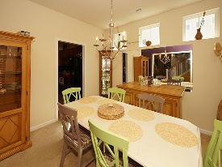
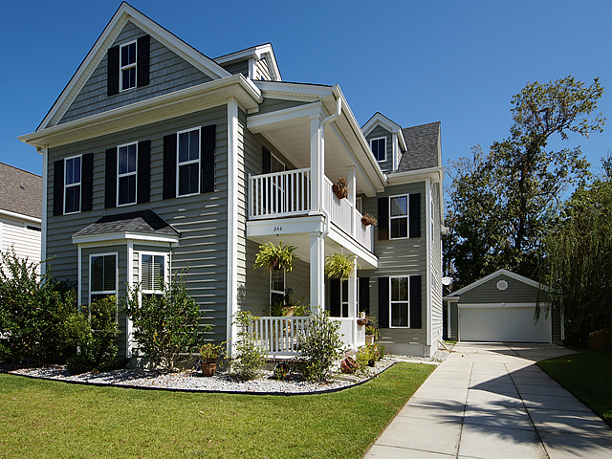
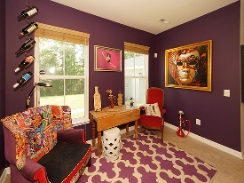
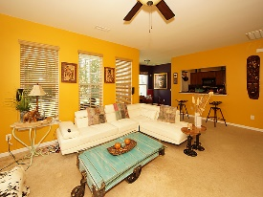
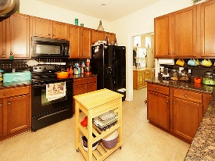
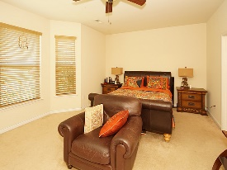
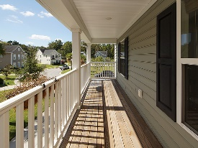
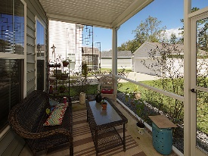

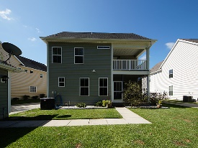

Inviting Charleston Single-Style Home
244 Old Savannah Dr
Liberty Hall Plantation
Goose Creek, SC 29445
Open House Canceled!
Under Contract In 3 Days!
MLS# 17026414
$249,900
4 Bed / 3½ Bath
This inviting Charleston Single-style home is nestled on a quiet cul de sac. The lot backs up to a wooded area, for added privacy. The extra-long driveway and detached garage give you plenty of space for parking and storage. The dual-piazzas welcome you home and are a great place for your rocking chairs. As you enter, you'll be greeted by 9-ft smooth ceilings and a spacious open floor plan, with lots of natural light. The formal dining room is perfect for entertaining and family dinners. The spacious first-floor master bedroom features a walk-in closet and a nice en-suite, with a garden tub and a separate shower. The large upstairs loft, with outside access to the upstairs porch, would make an excellent game room or entertainment room. The screened-in back porch and fenced-in backyard will be perfect for grilling out, entertaining, or watching the kids play. You'll appreciate neighborhood amenities, including a community pool and play park. Conveniently located near shopping, dining, and the interstate. Come see your new home, today!
Connie White, Broker
843-532-3356 · conniesyouragent@gmail.com
Charleston Homes · 597 Old Mt. Holly Road · Suite 301 · Goose Creek, SC 29445

