Slide 1
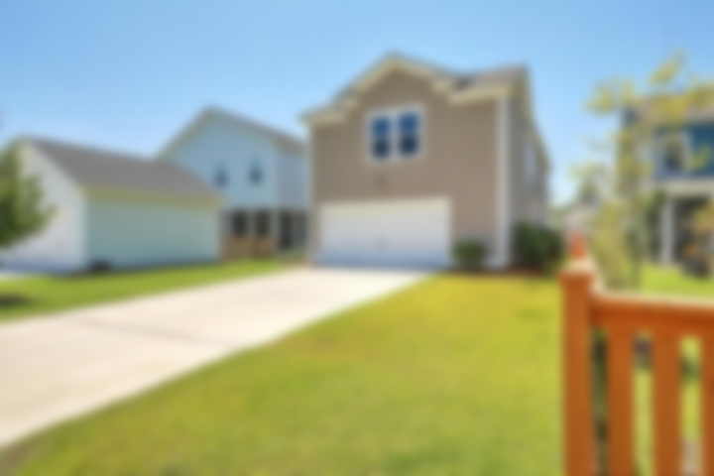
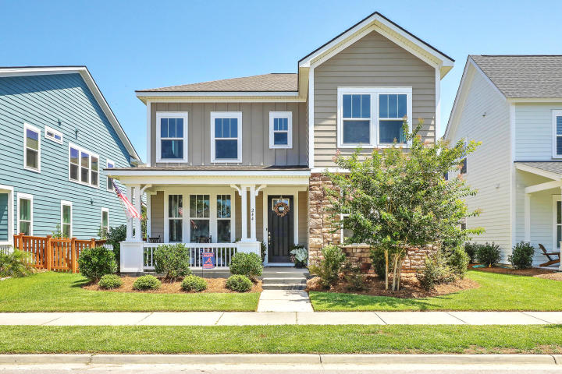
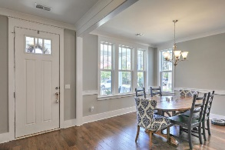
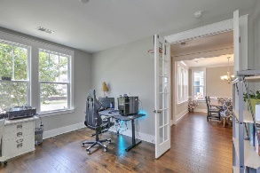
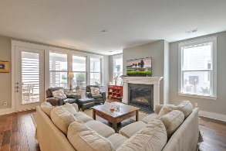
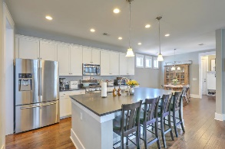
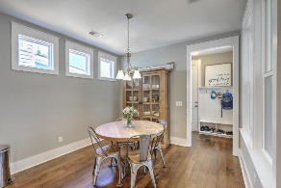
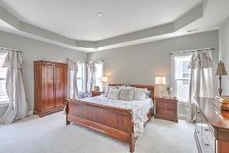
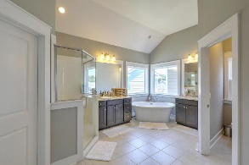
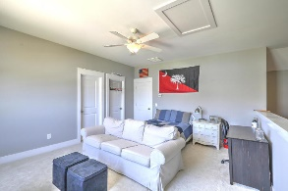
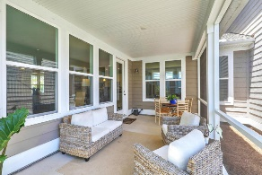
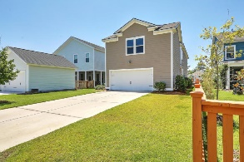
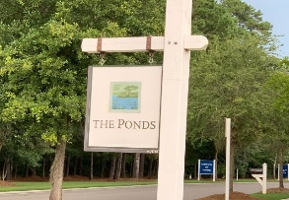

244 Ribbon Road
The Ponds ~ Summerville, SC 29483
MLS# 19019158 ~ $360,000
Welcome Home!
This beautiful house is located in the coveted Ponds neighborhood and Dorchester District 2 school district! Upon entering the home via the lovely, spacious front porch you are greeted to your right by french doors leading to an office (or bedroom) complete with a closet. To your left is a large formal dining area leading to a butlers pantry and WALK IN food pantry. Then you make your way to a large open kitchen/living area. The kitchen includes an eat-in area, recessed lighting, granite counter tops, stainless steel appliances, and gas range/oven. Enjoy the gas fireplace and abundant natural lighting in the living area or move out to the sizeable screened in back porch. Completing the downstairs area is a two car garage with plenty of storage area.
Located above the garage is a roomy loft area, complete with large storage closet and full bath. The upstairs features 2 ample bedrooms, full bath, and laundry room. One of the jewels of the home is the beautiful, inviting master suite. The suite offers a large bedroom area (with tray ceilings), DUAL walk-in closets, and breathtaking bathroom area. French doors separate the bathroom area, allowing you to soak and relax in the large garden tub or enjoy a hot, private shower.
Enjoy the low maintenance, well landscaped yard or take a walk/bike ride through the beautiful neighborhood. The neighborhood also offers miles of beautiful walking trails, ponds for kayaking or fishing, amenities center, neighborhood parks, and beach entry pool. There is also a YMCA on site with memberships available. Come see this gem today, it will not last long!
Chris Phillips
(843) 446-9199
chris.phillips@cbcarolinas.com
www. cbcarolinas.com
Coldwell Banker Residential Brokerage
4969 Centre Pointe Dr
Suite 203
Charleston, SC 29418

