Slide 1
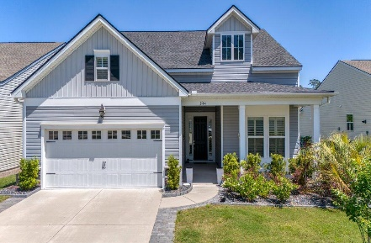
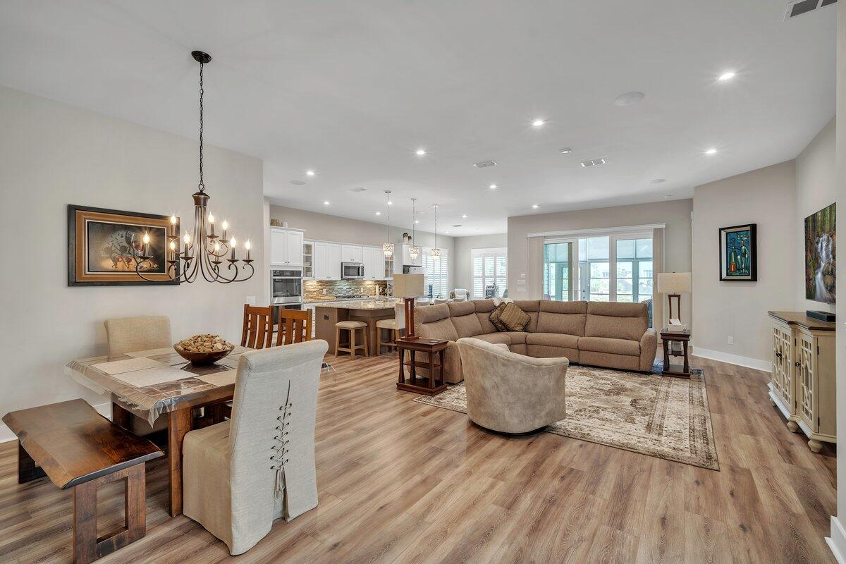
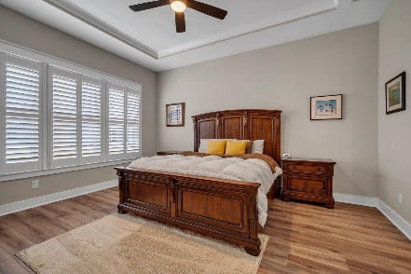
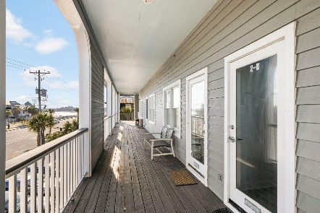
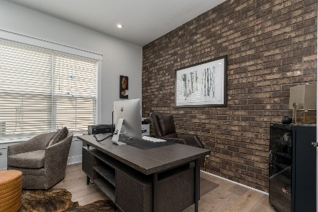
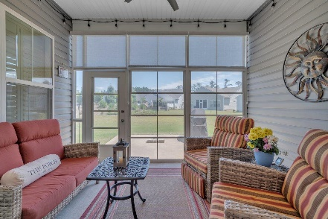
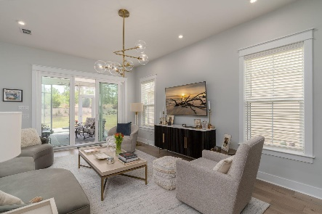
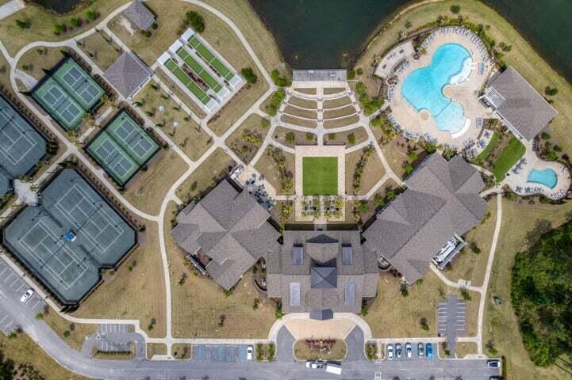

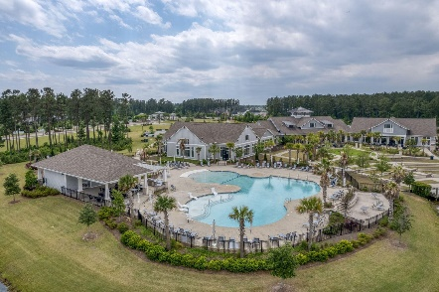
244 Tupelo Lake Drive Cane Bay Plantation | Summerville, SC 29486 | MLS# 24010270 | $627,000
Darrell Creek Elevated Home With Elevator & Salt Pool
$1500 AGENT BONUS & $10,000 PRICE IMPROVEMENT
3 Bed | 3 Bath | 2,725 SF
Co-sponsored by
Offering $3000
Lender Credit
Welcome home to 244 Tupelo Lake Drive, nestled in the serene Four Seasons community, where lakefront living meets comfort and elegance. This popular 3-Bedroom, 3-Bath Ibiza Loft Floorplan has it all, including an Office, Additional Storage Room, and Capacious Loft. As you step inside, the first thing you will notice is NO CARPET! This home has LVP flooring throughout, creating a seamless flow and easy maintenance. To your right is the Office, Guest Bedroom and Bathroom. It then opens up to a spacious and bright open Dining and Living Area. The heart of this home is the Gourmet Kitchen with a magnificent 12-foot granite island, perfect for culinary enthusiasts and entertaining guests alike. Also, to be noted is the double oven, upgraded tile backsplash, gas cooktop, and breakfast nook.
The Master Suite is a true Retreat with tray ceilings, a Spa-Like en-suite Bathroom to relax and rejuvenate in, and large, luxurious walk-in closet. Step into your dream laundry room - spacious, functional, and fun. Ample cabinets provide plenty of storage for all your essentials, keeping everything neatly organized. Travel upstairs to the super spacious Loft, with its own Guest Bedroom, Full Bathroom, and Living Space. One thing this home is not lacking is storage! Don't miss the Walk-In Storage Space above the Garage, which could also serve as a great workshop, sewing room, or even a 4th Bedroom! Additional upgrades to be noted are plantation shutters for elegance and privacy, a surround sound stereo system for premium entertainment, upgraded lighting and ceiling fans for comfort and energy efficiency, vinyl windows on the back porch for durability and easy maintenance, and meticulously upgraded landscaping for added curb appeal.
In Four Seasons you will never be bored, as this is the only Active Adult Community in the area that is built around a 300-acre lake with its own private boat dock! Other amazing amenities include an indoor and outdoor pool, fitness center, dog park, bocce, pickleball, tennis courts, a kayak launch and so much more! There is also a packed monthly events calendar and Full-time Lifestyle Director. Once you move to the Four Seasons, you will never want to leave! And this home is the perfect way to retire in LUXURY! Also available is a $3000 Lender Credit from the Preferred Lender.
Call for your showing today, this true gem of home a home will not last long!
*** $1500 Agent Bonus is with an acceptable offer by 6/1 ***
House Tour | Amenity Tour
Elissa Campbell
843-853-1433 | elissa.campbell@agentownedrealty.com
AgentOwned Realty Preferred Group | 824 Johnnie Dodds Blvd | Mt Pleasant, SC 29464

