Slide 1
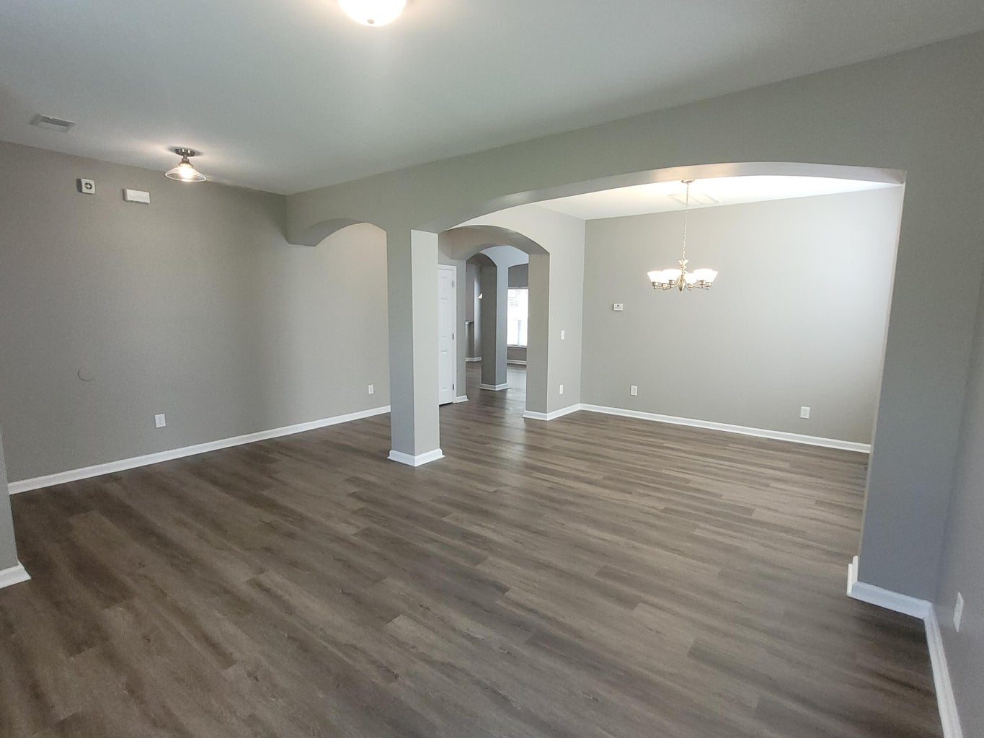
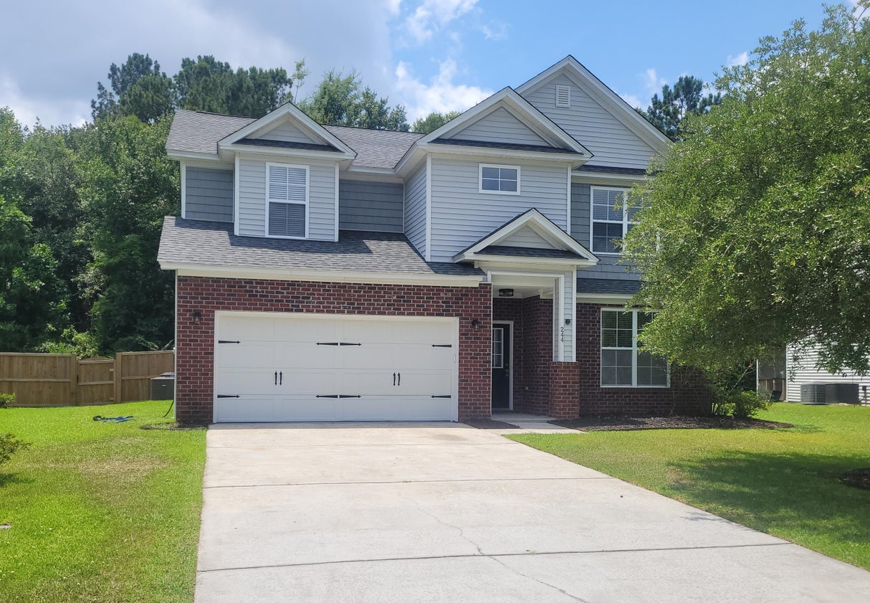
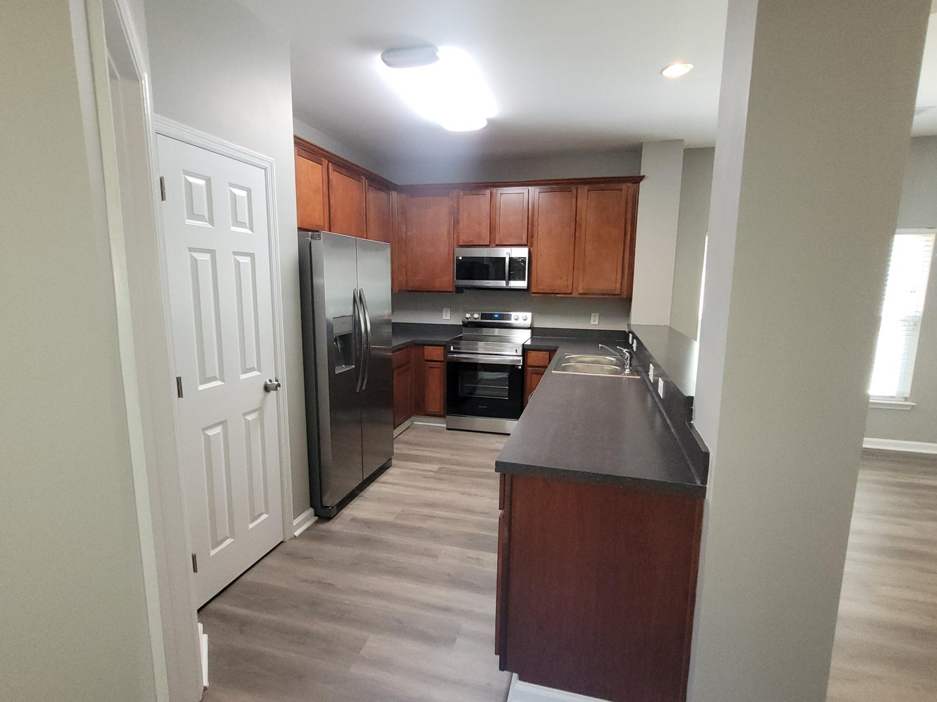
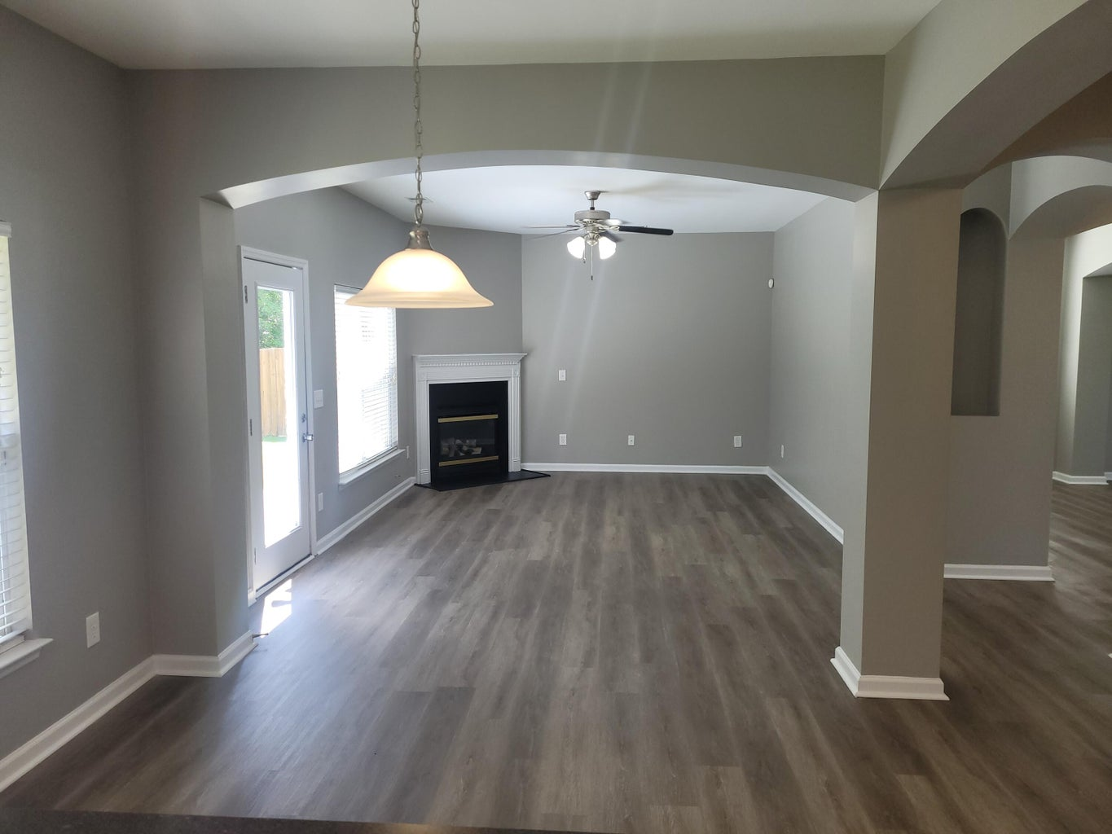
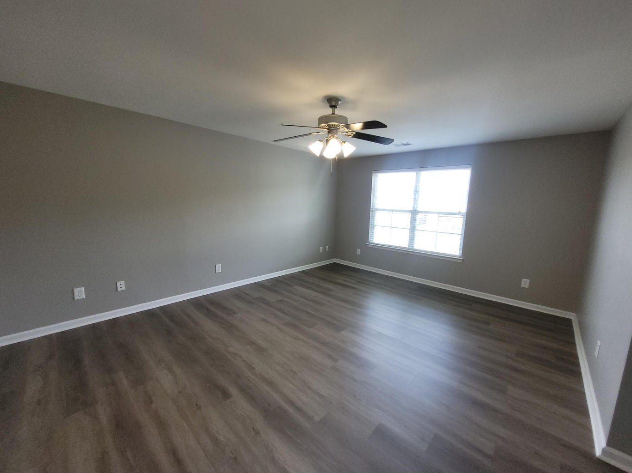
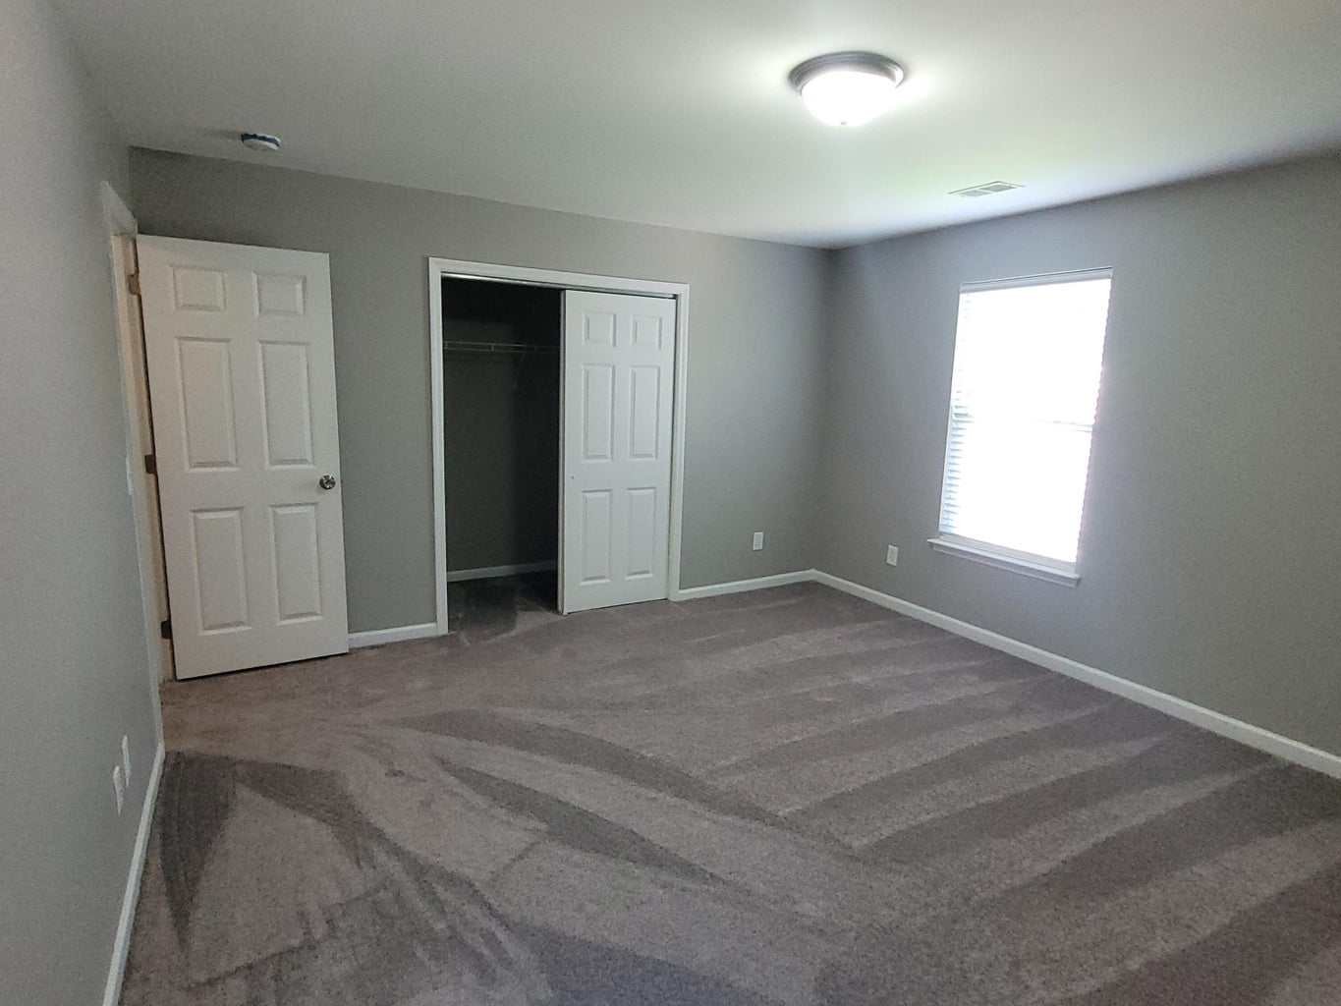
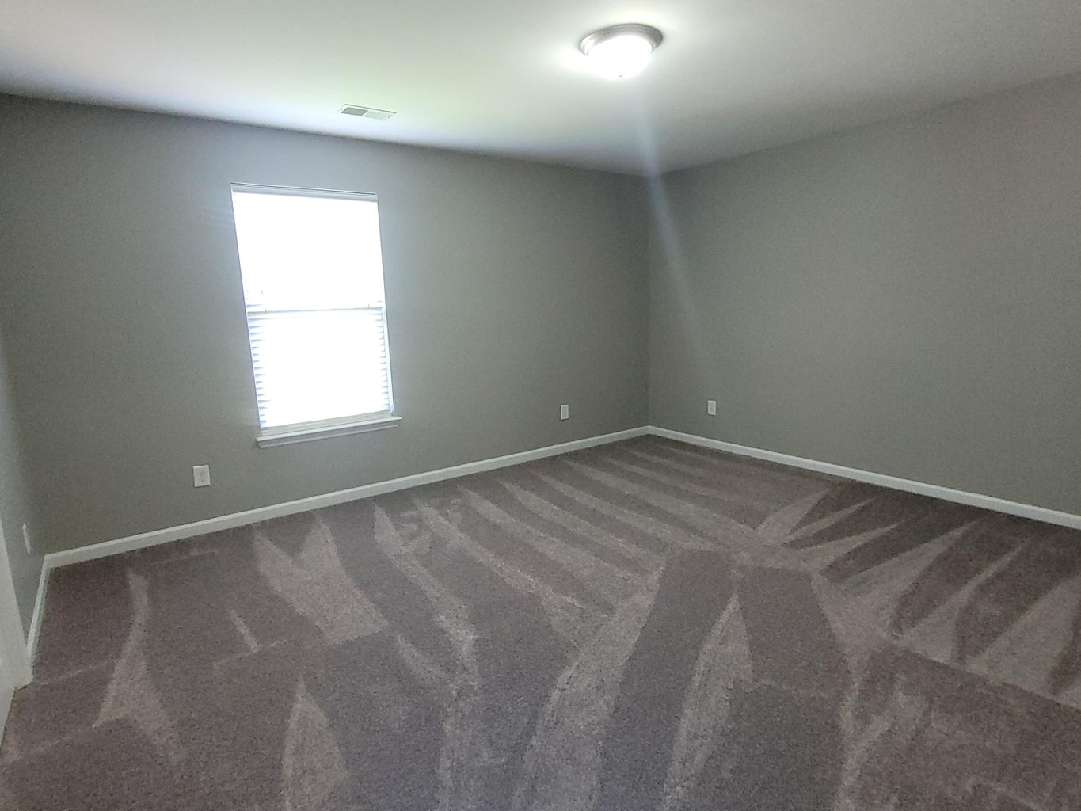
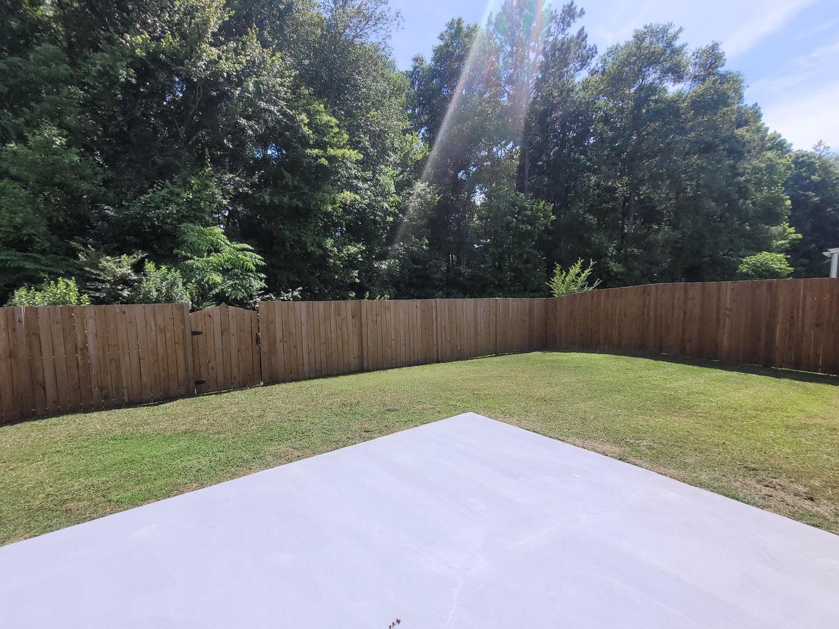
SELLER OFFERING $15K BUYER INCENTIVE!
244 Westbrooke Road
Felder Creek | Summerville, SC 29486 | MLS# 24013925 | $374,899
Buyer can use incentive however they like
Pay closing costs
Buy down the rate
Get a rate as low as 5.75% with FHA financing
No money down options with
VA and USDA financing
Beautiful home with 4 bedrooms and 2.5 baths over 2500 sq ft
Best priced house in Felder Creek at $374,900
Move in ready
New roof
New LVP flooring and carpet throughout
New hot water heater
New appliances
Privacy fence
Easy commute with less than 1.5 miles to I-26
Close to restaurants, shopping and Cane Bay schools
Dora L McGillis
843-343-5012
doramcgillis@hotmail.com
www.hbrtwn.com
Harbourtowne Real Estate
672 Marina Drive, Ste 110
Daniel Island, SC 29492
Harbourtowne Real Estate | 672 Marina Drive, Ste 110 | Daniel Island, SC 29492

