Slide 1
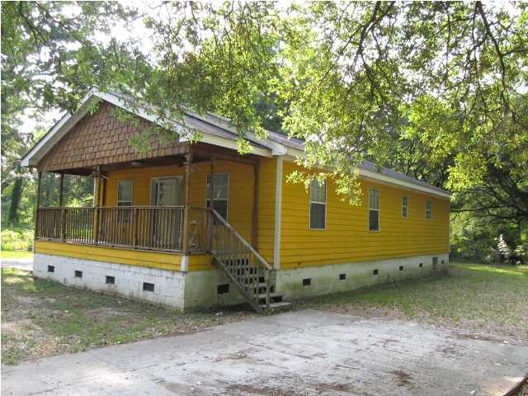
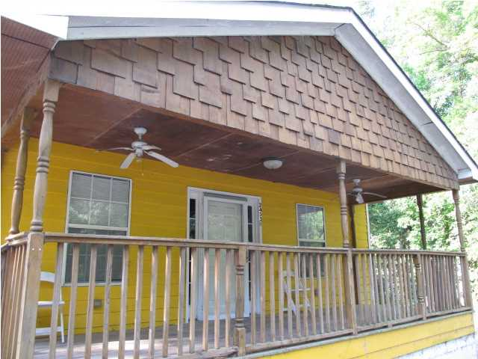
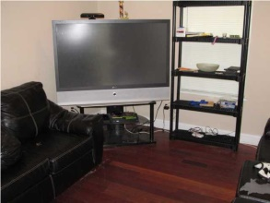
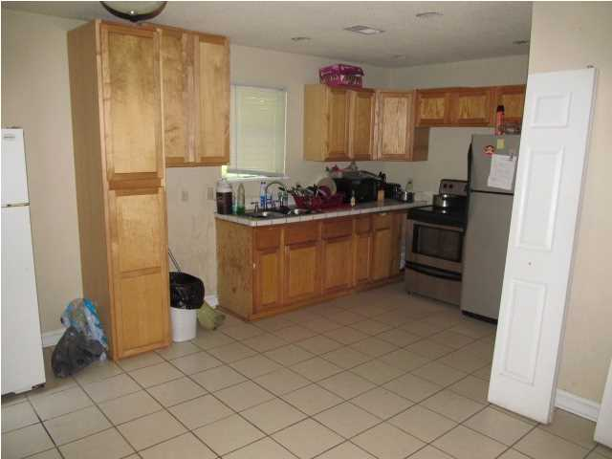
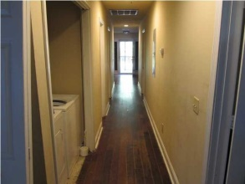
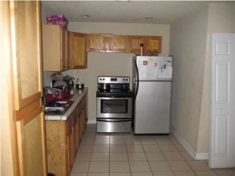
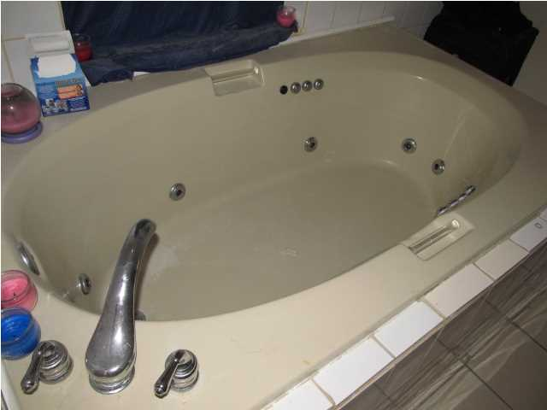
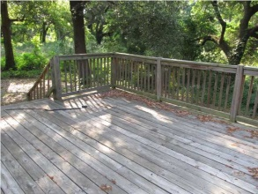
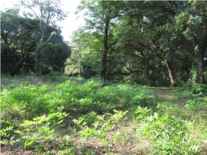
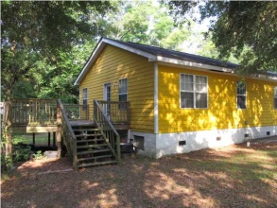
A must see!
2453 Taylor St
Liberty Park
North Charleston, SC
MLS# 1415514
$109,000
Custom built home in quiet neighborhood on large wooded lot.
Hardi plank siding. 17'x15' deck in the back.
Cedar shake shingles on front porch with ceiling fans.
Hardwood floors throughout.
Dark Oak, Brazilian Cherry, and Bamboo.
Living Room is very spacious with great natural lighting.
Stainless steel appliances.
Kitchen has tile.
Master bedroom has 2 walk-in closets.
Master bath has jetted tub and separate shower.
Lots of storage space.
David Hickman | 843.505.0456 | davidisyouragent@gmail.com | www.omnicarolinarealestate.com
Omni Carolina Real Estate | 126 Eston Dr | Goose Creek, SC 29445

