Slide 1
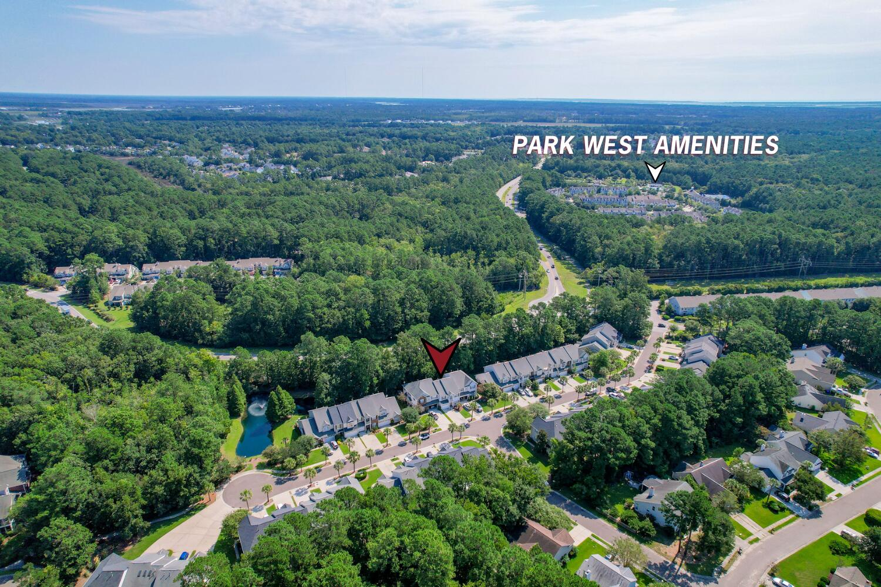



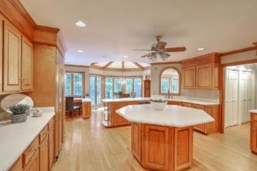
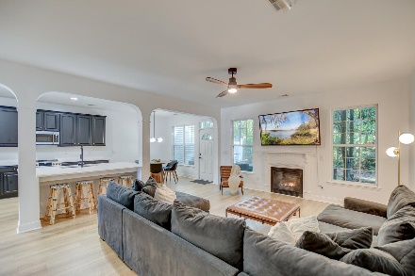



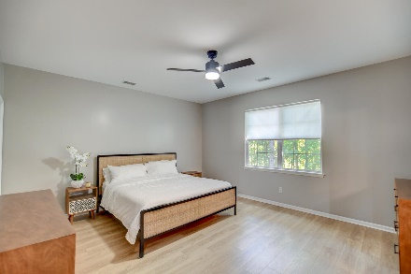

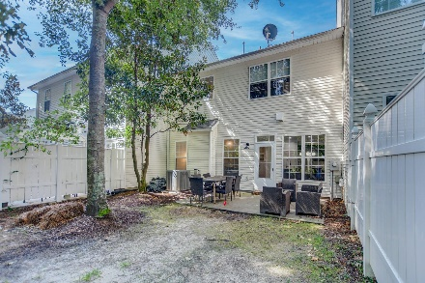
Parkshore Marshfront
Back on the Market!
2455 Draymohr Court
Park West | Mount Pleasant, SC 29466 | MLS# 23022223 | $550,000
Welcome to Keswick in Park West - where luxury living meets contemporary elegance. Nestled in the heart of this prestigious community, this beautiful townhouse exudes sophistication and charm. As you step inside, you'll be greeted by new LVP flooring and an abundance of natural light that bathes every corner, creating an inviting and airy ambiance. The family room, adorned with a cozy fireplace, provides the perfect setting to unwind after a long day. Large windows frame picturesque views of the meticulously landscaped backyard, bringing the outdoors in. The built-in shelving and cabinets add a touch of convenience and style. The seamless flow from the family room to the dining area and the stunning kitchen is ideal for both intimate dinners and entertaining guests.
The newly updated kitchen is a masterpiece, boasting striking cabinetry that complements the gleaming quartz countertops and backsplash. New Cafe appliances including a range, dishwasher, and microwave gleam beneath the soft lighting, making every culinary endeavor a delight. A pantry ensures ample storage, while the farmhouse sink and island with a breakfast bar redefine functionality and elegance. The first floor offers versatility with a bedroom/flex space, providing options for a home office, guest room, or additional living area. A thoughtfully designed powder room completes the convenience of this level. Retreat to the upper floor, where the spacious owner's suite awaits. The walk-in closet caters to your storage needs, while the ensuite bath is a sanctuary of relaxation. Pamper yourself in the dual sink corner vanity, rejuvenate in the step-in shower, or indulge in a soothing soak in the luxurious tub.
Two additional bedrooms offer comfort and style, with one bedroom featuring private access to a serene balcony. A full bathroom on this floor ensures that every family member or guest enjoys their own personal space. The stairway also features new seagrass carpeting. The outdoor haven is a true gem, surrounded by a fenced backyard adorned with mature trees that provide both shade and privacy. Whether you're enjoying a lazy afternoon on the roomy patio or taking in the serenity of the surroundings, this backyard offers a seamless blend of nature and comfort. Additional noteworthy features include new light fixtures, ceiling fans in every room, and fresh interior paint.
Park West has great amenities including a swimming pools, tennis courts, playgrounds, and walking trails.Here you are just 1.6 miles from shopping and restaurants, 5.7 miles from Mt Pleasant Towne Centre, 9.4 miles from Isle of Palms, and 12.7 miles from Downtown Charleston. Keswick in Park West embodies luxury living at its finest, and this townhouse is the epitome of modern refinement. With its impeccable design, thoughtful features, and premium finishes, this property offers a lifestyle of unparalleled beauty and comfort. Don't miss the opportunity to make this exquisite residence your own.
Alysbel Tescaritt-Jimenez atescaritt@mattoneillteam.com 305-606-1482

