Slide 1
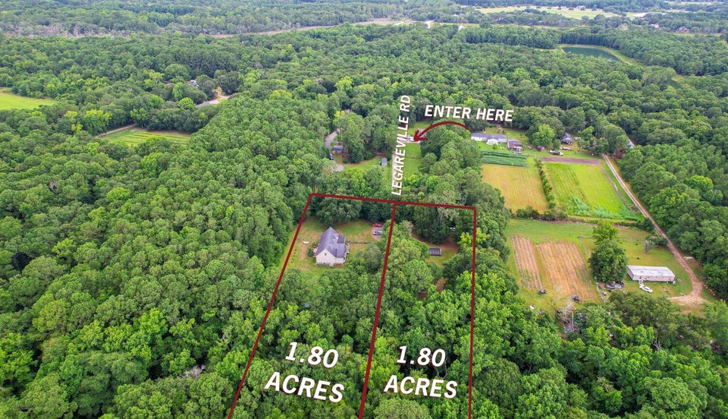


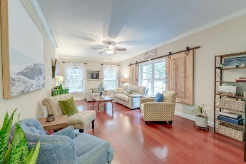
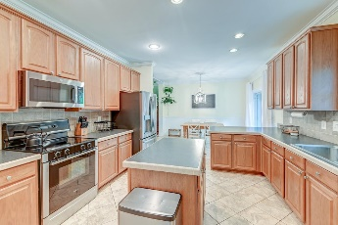
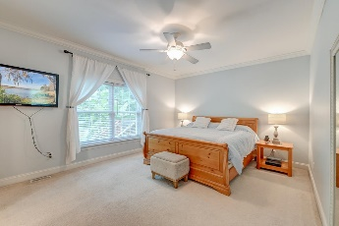
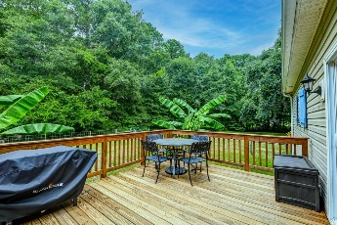
Quiet Secluded Charm
2457/2458 Audette Avenue
Johns Island, SC 29455 ~ MLS# 24018856 ~ $1,020,000
Nestled in a serene, wooded enclave on Johns Island, this enchanting home and lot offers the space, tranquility, and upgrades you've been longing for. As you approach, you're greeted by a sprawling property adorned with majestic trees and a lush, natural setting. The charm of this residence is evident, with its vibrant plants, flowers, and an inviting large front porch perfect for soaking in the picturesque views. Step inside, and you're welcomed by gleaming engineered hardwood cherry flooring, elegant crown molding, an open floor plan, and an abundance of natural light. The living room is a radiant haven, bathed in sunlight. Journey further to discover the eat-in kitchen, a culinary dream with new stainless steel appliances, a stylish backsplash, ample cabinetry, a center island, and a breakfast bar with seating. The adjacent dining area opens to the new large deck and the stunning backyard, perfect for entertaining or quiet relaxation. The main level primary bedroom is a spacious retreat featuring a walk-in closet and a barn door leading to an en suite bath with a dual sink vanity and a large step-in shower. Two additional spacious bedrooms, a full bathroom, a laundry room, and a powder room complete the main level. Upstairs you'll find updated luxury vinyl plank flooring, two more bedrooms, and a beautifully appointed bathroom with a step-in shower. A huge newly converted 1319 sq ft bonus room/in-law suite, complete with a kitchenette, offers endless possibilities and can be accessed from inside the home or a separate exterior entrance. Additional noteworthy features include a fully encapsulated crawlspace, 2x6 framing, and a commercial grade tankless water heater.
Perfectly positioned just 9 miles from Freshfields Village, 11.3 miles from Beachwalker Park, and 14.4 miles from downtown Charleston, this home is a rare find. Don't miss the chance to make it yours.
*TMS #2610000066 and 2610000067 included in sale
Verna Bunao-Weeks verna@mattoneillteam.com 843-364-2447

