Slide 1
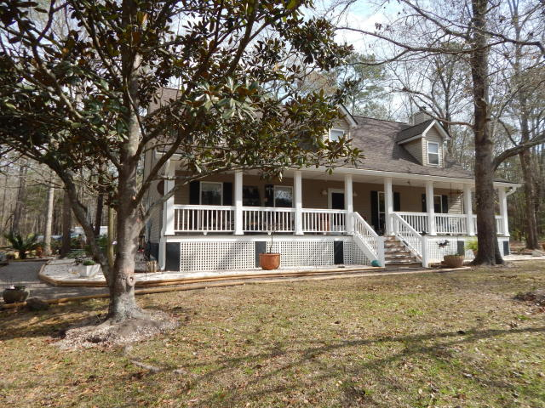
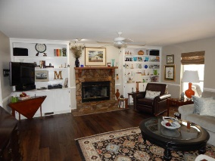
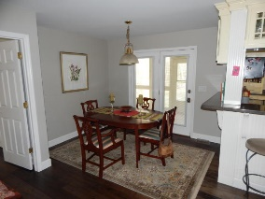
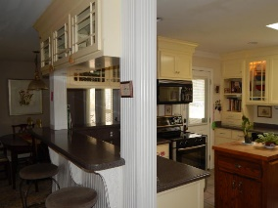
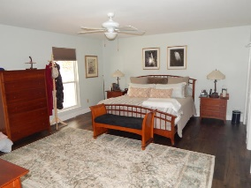
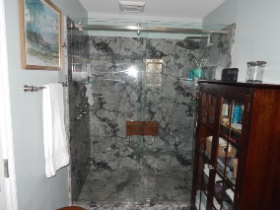
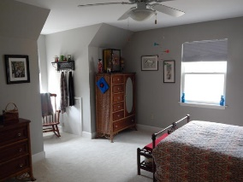
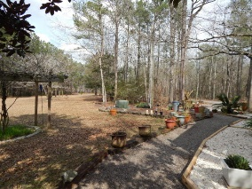
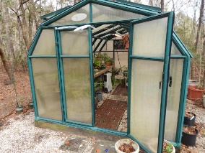
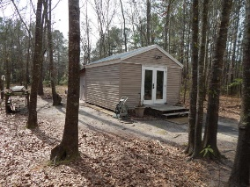
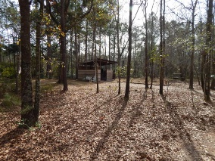

245 Kingrail Lane
Wisboo Hall
Huger, SC 29450
MLS# 17003507
$547,000
Live in beautiful Wisboo Hall with acreage, horses allowed, and adjacent to the National Forest. Completely remodeled and 1st floor Master! Below Appraised Value!
New Price! This is a beautiful, quiet slice of Heaven in the country, yet within ten minutes of Mt. Pleasant. The home has had extensive remodeling, including new bathrooms and new flooring. Sit by the fireplace on chilly evenings. There is a lovely landscaped yard and entrance way. The property is over five acres and has a two stall run-in barn and small pasture for horses. Horses are allowed. The rear entrance has a screen porch. There is a small separate storage building, a greenhouse and a small creek behind the property. There is access to The Francis Marion National Forest for trail riding, hiking and bird watching. The property has a wooded buffer surrounding it for privacy and there is excellent space between neighbors. Please Have your Realtor make an appointment.
Carolina One Real Estate
2713 Highway 17 North
Mt. Pleasant, SC 29466
Terry Hamlin
(843) 830-3946
terry@thamlinproperties.com

