Slide 1
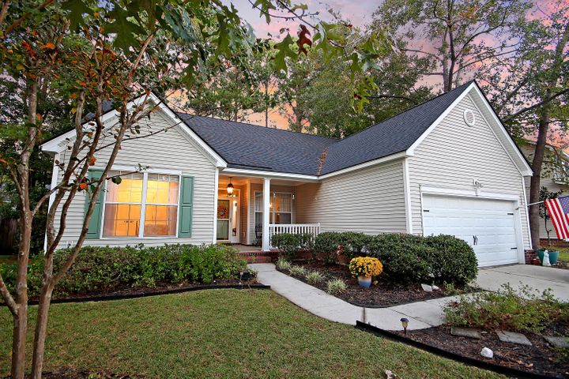

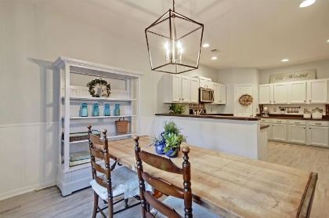
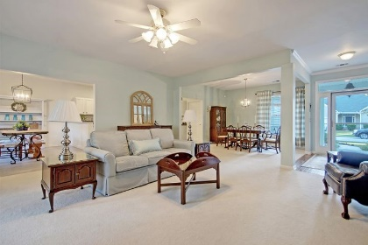
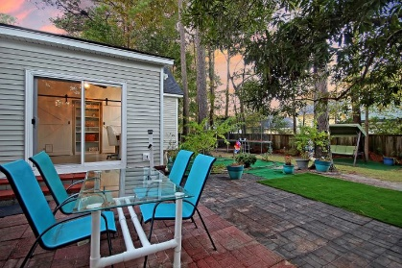
PRICE REDUCED!
Close to Shopping
Dining, & Area Beaches
2460 Bergeron Way
Planters Pointe ~ Mount Pleasant, SC 29466 ~ MLS# 20031216 ~ $424,900
This beautiful Mt Pleasant home is an absolute must see! Impeccably maintained, the home offers tons of beautiful updates & a spacious open concept floorplan. Step into the gorgeous, bright & airy living room & separate dining area. The large & updated kitchen features lots of storage, bar seating, a gas range, & a walk-in pantry. It flows into the eat-in kitchen area & features new waterproof vinyl flooring. At the back of the home is an updated sunroom/office. Custom cabinetry with barn doors have been added for even more storage! A large picture window looks out to the spacious fenced backyard with a patio area & lovely, mature trees. The owner's suite is separate from the other two bedrooms and has a walk-in closet, and the en-suite is equipped with dual vanity, a large soaking tub, and a separate shower. The additional two bedrooms offer plenty of space and share a full bathroom. The incredible amenities include a swimming pool, tennis court, basketball court, playpark, and clubhouse. This amazing property is located close to shopping, dining, area beaches, and downtown Charleston. Come by today!
Nate Gainey 843-513-2038
nate@mattoneillteam.com
Christopher Smith 843-267-0735
christopher@mattoneillteam.com

