Slide 1
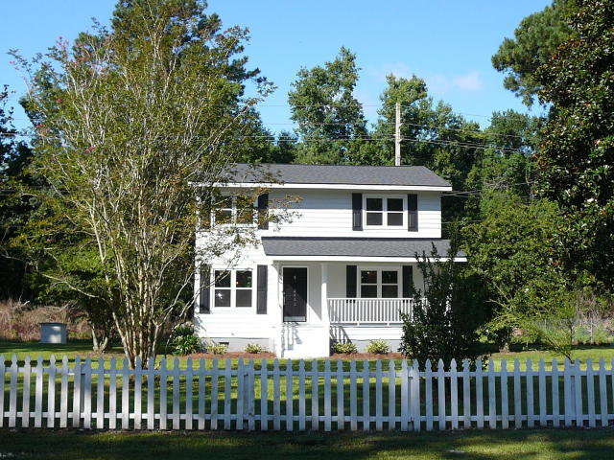
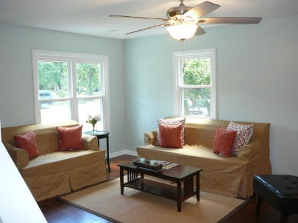
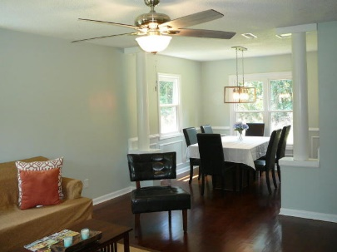
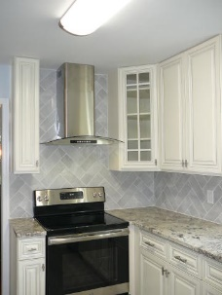
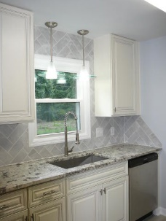
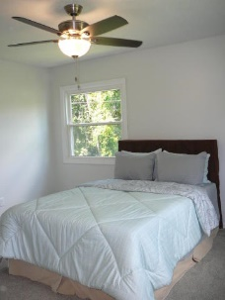
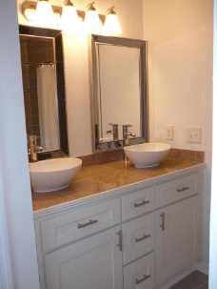
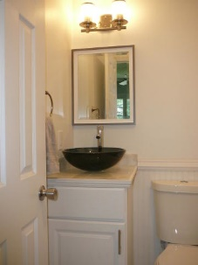
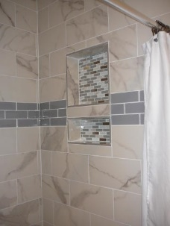
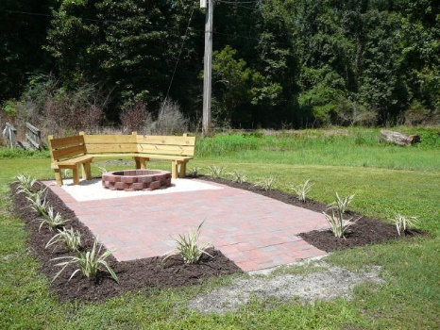
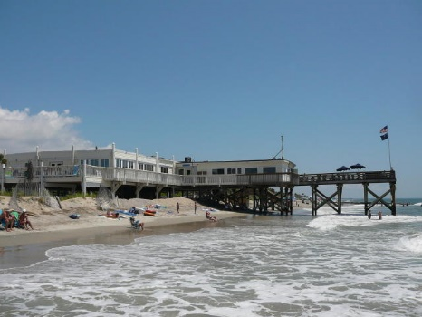

2463 SC Highway 174
Edisto Island, SC 29438
MLS# 20019135
$279,900
4 Bed · 3 Bath · 1,568 sf
3.5% AGENT COMPENSATION BEING OFFERED IF A CONTRACT IS RATIFIED PRIOR TO OCTOBER 22, 2018.
3.5% Comp! Reduced! Edisto Reno!
NEWLY RENOVATED HOME ON ONE ACRE
Only 7.7 miles from Edisto Beach-very quick drive!
New roof, windows, and packaged HVAC unit
Newly remodeled kitchen and bathrooms
New stainless appliances and new cabinets
Beautiful hardwoods have been sanded and refinished
All new light fixtures and ceiling fans
Freshly painted inside and out
New landscaped patio and fire pit
New water heater and well pump
Dual Masters with one up and one down
Bryant Pearson
(843) 860-7667
bryantpearson@gmail.com
Agent Group Realty
433 Plaza Real Suite 275
Boca Raton, FL 33432

