Slide 1
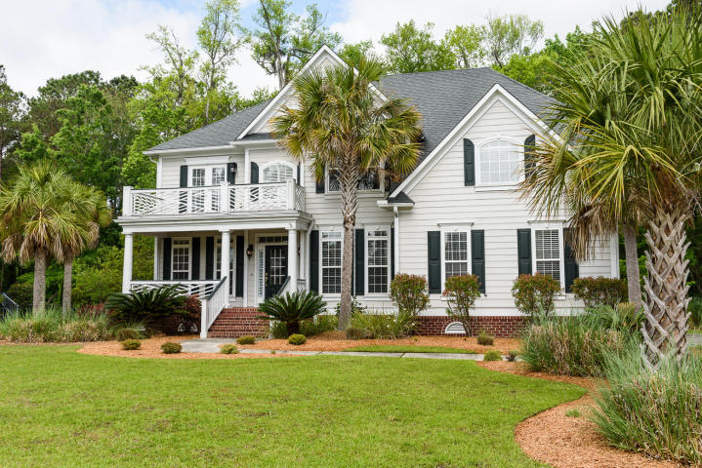
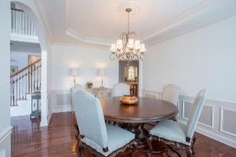
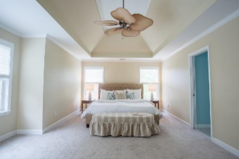
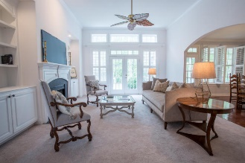
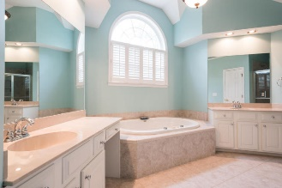
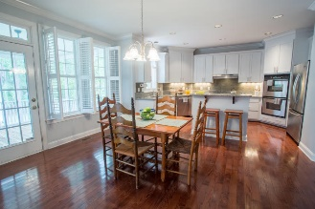
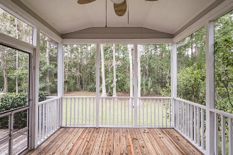
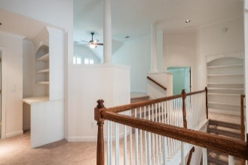
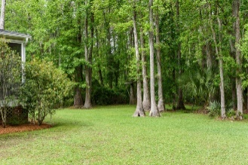


2465 Darts Cove Way
Dunes West ~ Mount Pleasant, SC 29466
MLS# 17011501 ~ $675,000
Just Reduced
$785,000!
$5,000 Bonus to buyer's agent
For a ratified contract by Christmas 2017!
Bonus paid at closing.
Immaculate home with phenomenal curb appeal! Dramatic two story foyer and wall of windows in the family room with fireplace, open to the stunning eat-in kitchen. Stainless steel appliances, granite counters, double ovens, five burner gas cooktop & tall white cabinets. Hardwood floors throughout most of the first floor. New paint and carpet! Formal living & dining room. First floor guest suite or office. Lots of built-in cabinets. Second floor French doors to balcony overlooking palms and wetlands. Huge master suite with tray ceiling. Master bath tiled with vaulted ceilings, two person jacuzzi, generous shower, two vanities, two walk-in closets and a master suite retreat. Great bonus room or children’s play room off of the second floor landing. Screened porch and large deck overlook private wooded back yard. Lovely landscaping and palm trees. So livable and elegant, too many extras to list. Dunes West boasts three pools, one with a waterslide! Golf, walking and biking trails. Amenities also include boat ramp, 2nd gated entrance, and exercise facility.
Mac Jenkinson
M (843) 224-0210
mac@carolinaone.com
Beth Moore
M (843) 532-4892
bmoore@carolinaone.com
www.jenkinsonandmoore.com
Jenkinson & Moore, LLC | Carolina One Real Estate | 1503 Palm Blvd | Isle of Palms, SC 29451-2280

