Slide 1
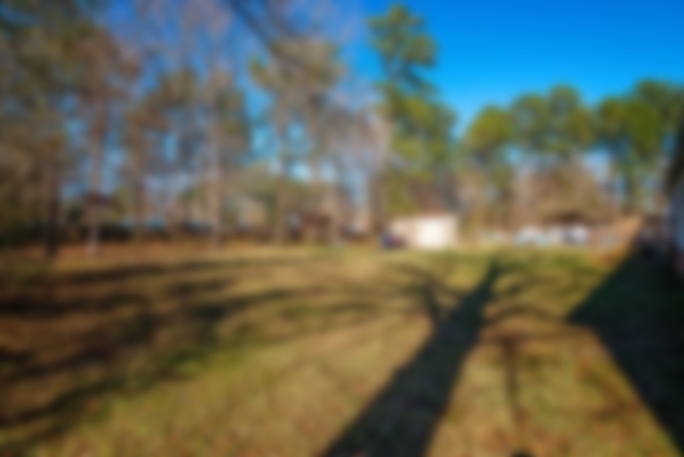
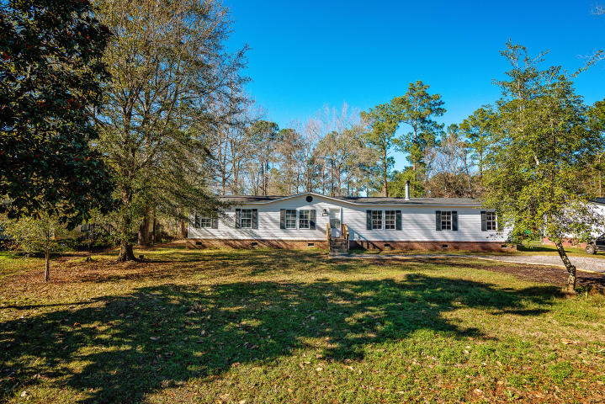
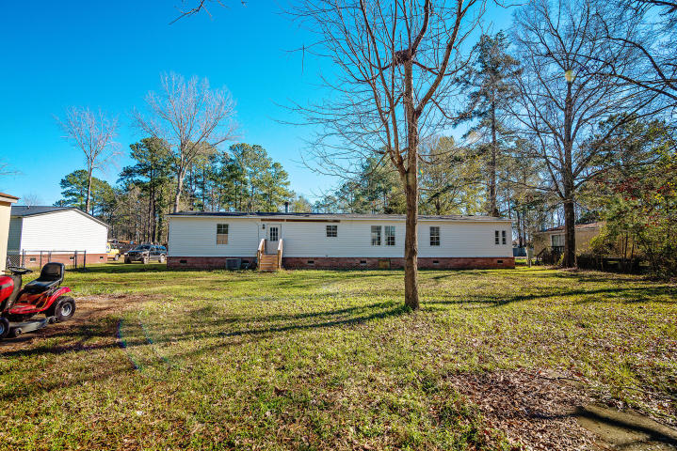
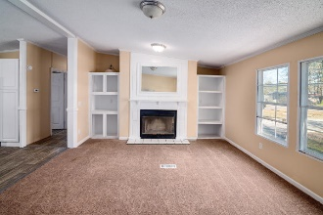
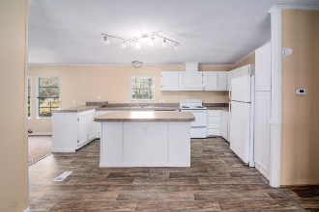
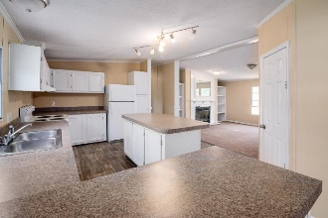
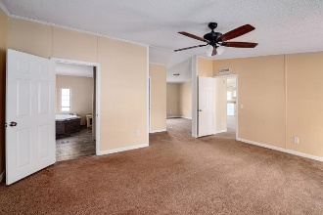
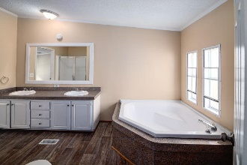
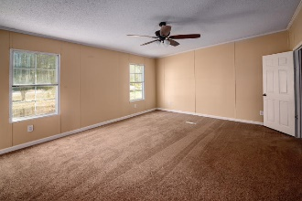
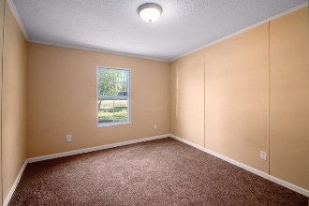
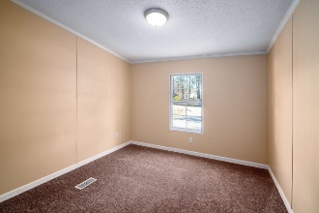
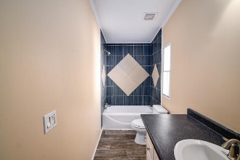



246 George Keen Drive
Pinehill Acres ~ Summerville ~ MLS# 19000527 ~ $165,000
Renovated 4 Bed 2 Bath+ Bonus Room On 1/2 Acre
This newly renovated move in ready home is nestled on a large 0.50-acre lot. It's located in the desirable Dorchester II School District. As you enter, you'll be greeted by a spacious open floor plan, with a great flow for entertaining and everyday living. Enjoy cool evenings in front of the cozy fireplace, in the huge family room. The open kitchen boasts an abundance of white cabinets, counter space and large island. All appliances convey! The large laundry room makes doing the laundry a breeze. The spacious master bedroom features a walk-in closet and a nice en-suite, with dual vanities, a garden tub, and a separate shower plus a huge bonus room perfect for an office, exercise room, 5th bedroom, etc..The 3 large secondary bedrooms are split from the master for added privacy. New roof (7/18), New Vinyl Flooring and Carpet, New Vanities, New Countertops, New Light Fixtures and more all installed between June- December 2018. No HOA and in Flood Zone X. A Must See Schedule your appointment today!
Asking $1,200,000
MLS# 17023051
3,692 SqFt
4 Bed/3½ Baths
Short Drive to Historic Downtown Charleston & Beaches
Jacqui Swain
(843) 295-9484
jacqui.swain@carolinaone.com
www.jacquisellscharleston.com
Carolina One Real Estate
1530 Old Trolley Road
Summerville, SC 29485

