Slide 1
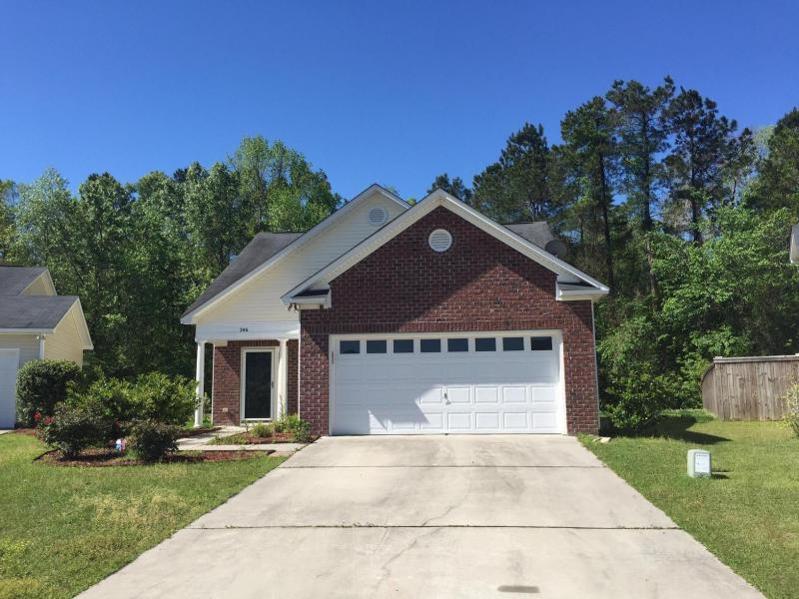
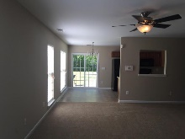
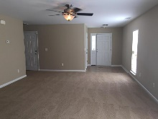
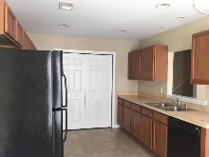
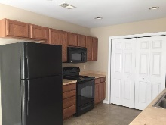
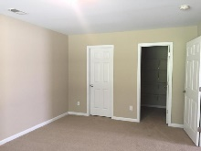
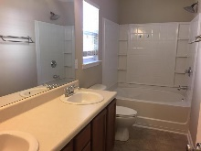
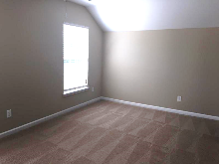
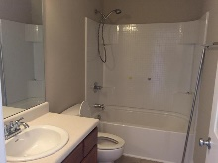

246 Island Green Road Brickhope Greens :: Goose Creek, SC 29445 MLS# 16009379 :: $180,000
Back on
The Market!
New interior paint, new carpet makes this a must buy. Conveniently located off Liberty Hall Road near the Naval Weapons Station. Master bedroom and bath downstairs with two bedrooms and bath upstairs. Large 2 car garage. Kitchen like new and the refrigerator conveys with the property. Large backyard partially fenced.
Greg Hughes
843-884-1800 - O
843-708-4734 – C
ghughes@carolinaone.com
Carolina One Real Estate
Mt Pleasant Office 195 W Coleman Blvd Mt Pleasant, SC 29464

