Slide 1
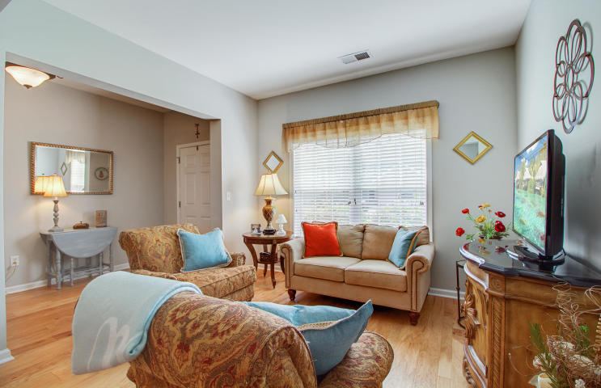
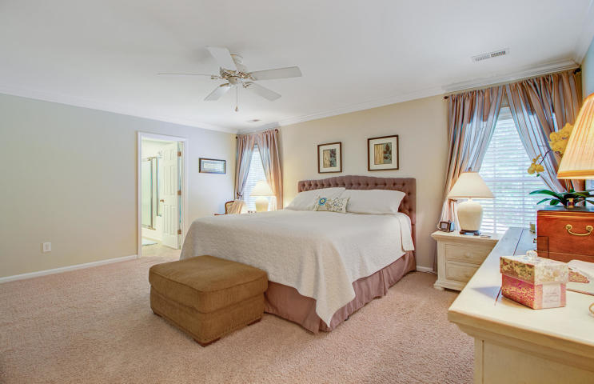
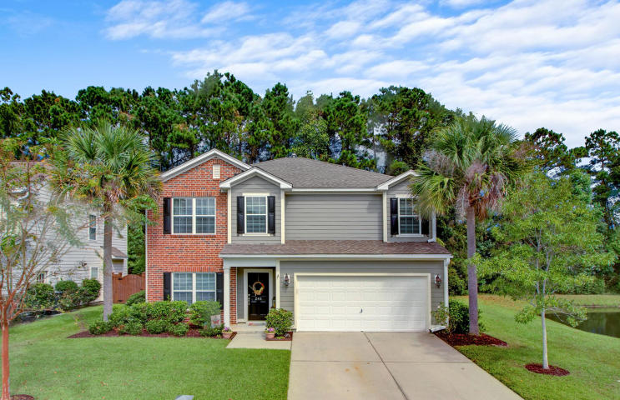
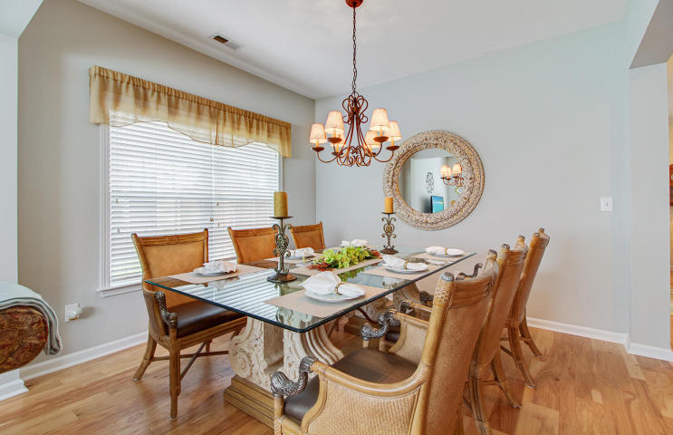
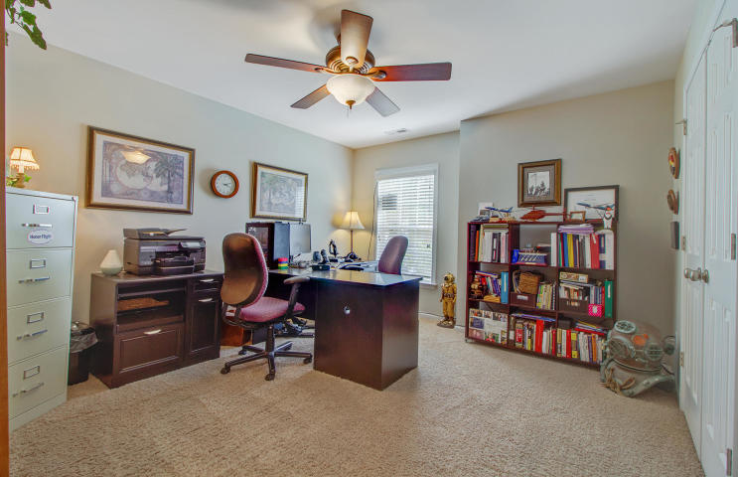
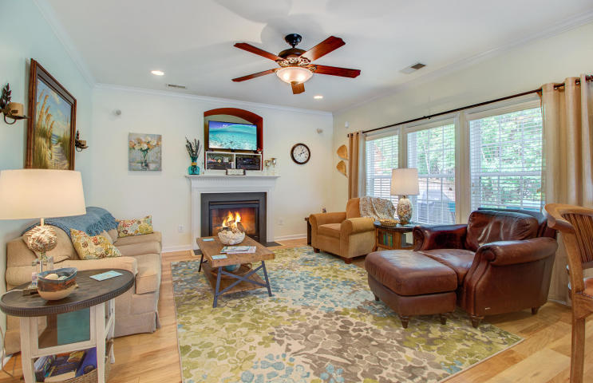
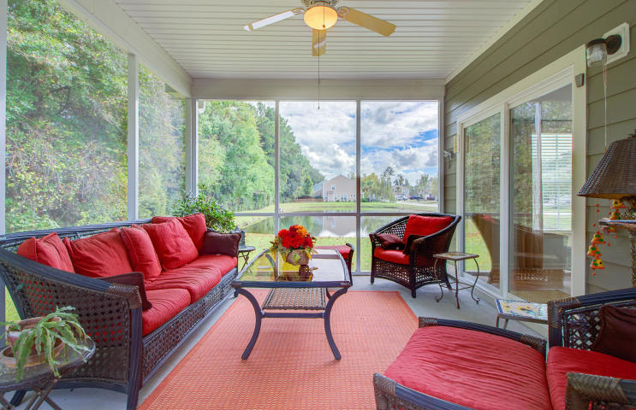
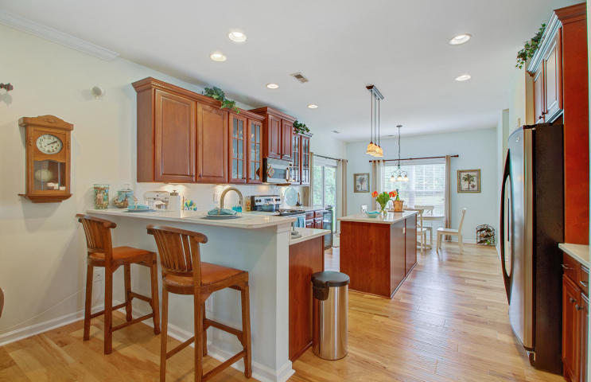
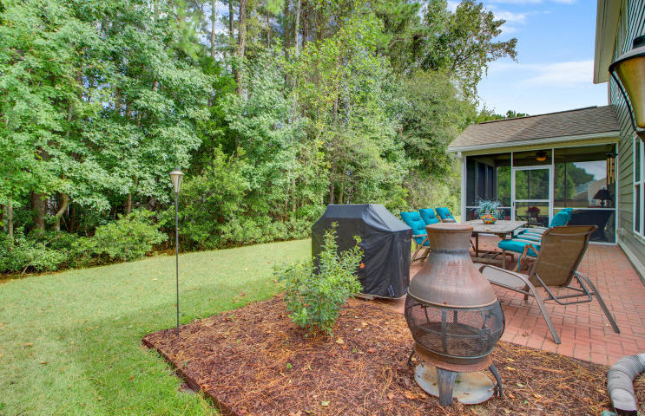


New Listing!!
Come check it out!
246 Nelliefield Creek Dr
Nelliefield Plantation
Wando, SC 29492
MLS# 18027260 ~ $369,900
Meticulously maintained and lovingly upgraded describe 246 Nelliefield Creek Drive. From the moment you approach the home, it is plain to see that this home is truly special. Situated on a large pond lot with an ultra private rear yard, this home is certainly in mint condition having just been painted. As you enter you will be impressed that the interior is just as lovely as the exterior. The current owners, who are the original owners, have upgraded this two story traditional home generously! Hardwood floors are throughout the entire first level. As you explore the kitchen you will fall in love with the quartz counters and subway tile backsplash. There is plenty of counter space for the cook in the family and a large pantry is sure to please! The deep stainless steel single bowl sink has a pulldown faucet and the under cabinet lighting is an added special touch. While eating in the kitchen you can take in the views of the pond and the private wooded rear yard. The layout of the home is excellent for families and for entertaining. The kitchen opens to the large family room with a gas fireplace along the rear of the home. There is a formal dining room for holiday gatherings and special meals, and it opens to an additional sitting room. A screened porch off the kitchen provides yet another sitting area and location from which to enjoy the private rear yard and pond views. The current owners did not stop there- they added a brick patio and zoned irrigation system for the yard. All bedrooms are upstairs in this home. The master suite overlooks the back yard and has plenty of room to accommodate a king bedroom suite. The master bath includes a separate soaking tub and shower and leads to a massive walk in closet. Each guest bedroom also has generous sized closets. One of the four bedrooms is currently used as a home office, a reminder of the versatility of this home's floor plan. The upstairs laundry room is massive and sun-filled making laundry more enjoyable (if that is possible!) There is no shortage of storage space in this fantastic home. The two car garage has an overhead storage rack too. As you tour this home take in all the details including numerous recessed lights, surround sound speakers, blinds installed on all windows, the gas fireplace with heat blower and the fact that this home has gutters and downspouts. There are so many details to appreciate, so check out the incredible 3D Walk Through Tour in the photos section. Then schedule your appointment to tour 246 Nelliefield Creek Drive to see for yourself why this home is a cut above the rest! Nelliefield Plantation residents enjoy a lovely pool and there are plans for a new park and playground for residents to enjoy as well! Students in this community attend the brand new Philip Simmons Elementary and Middle School and Philip Simmons High School. Families will be excited to know plans are being made to build a bike, walking and golf cart path connecting the community with the schools. This community is conveniently located off Clements Ferry Road nestled between Mt. Pleasant and Daniel Island, convenient to both Rt. 526 and Rt. 41. It is a short ride to historic Downtown Charleston and to the beach. Several new businesses, restaurants and stores are opening in this thriving part of town making it an exciting time to live in Nelliefield Plantation.
3D Walk thru tour: https://my.matterport.com/show/?m=GrGKijsQoLm
Ellen O'Neil
Broker/Owner, ABR, e-PRO, CNE
Charleston Realtor of Distinction
(843) 300-8530
www.EllenONeilProperties.com

