Slide 1
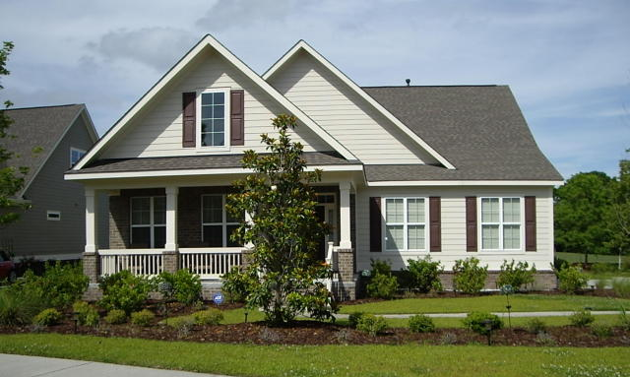
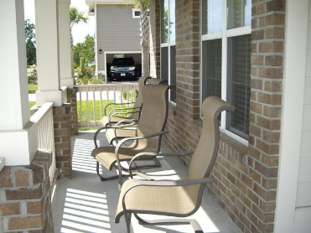
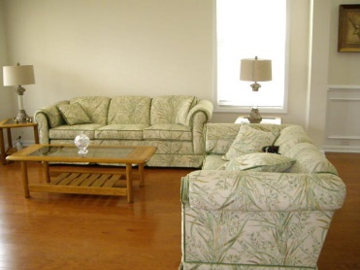
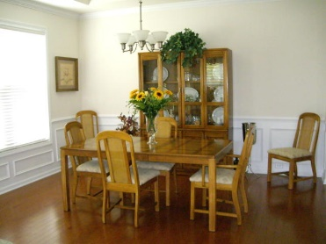
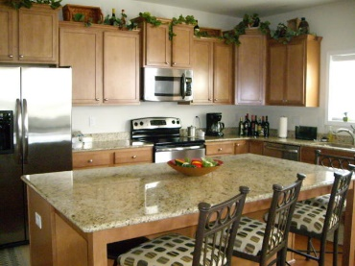
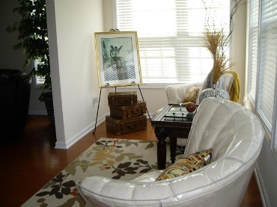
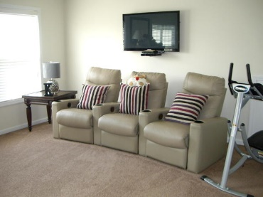
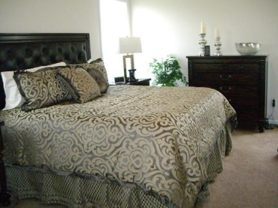
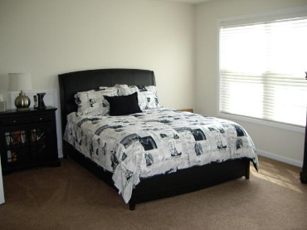
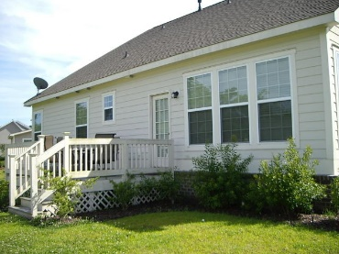


247 Shadowmoss Parkway Shadowmoss Charleston, SC 29414 MLS# 15017249 Price Reduced to $398,800!
Amazing Crepe Myrtle Floor plan by D R Horton. Walk in and be greeted by light airy foyer with view of the formal living room, formal dining room with tray ceiling. Crown molding and wainscoting. Pass the stairs and head for the open kitchen complete with staggered height cabinets with crown molding, granite countertops, stainless steel appliances and huge island. The kitchen is open to the family room which leads to sunroom. Just off the family rooms the spacious owner's suite with tray ceiling and a big walk in closet. The master bath is spa like with double sinks and separate tub and walk in shower. Also downstairs is a guest bedroom/mother in law suite with access to a full bath. This room is also ideal as a study. Head upstairs to find 2 more huge guest bedrooms each with full bath. Like outdoor? Sit and relax on the deck and enjoy the golf course views. This home has stainless appliances, hardwood floors throughout the living area. Ceramic tile in all bathrooms and laundry room, recessed can lights, cement plank siding, lawn irrigation, tank less water heater and so much more. Shadowmoss has great amenities to join if you wish. The golf course features a driving range, a fully stacked pro shop and a full service snack bar and lounge. Shadowmoss residents also have the option to join tennis, pool and gym membership.
Cathy Rosenblum
843-817-7869
crosenblum@comcast.net

