Slide 1
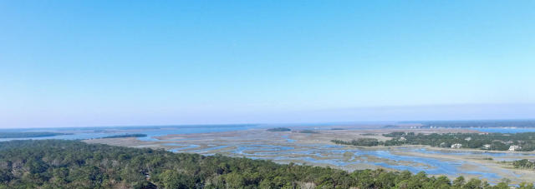
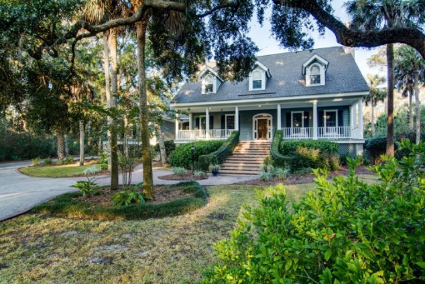

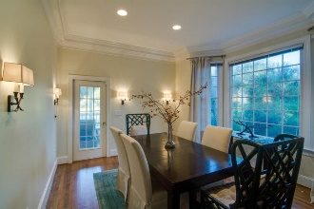
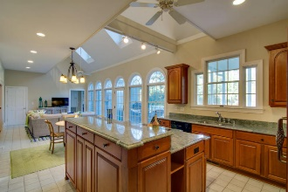
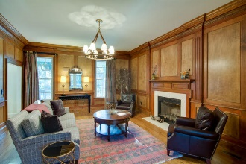
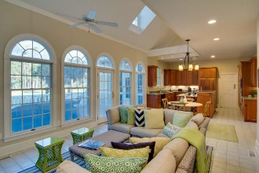
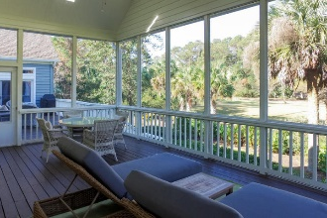
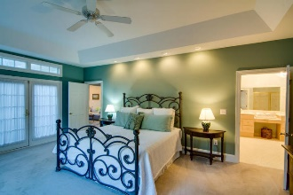
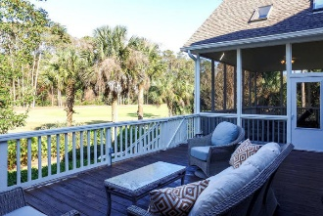
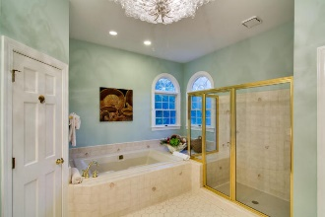
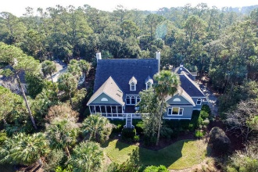


Classic Seabrook Home at a Great Price 4445 square feet and 4 bedroom and 3.5 baths at only $213/square foot.
2480 Cat Tail Pond Road
Seabrook Island
MLS# 16029812 $949,000
Exquisite and extremely well maintained home on Seabrook Island’s Crooked Oaks Golf Course offers all that the Lowcountry has to offer in its finest form. The stunning curb appeal begins with the inviting herringbone driveway. The irrigated landscaping is mature and provides great privacy, and includes oleander, rosemary, crepe myrtles, and several varieties of palms. Live oaks draped in Spanish moss are enhanced in the evening with up-lighting. The beautiful ivy lined brick stairway leads you to a large front porch and stunning glass and hardwood door. Enter the large foyer with a hardwood floor, beautiful staircase, and soaring ceiling. To your left is a wood paneled study, and to the right a formal living room, both featuring wood burning fire places.
Through the foyer natural light invites you into the great room and kitchen where you will have views of the 6th fairway and beyond. These rooms and all bathrooms are tiled for easy maintenance. The kitchen features high-end cherry cabinets with pull-outs, Dacor appliances, and beautiful quartzite counter tops. The roomy master suite is also downstairs and features great views, and a large, two-door walk-in closet. Both the master and the great room open to a large deck. The formal dining room opens to a large screened in porch with skylights and a ceiling fan.
Upstairs, there is a second master suite with dual vanities and a walk-in closet, and two more bedrooms that share a full bathroom. Dormer windows bring the outdoors in to both the great room and the second floor. There is also a very large room above the garage that makes for a perfect game room, play room, or lounge, adding yet another space for privacy. There is plenty of storage including a large cedar board lined closet.
There are ceiling fans throughout the house, along with an alarm system, central vacuum, impact resistant low-E windows, gutters, speakers, and even an outdoor shower for your return from the beach. The home can be sold furnished with a few exclusions.
Lee Lindler Cell (843) 637-0803 | LeeL@GoldenBearRealty.com
Golden Bear Realty | 1900 Seabrook Island Rd | Seabrook Island, SC 29455
www.goldenbearrealty.com

