Slide 1

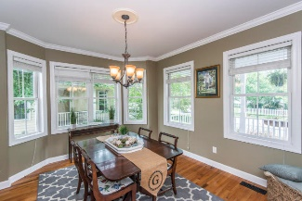
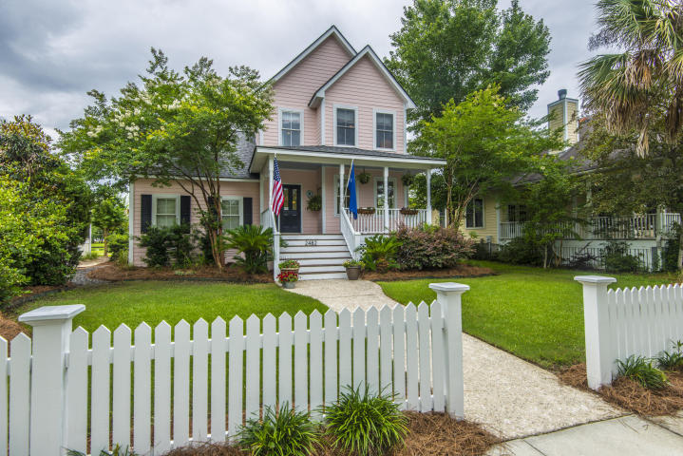
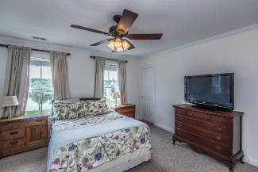
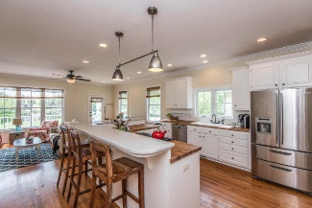
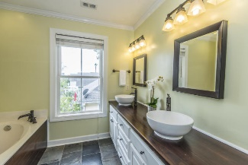
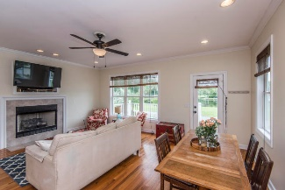
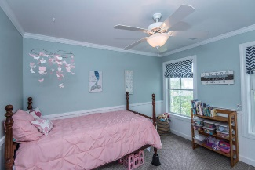
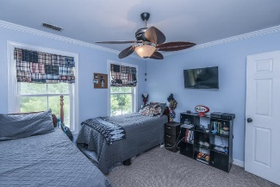
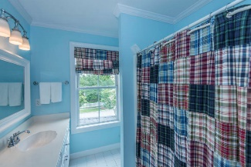
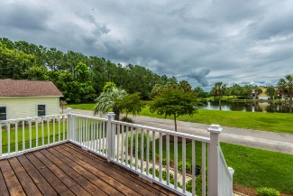
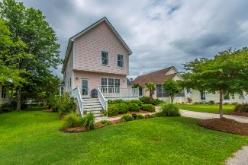
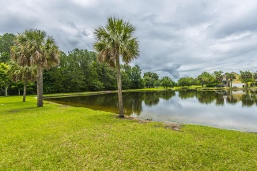


Lowest Price in Rivertowne on the Wando OPEN HOUSE | Sat, Aug 25 | 2:00 PM - 4:00 PM
2482 Cheswick Lane Mount Pleasant, SC 29466 | MLS# 18015652 | $413,500
$2,000 Realtor Bonus for an acceptable contract closed before 9/28/18
Charming coastal cottage located just steps from the Wando River in the desirable Rivertowne on the Wando. This home is move-in ready with new roof and newer HVAC units. As you enter the foyer, you are welcomed into a separate dining room. The home boasts an open floor plan with an abundance of natural light overlooking a peaceful view of a pond and green space. The kitchen has been updated with quartz and butcher block countertops, stainless appliances, gas stove, new dishwasher, and barstool seating. The master bedroom has a separate walk-in closet and the bathroom has been updated with slate flooring and dual sinks. There are two additional bedrooms and another full bath. Rivertowne on the Wando offers a neighborhood pool, tennis courts, play park, a community dock on the Wando River, miles of walking trails, a 18 hole golf course, clubhouse, and outstanding schools. The neighborhood is located just a few minutes from shopping and restaurants, 15 minutes to the beach, 20 minutes to downtown Charleston, and 25 minutes to the airport. Rivertowne on the Wando is a welcoming neighborhood to call home. $2,100 credit available toward buyer's closing costs and pre-paids with acceptable offer and use of preferred lender
Debbie Rogers (843) 990-2915
deborah.rogers@carolinaone.com
www.DebbieRogersSellsCharleston
Carolina One Real Estate | 2713 Highway 17 North | Mt. Pleasant, SC 29466

