Slide 1
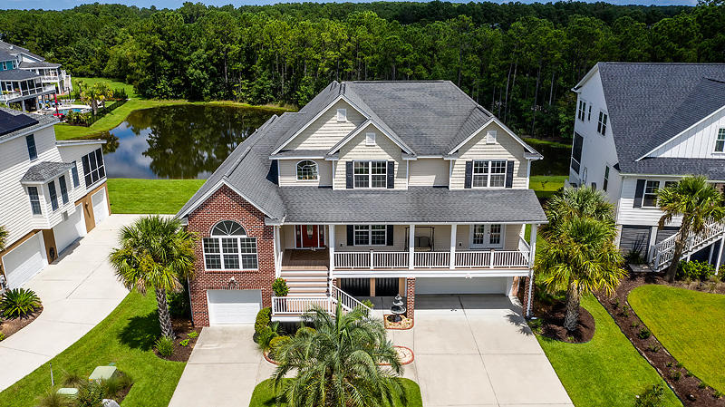
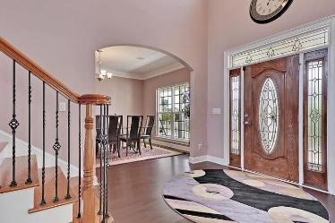
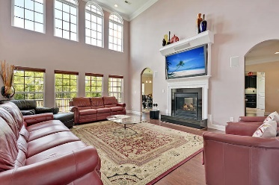
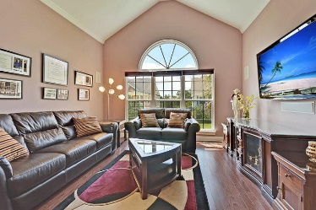
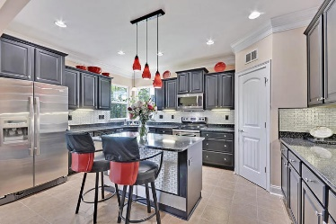
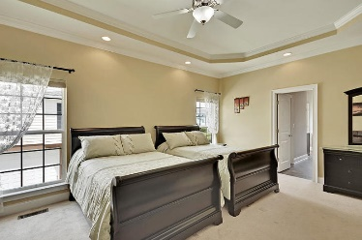
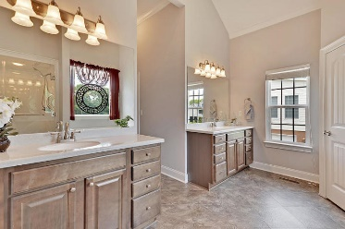
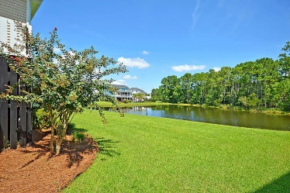
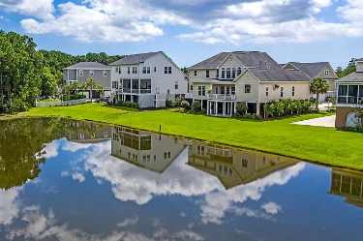

2488 Worthington Drive
Planters Pointe · Mount Pleasant, SC 29466
MLS# 19025014 · $675,000
Gorgeous Listing
Perfect if you work from home!
GORGEOUS elevated 4 bedroom, 4.5 bath home with 2 offices and tons of storage! The home has beautiful curb appeal with professional landscaping and full front porch that is perfect for rocking chairs! Entering the home you are greeted with a grand foyer, an abundance of natural light, and soaring ceilings. There is a large dining room to the right and office with surround sound and hard wiring to your left. Continuing in is the first floor master bedroom suite with spa-like master bath including relaxing soaking tub, dual vanities, separate shower, and his and her closets! The oversized family room has 20+ foot ceilings, a marble fireplace, wall of windows with awesome pond views. The chef inspired gourmet kitchen has a cozy keeping room with stone front fireplace, eat-in area, granite island, granite countertops, stainless steel appliances, 42" cabinets, tiled backsplash and a large walk-in pantry. Next to the kitchen is the massive laundry room with folding counter, cabinets, and sink. Next is another room with walk-in storage, hard wiring, and separate entrance that could be an office, exercise room, media room, fifth bedroom, to many options! Finishing off the first level is a powder room. Upstairs there is a second master bedroom with ensuite bathroom and walk-in closet that has beautiful views of the pond. The are two additional large bedrooms each with walk-in closets and private baths. The 5+ car garage is fully insulated and has room for a workbench, golf cart, fishing, boating accessories and more storage! Attention to detail is evident in this home with all the extra details-too many to list! Planters Pointe in Mount Pleasant is a wonderfully landscaped community with a play park, tennis courts and community pool! The neighborhood is close to local shopping and grocery stores and is a short drive to downtown Charleston with 5-star restaurants, world class shopping and iconic history as well as a short drive to the beaches, the airport, Boeing and Daniel Island. Come take a look-you will not find another home like this one!
Stan Huff
843-670-2835
stan.huff@agentowned.com
Jill Marcacci
843-297-5590
jill@agentowned.com
www.agentownedrealty.com
AgentOwned Realty Co. Preferred Group, Inc. | 824 Johnnie Dodds Blvd | Mt Pleasant, SC 29464

