Slide 1
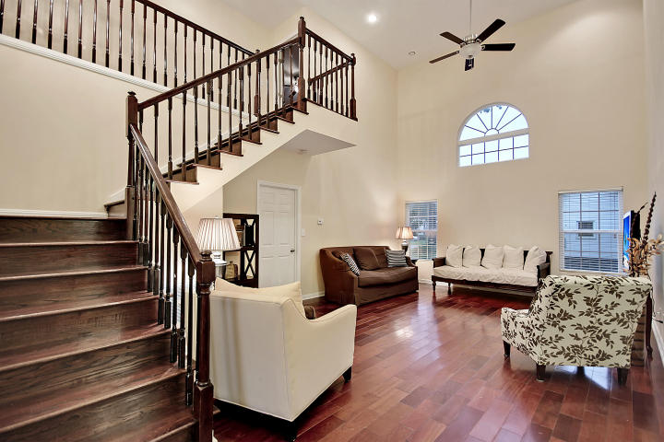
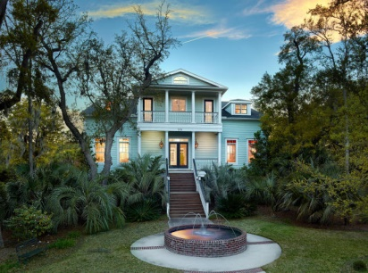
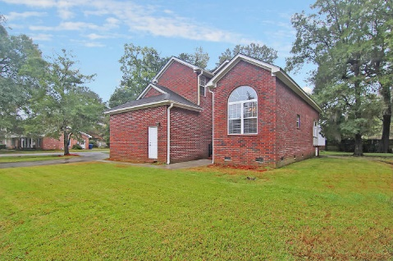
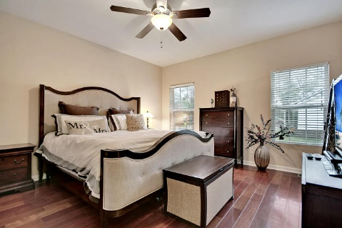
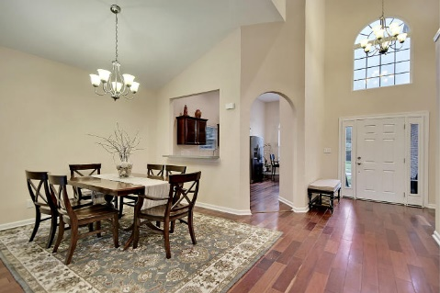
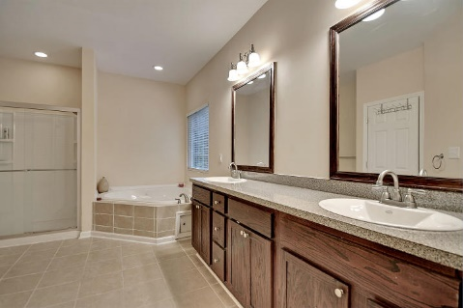
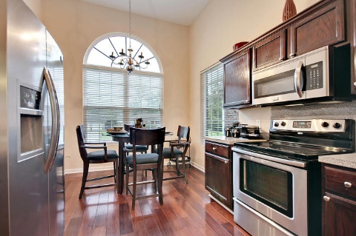

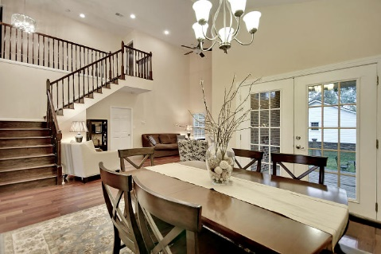
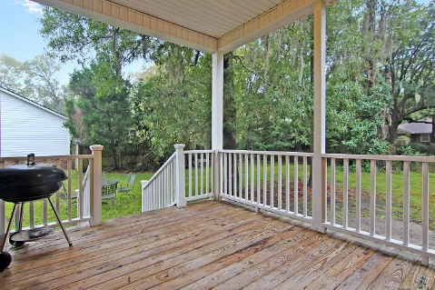
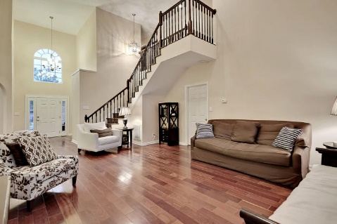
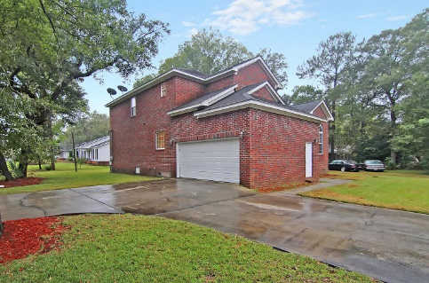

West Ashley Beauty
Open House
Saturday, Feb 20th
from 11-3
2489 Flamingo Drive
Longbranch ~ Charleston, SC 29414 ~ MLS# 15028688 ~ $267,000
Beautiful West Ashley brick two story home offers 4BR, 2.5BA and a 2CG.
Step into a soaring two story foyer and open floor plan that has beautiful Brazilian cherry hardwood floors throughout.
Palladian windows add a flare to the home as well as invite in plenty of natural light.
The spacious living room flows into the dining room with its vaulted ceiling and French doors leading to the deck overlooking the backyard.
The eat-in kitchen boasts a ton of counter space and SS appliances.
The 1st floor master has a gigantic master bath with dual vanity, Jacuzzi tub, walk-in closet and walk-in shower.
Three bedrooms upstairs share a full bath with dual vanity and the fourth bedroom has a large walk-in closet.
Nate Gainey nate@mattoneillteam.com 843-513-2038

