Slide 1
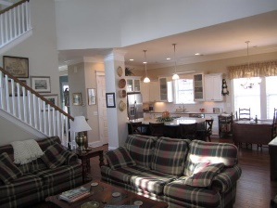
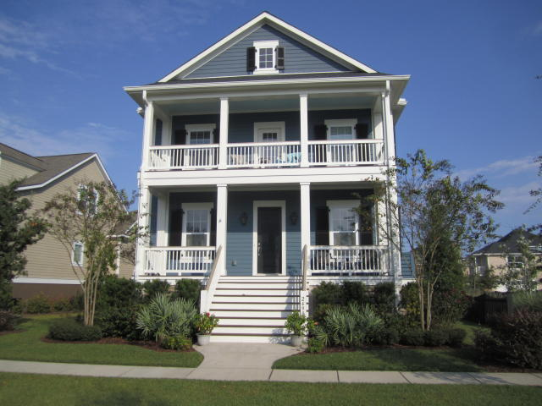
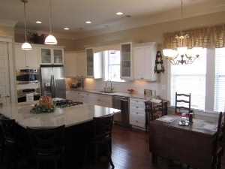
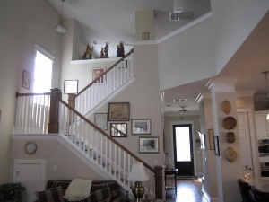
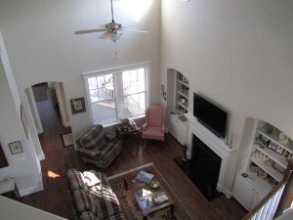
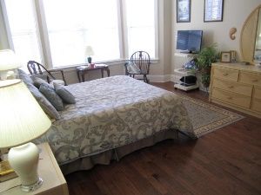
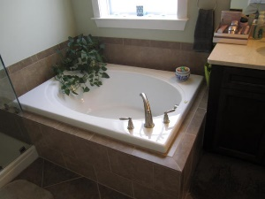
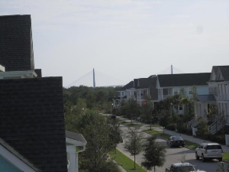
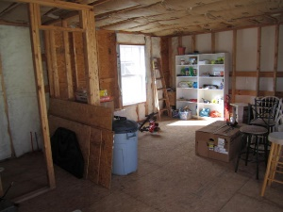


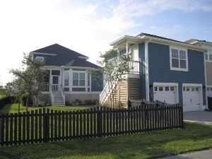
2490 Daniel Island Drive
Smythe Park @ Daniel Island
MLS# 15026495 ~ $685,000
Under Contract in 72 hours!!
This David Weekley Showcase home is ''Better than new'' is the most appropriate description. Three years new, this home features every luxury detail, upgrade and enhancement you could possibly want. This 3 BR, 2.5 bath, built in 2012, has been meticulously cared for. The open floor plan lends itself to entertaining and is located in Smythe Park. The first and second story porches allow you views of the Ravenel Bridge. Hickory hardwood floors, upgraded stainless appliances, Showcase trim, colors and features. First floor study and 2nd floor retreat. Approx 450 sq ft unfinished room above 2-car garage is floored and plumbed and ready for your completion. Home is still under 10 year builder warrantee. Buyer pays a one time neighborhood enhancement fee of .5% x sales price to the Daniel Island Community Fund at closing.
John Chap
Mobile - (843) 901-1174
jchap@beresfordrealty.com
www.beresfordrealty.com
Beresford Realty, LLC | 672 Marina Dr, S-206B | Charleston, SC 29492

