Slide 1
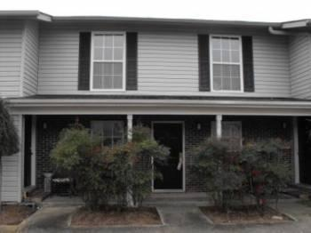

2494 Etiwan Avenue D-1 Melrose Park :: Charleston, SC 29414 MLS# 16002544 :: $49,000
Great Investment Property!!!
Just Reduced!
1 Bedroom :: 1 Bath
Currently has a tenant on a month to month that would like to stay.
At current price and Regine ($166/month) it cash flows positively.
Close to I-526 and Citadel Mall.
Greg Hughes
843-884-1800 - O
843-708-4734 – C
ghughes@carolinaone.com
Carolina One Real Estate
Mt Pleasant Office 195 W Coleman Blvd Mt Pleasant, SC 29464

