Slide 1
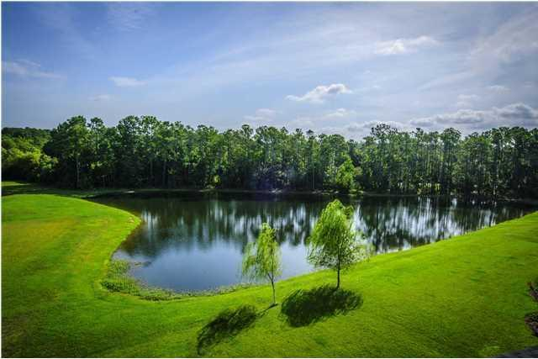
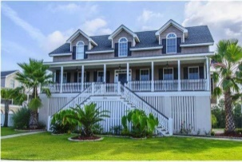
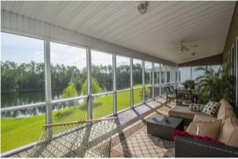
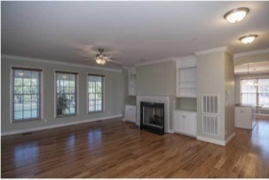
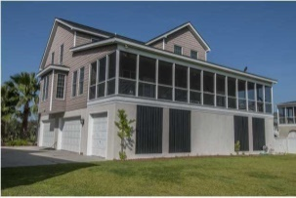
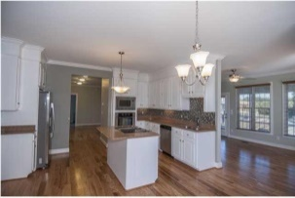
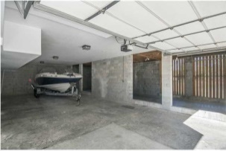


2496 Worthington Drive Planters Pointe ~ Mount Pleasant ~ MLS# 15012111 ~ $544,900 3,277 Square feet!
$10,000 Price Reduction & $3,000 Agent Bonus
with Closing by September 15th
4 BEDROOMS | 3½ BATHS | 3,600 SQ FT
REDUCED $10,000! Wonderful LAKE FRONT home, with beautiful views! This 5 bedrooms 3 and 1/2 baths, built in 2009, with 9 foot ceilings throughout is all you wish for. Elegant oak flooring throughout the Foyer, Dining Room, Living Room, Kitchen and Sitting Room.
Master on the first floor with private access to the porch. The kitchen has a breakfast nook, surrounded by windows, and an attached laundry area with wash sink. All stainless steel appliances, a Jenn-Air gas range and granite counter tops.
Enormous screened porch that run the length of the rear of the home and has gorgeous lake views. LARGE GARAGE with 3-Bay side entries that provides space for multiple autos, boats + gym/work shop + elevator shaft through 2rd floor.
Amenities: pool, golf, tennis courts, club house. AHS-1 year warranty!
Daniel Carabus
843-793-9265 M
dcarabus@carolinaone.com
www.danielcarabus.com
Carolina One Real Estate
195 W Coleman Blvd
Mt Pleasant, SC 29464

