Slide 1
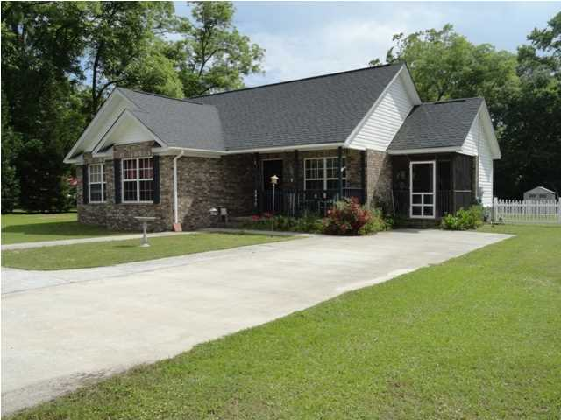
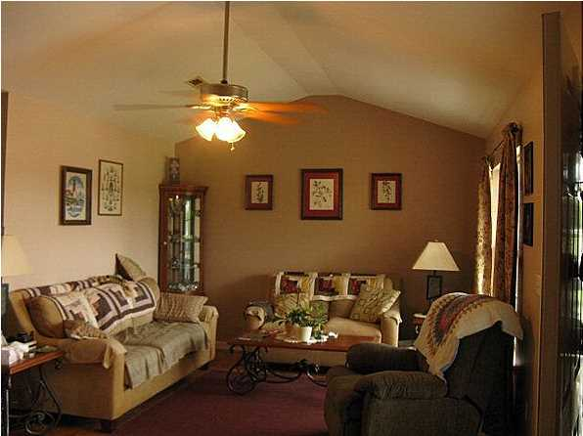
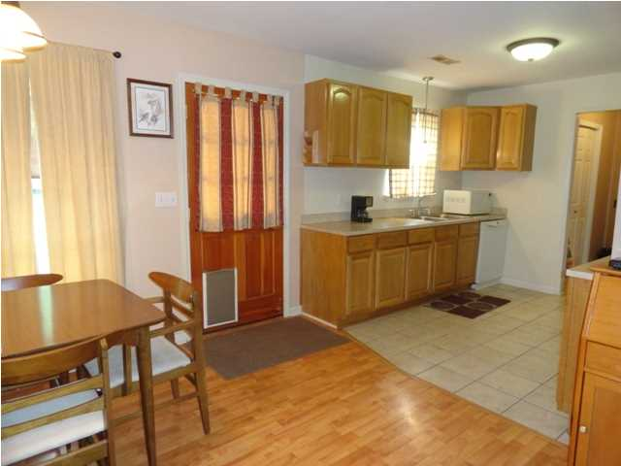
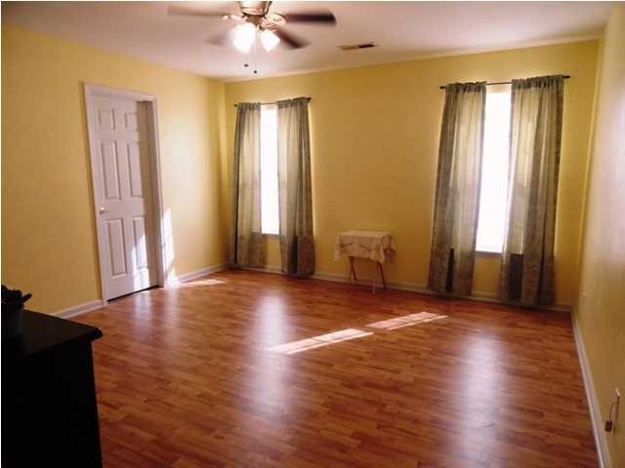
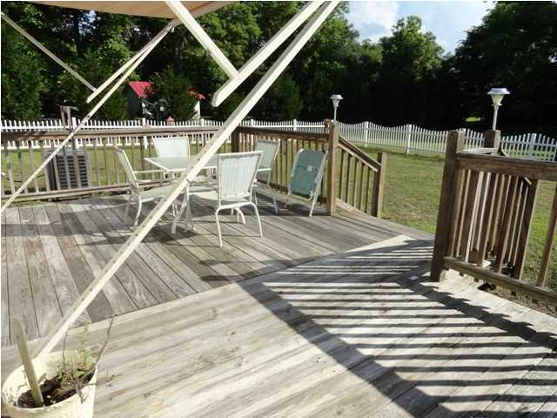
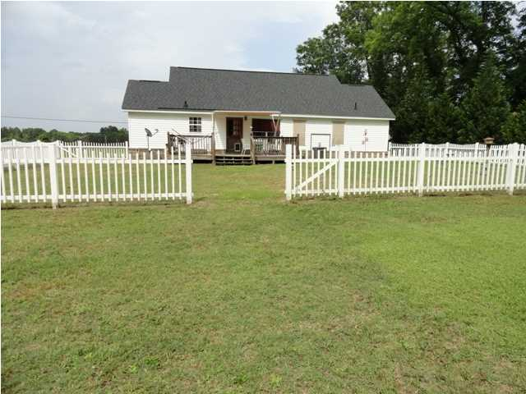



Country Living Near Lake Marion
2498 Eutaw Rd ~ Holly Hill MLS# 1310007 ~ $129,900
This lovely 3br, 2ba brick home conveniently located on the edge of town is close to Lake Marion (Santee/Eutawville) & Charleston. Walk in to this open floor plan with beautiful laminate flooring in the main living areas & bedrooms. Ceramic tile in the kitchen, baths and laundry room. The kitchen is equipped with a stainless steel gas range, dishwasher, refrigerator and lots of cabinet space. The gas fireplace installed in hallway among the bedrooms for heating efficiency during those cold winter months. The master bedroom is spacious with a walk-in closet and master bath featuring a jetted tub and separate shower. There are two other nice sized bedrooms and another full bath. Plenty of attic storage space. A side screened porch and a wonderful deck with a Sunsetter awning for backyard entertaining & relaxing. Let the children play in the backyard within the large white vinyl fenced in area. This backyard also includes 2 vinyl storage buildings and still has plenty of room for a garden!!Property extends beyond the white fence to the trees behind property. And remember, you have no HOA fees to worry about, so come see this attractive home today and make this your home town. The recreation is awesome.....Hunting, fishing and boating. This is where you need to be!!! Sellers are moving out of state and motivated.
JACKIE LAWSON
Sales Associate - Realtor
JLawsonHomes@gmail.com
C (843)568.1250
F (843)725.7118

